Slide 1

Dr. Hedgewar pustakalay sah sewa samitee Laxminagar,
Bhachhi
PRESENTS

Slide 2
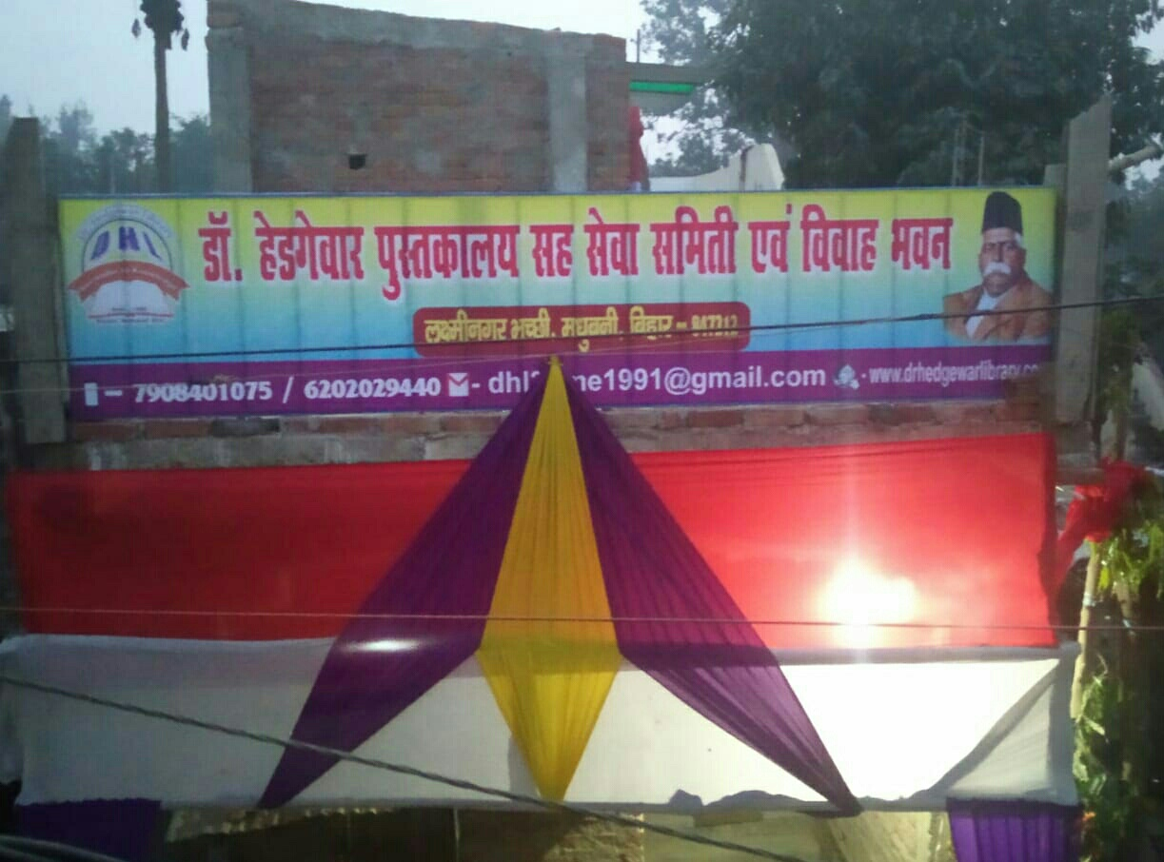
ONLINE COMPETITION
&
CELEBRATION OF 30th FOUNDATION DAY
2ND JUNE 2021

Slide 3
A brief look into
Activities from 1991 to 2021

Slide 4
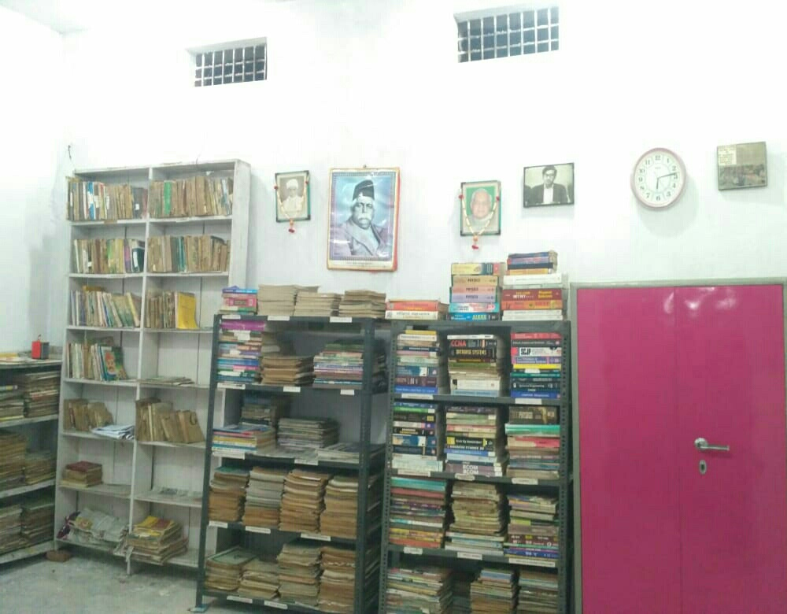
Our LIBRARY

Slide 5
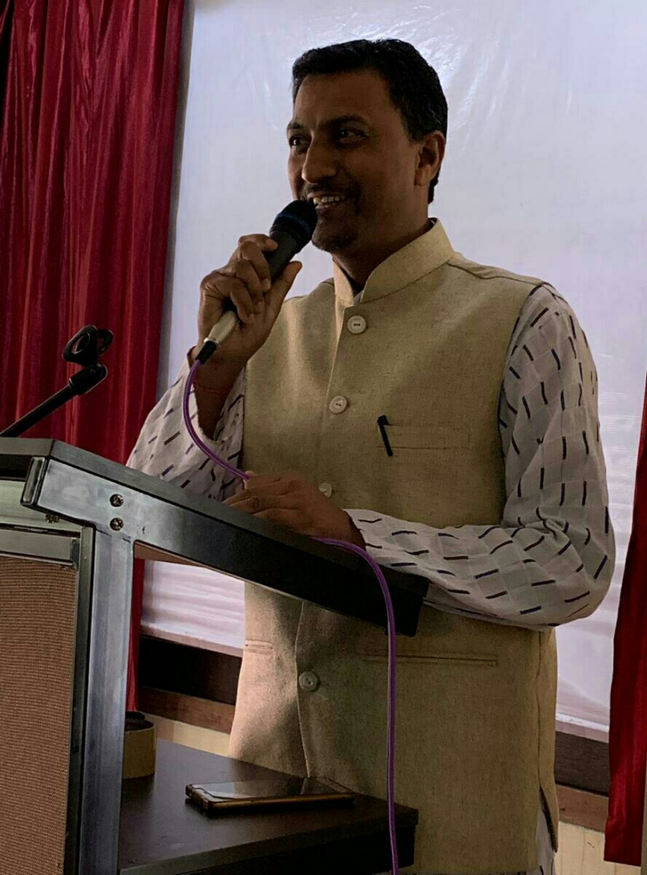
Principal Founder:
Pawan Kumar Ray

Slide 6
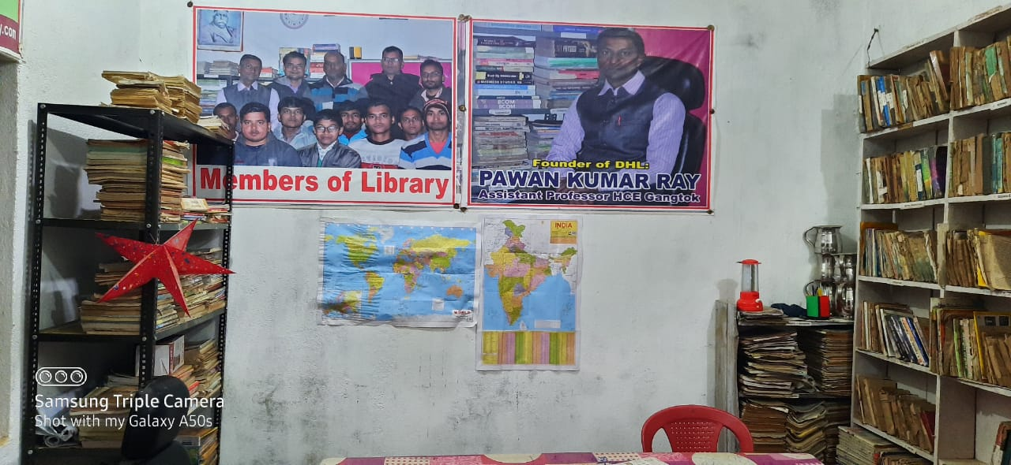
An inside view of our library which features Our founders MEMBERS and our achievers

Slide 7
Founder members:
1.Lalit Kumar (Business Man)
2.Pradeep Ray (Hardware Engineer)
3.Mahesh Kumar (Business Man)
4.Hiralal Ray (Business Man)

Slide 8
NEW
COMMITTEE MEMBERS

Slide 9
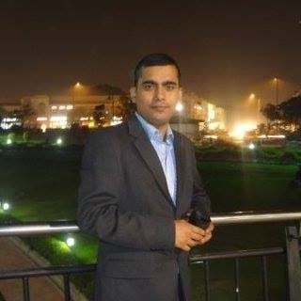
MR. Prakash Narayan jha
Associate Consultant, HCL Technology Ltd. (Google Ecosystem Unit)

Slide 10
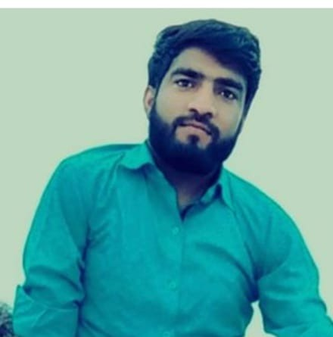
MR. Mahavir kumar
(Secretary)

Slide 11
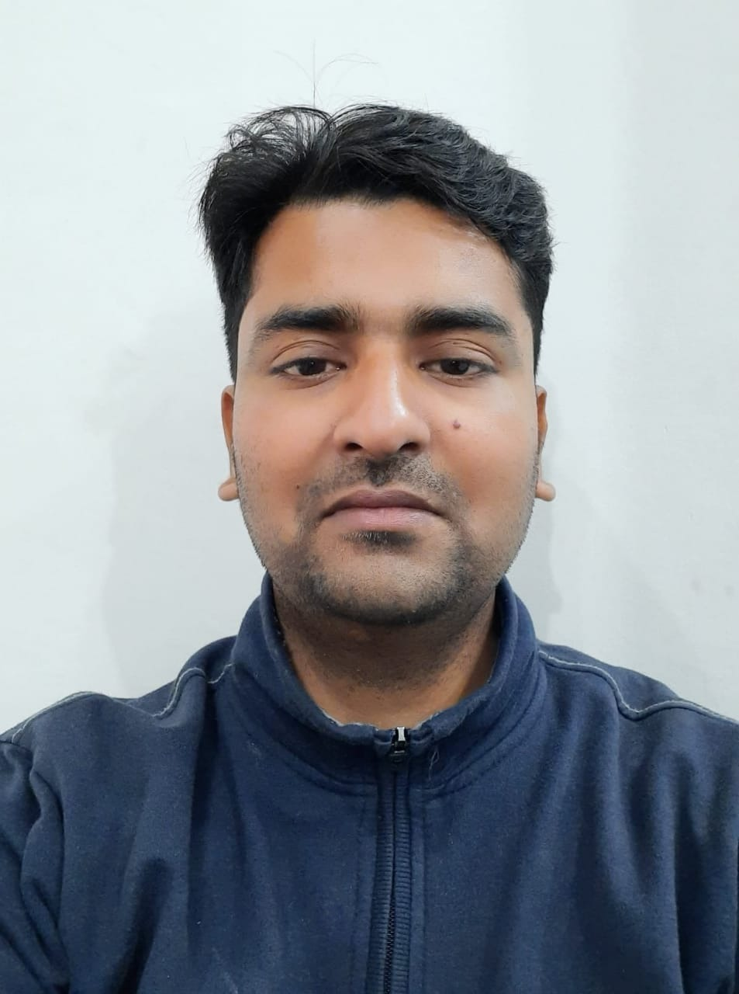
MR. Ashish chandra
(program & media coordinator)

Slide 12
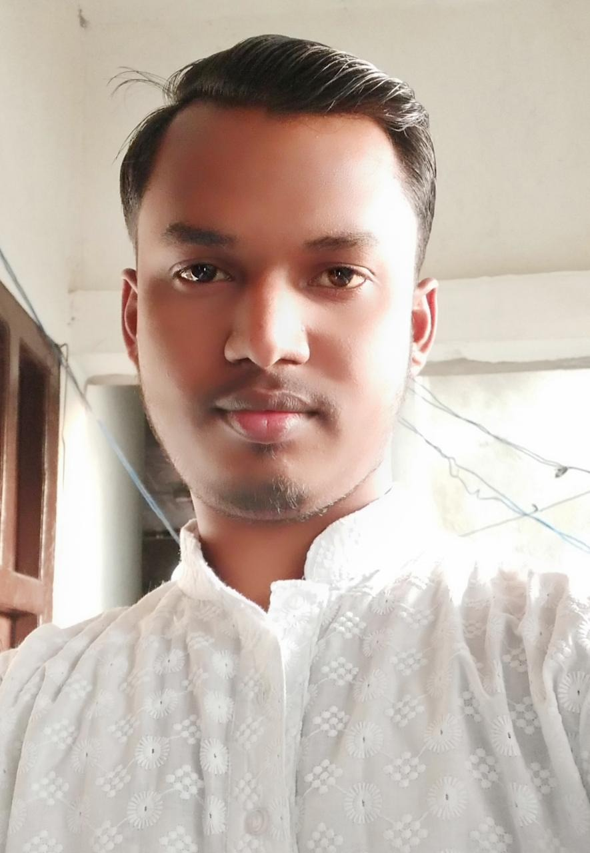
MR. Bhagwant ji MAndal (Treasurer)

Slide 13
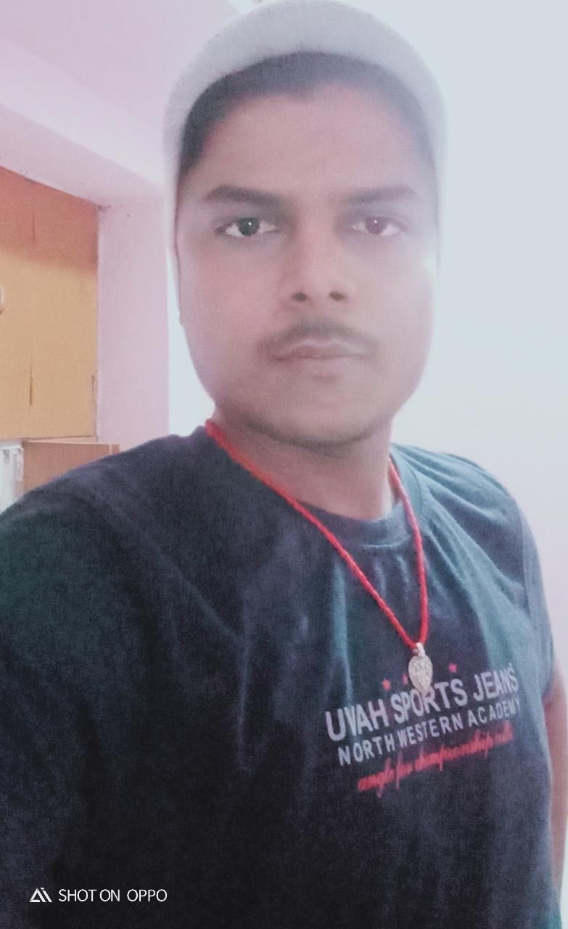
MR. Bikash Kumar
(coordinator)

Slide 14
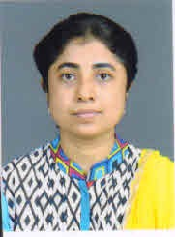
Ms.Pallavi Bhowmik
Co-ordinator of e-MAGAZINE

Slide 15
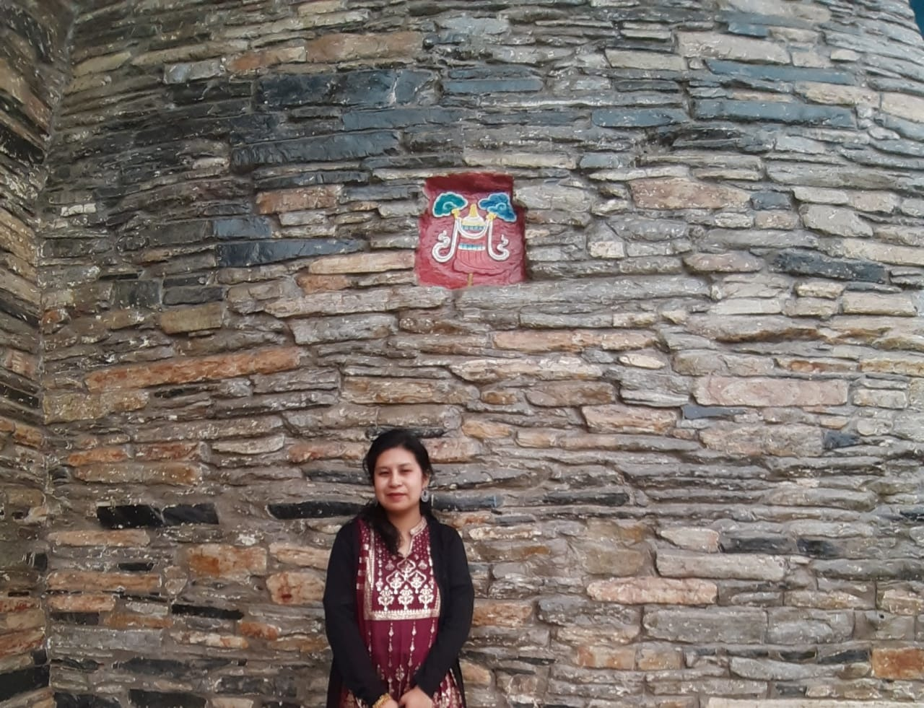
Ms. Minsang Tamang
Co-ordinator of e-MAGAZINE

Slide 16
Mentors
Dr. Hedgewar Library

Slide 17
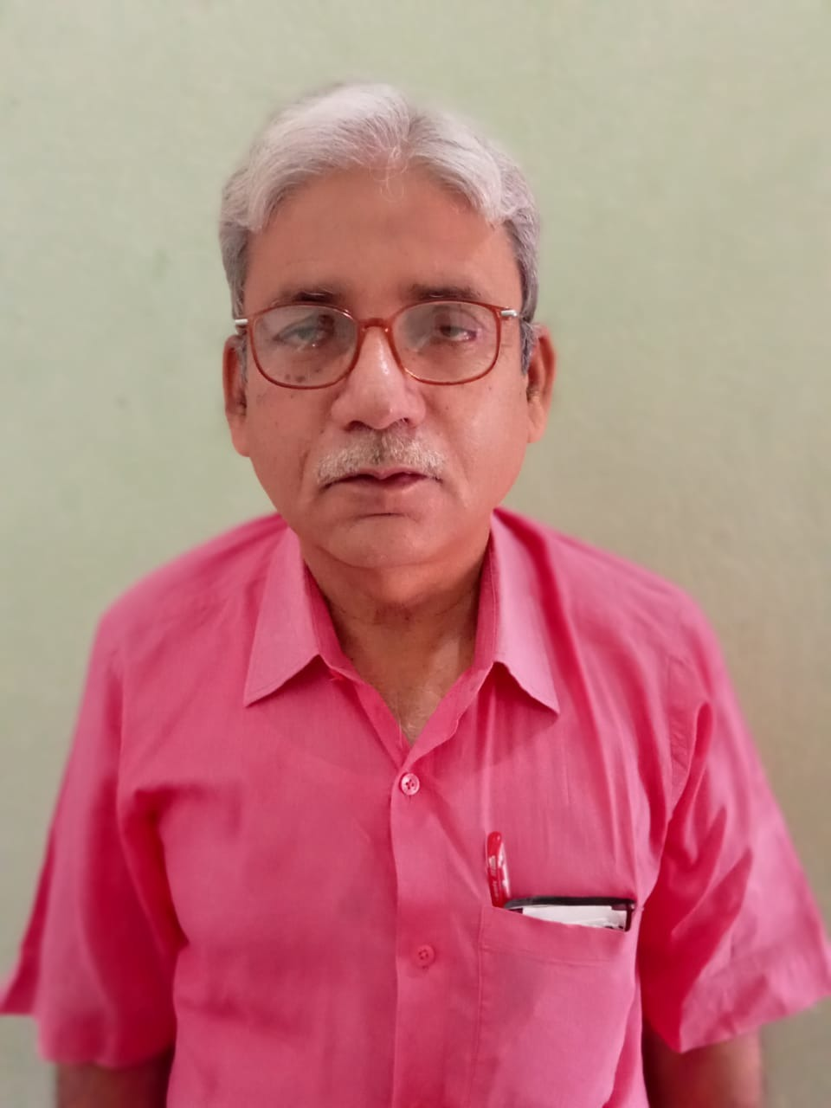
Md.Kamran principal R.P.D.j Higher secondary school jitwarpur madhubani

Slide 18
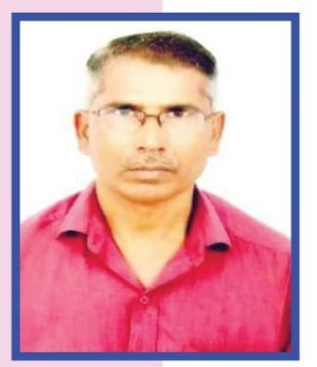
Shri. Shiv Narayan Ray
Warrant Officer, Indian Air force

Slide 19
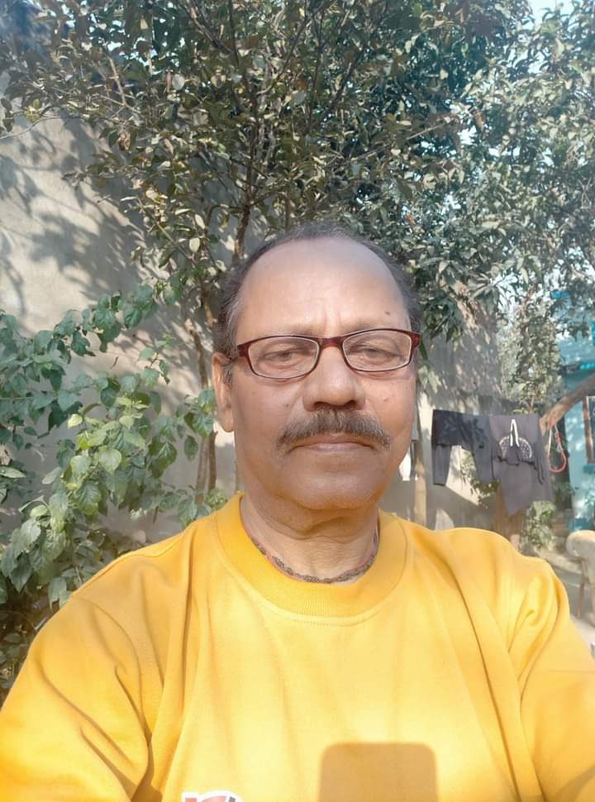
Arun kumar SINHA
RETD. BANK OFFICER SBI

Slide 20
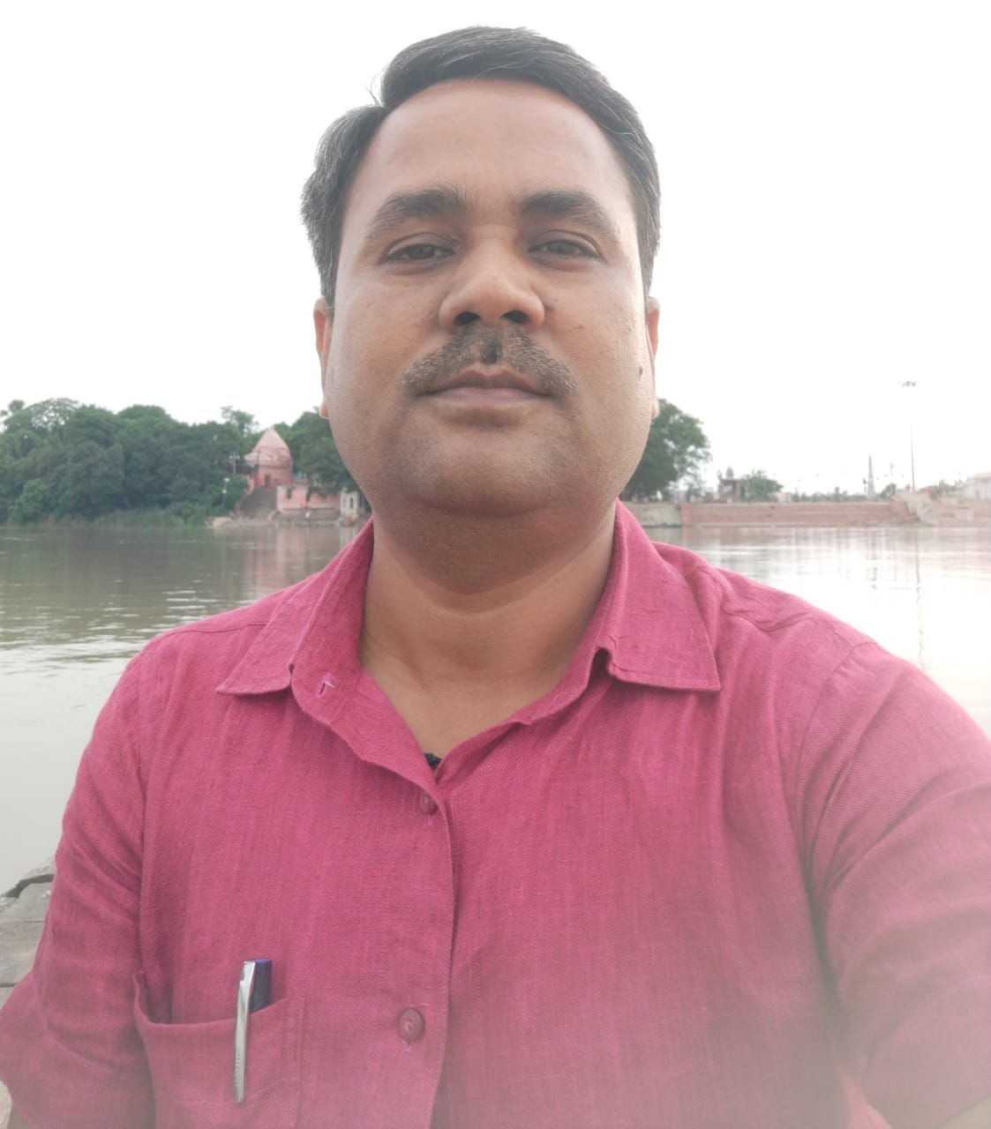
MR. Abhay kumar jha
Reservation Supervisor (HQ), DRM Office, Danapur, Patna, Bihar.

Slide 21
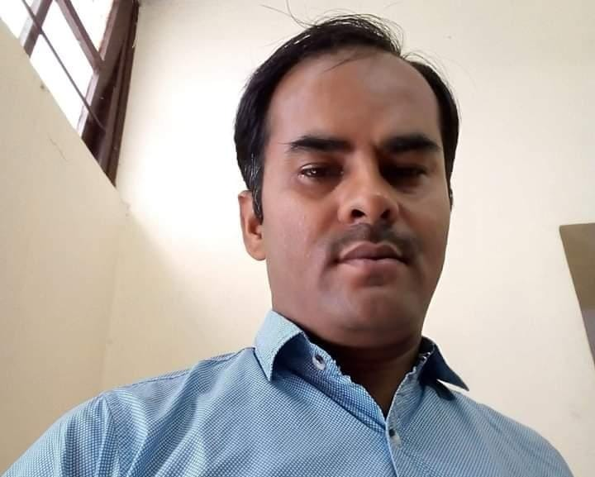
MR. Sanjeev Kumar
Assistant Section Officer Jharkhand Secretariat, Ranchi

Slide 22
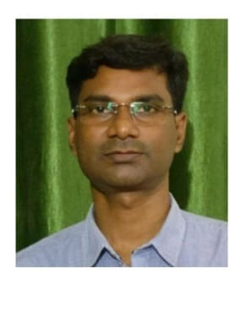
MR. Sudhir Kumar
B.D.O. Hanuman Nagar, Darbhanga

Slide 23
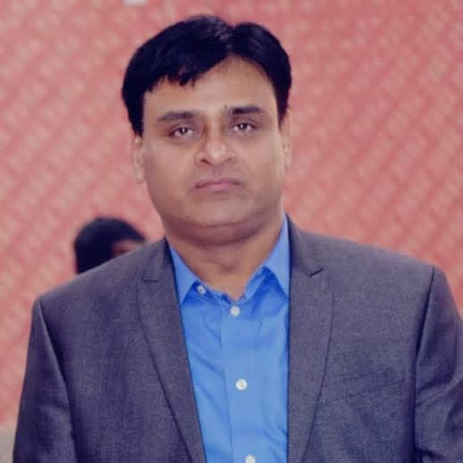
MR. Kishore Kumar
Zonal Head – North- AIB DCB Bank

Slide 24
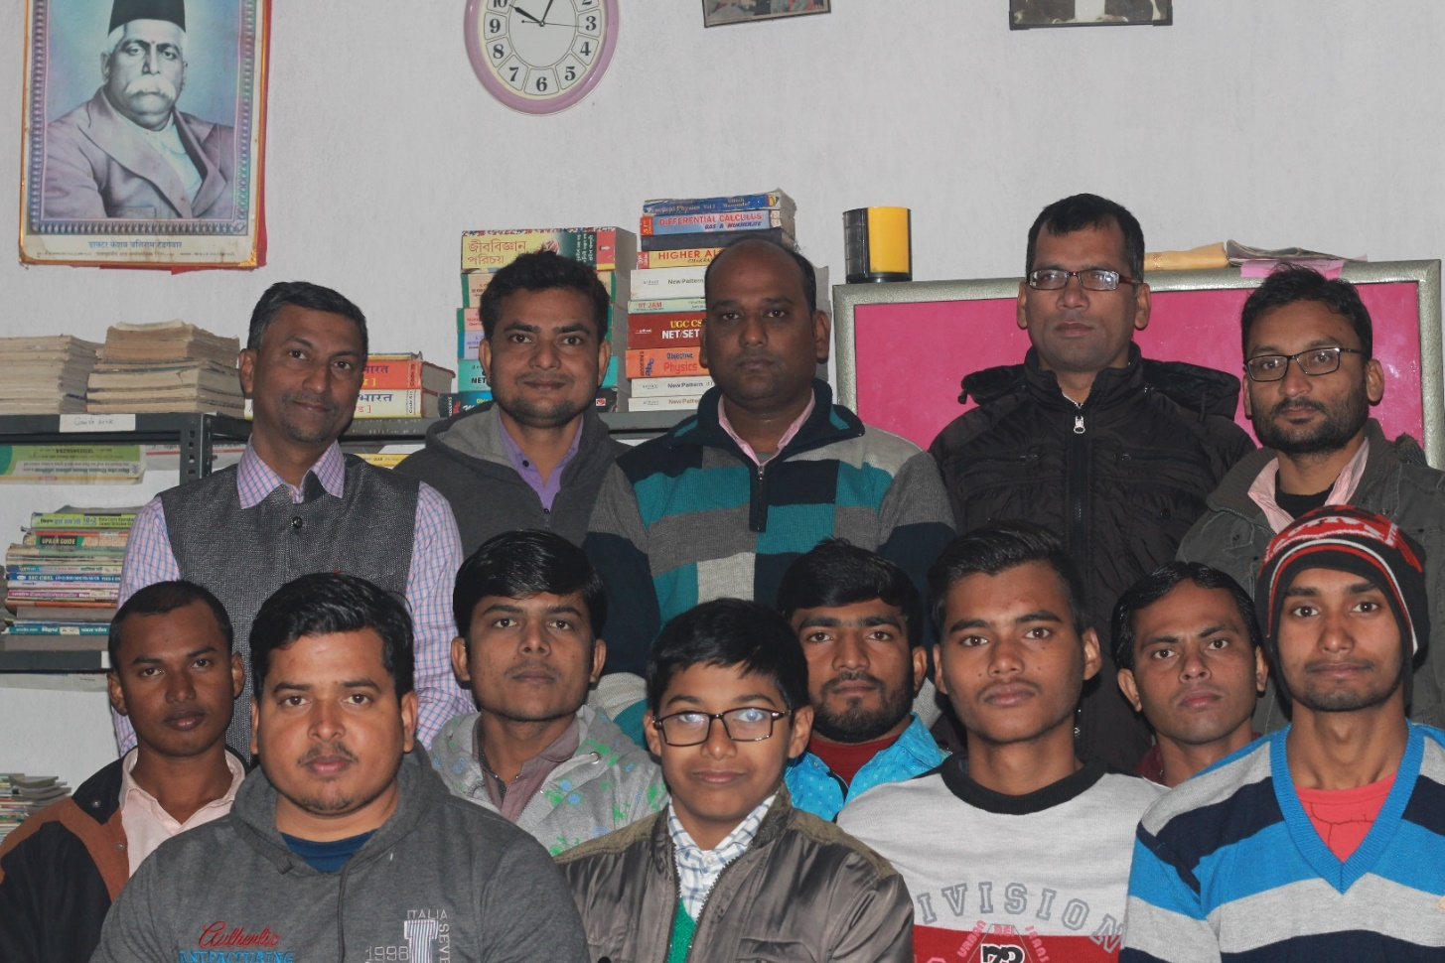
Members of THE Library

Slide 25
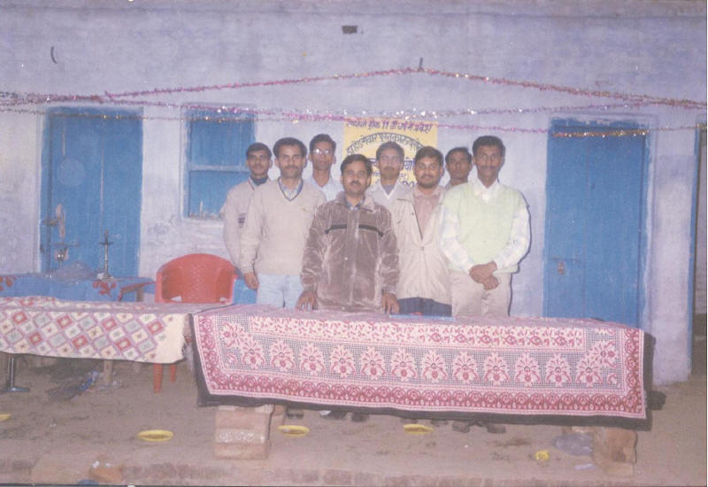
Our Earliest members

Slide 26
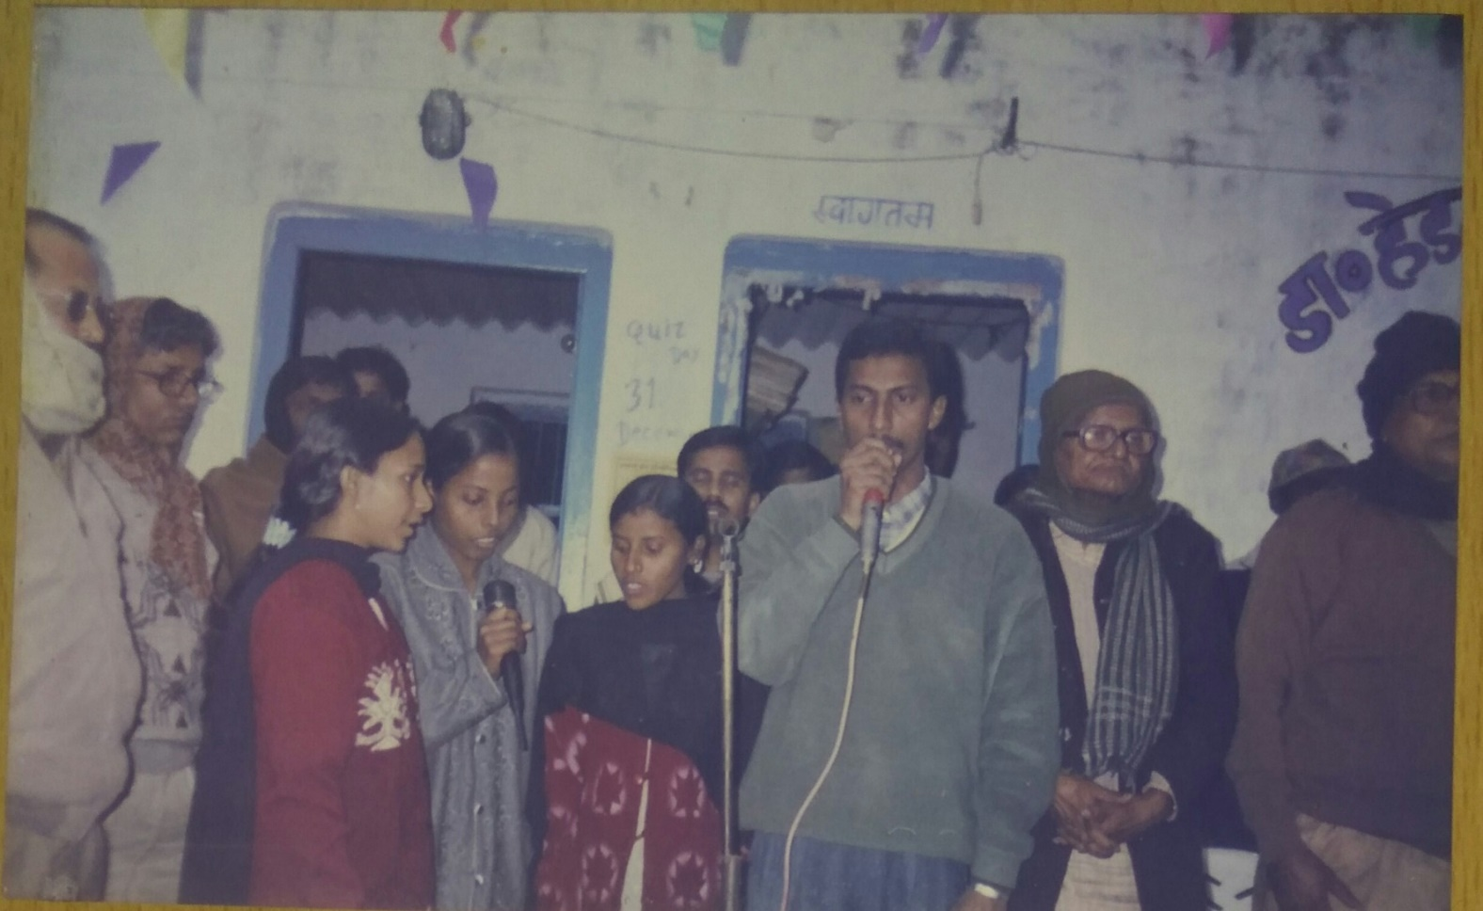
INAUGURAL Quiz contest in 1995

Slide 27
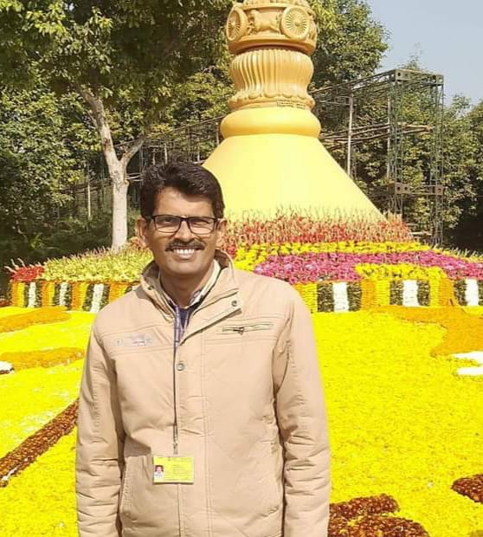
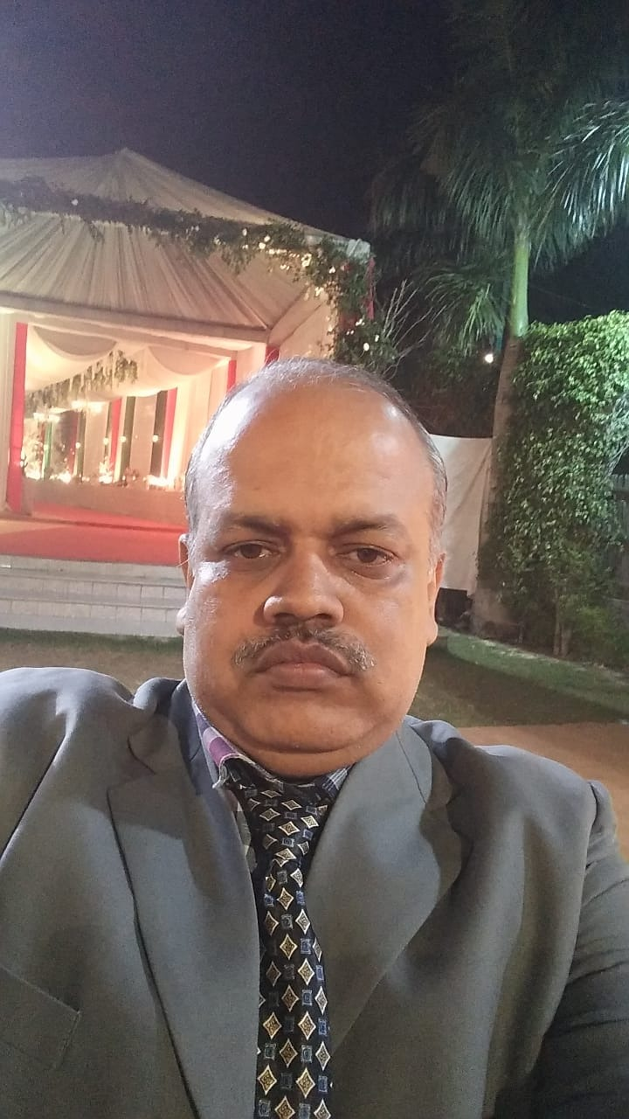
First winner of QUIZ CONTEST
AMITABH PRASAD & Shambhu nath singh employee of central govt.of india

Slide 28
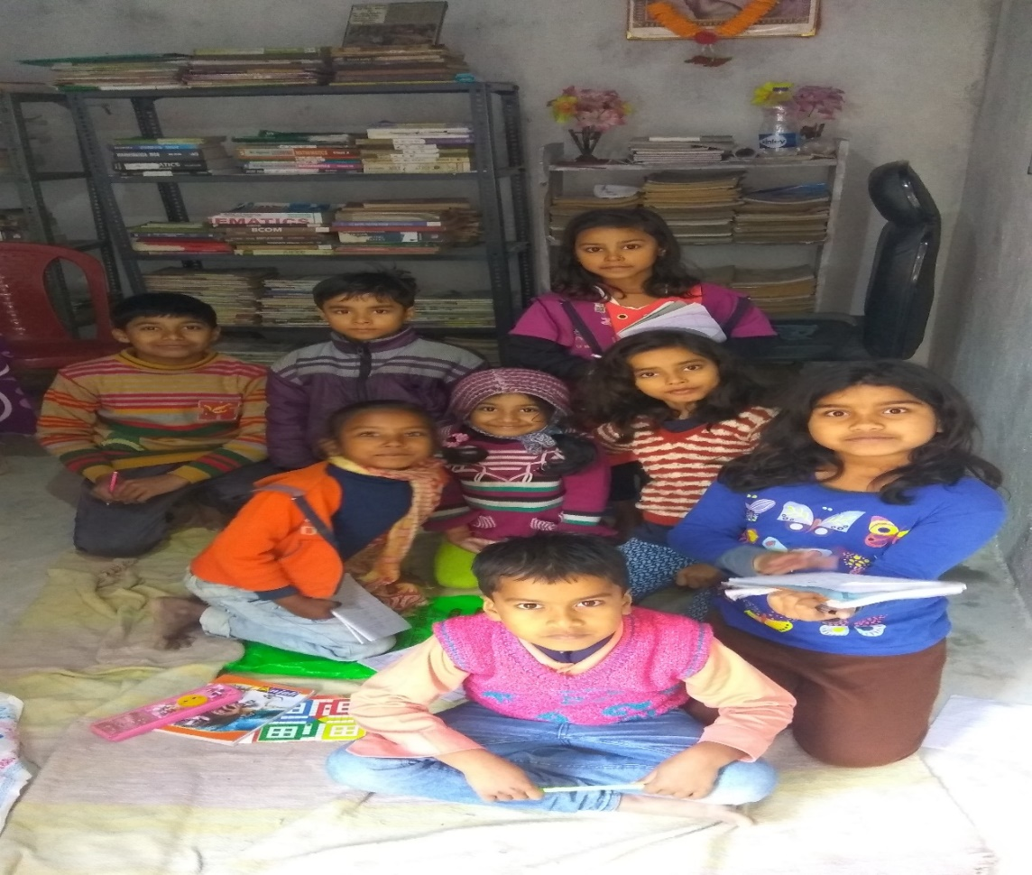
Little Children in our library

Slide 29
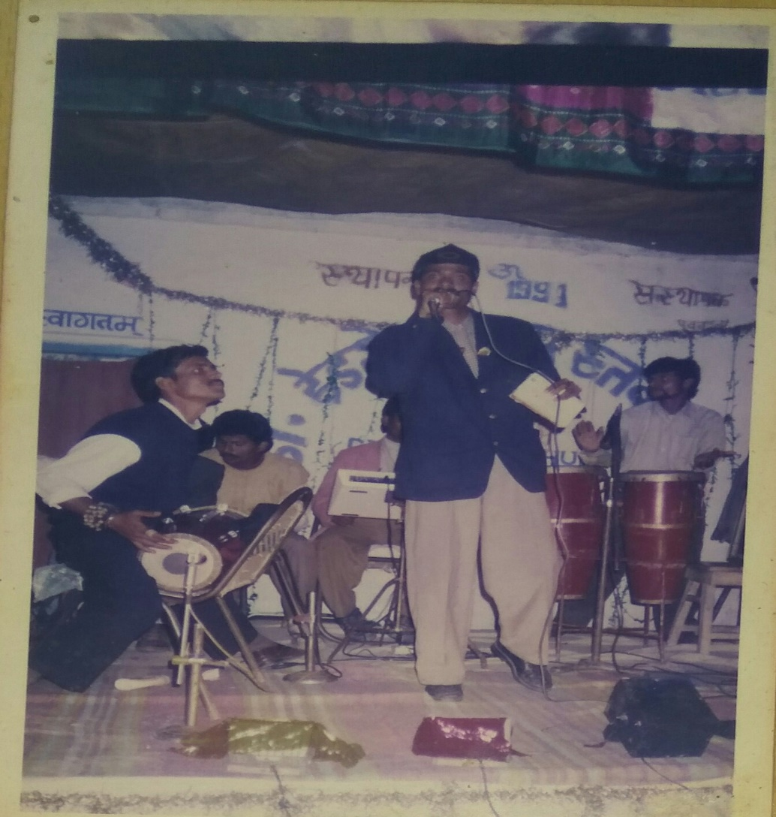
A Cultural program in our library in 1995

Slide 30
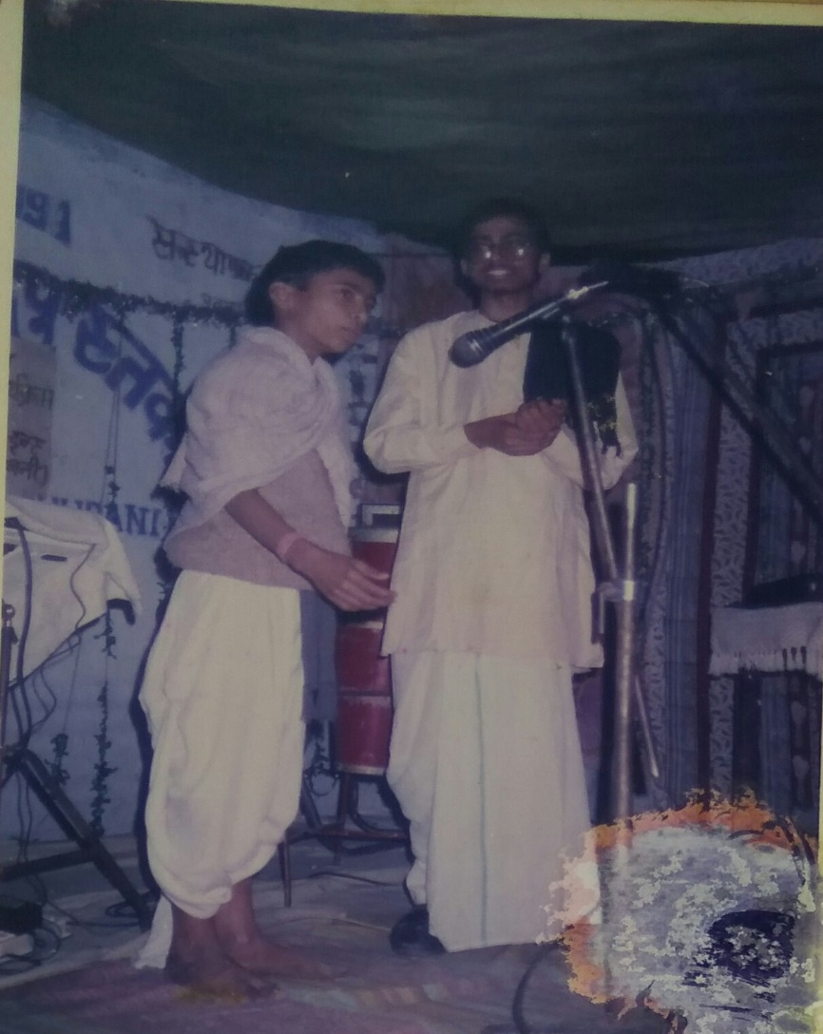
Skit by members

Slide 31
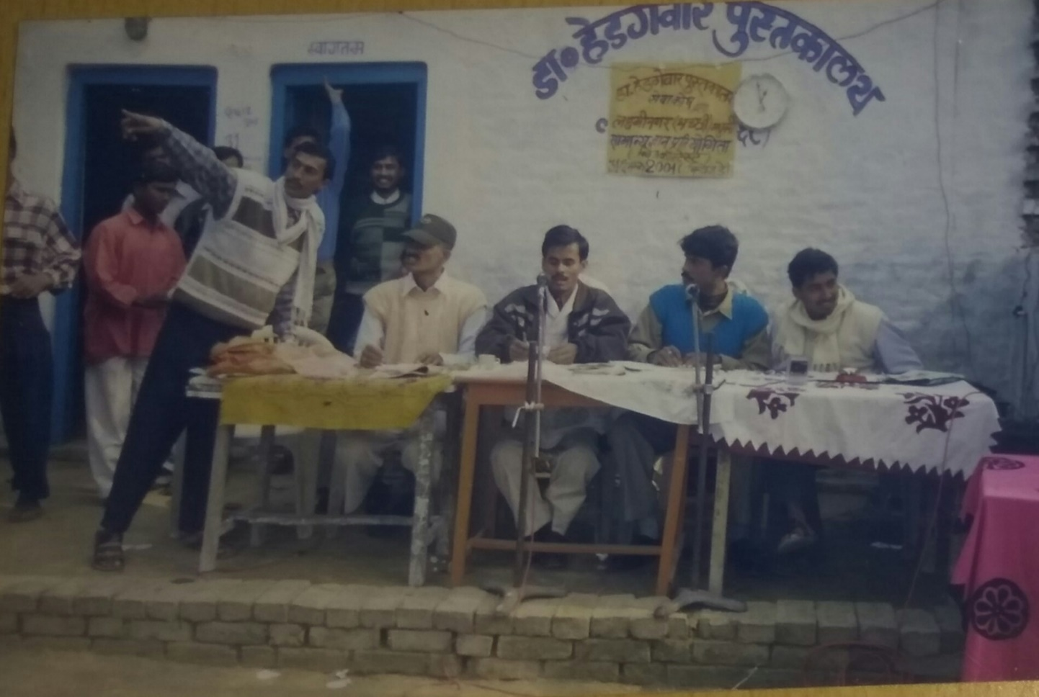
Old is Gold

Slide 32
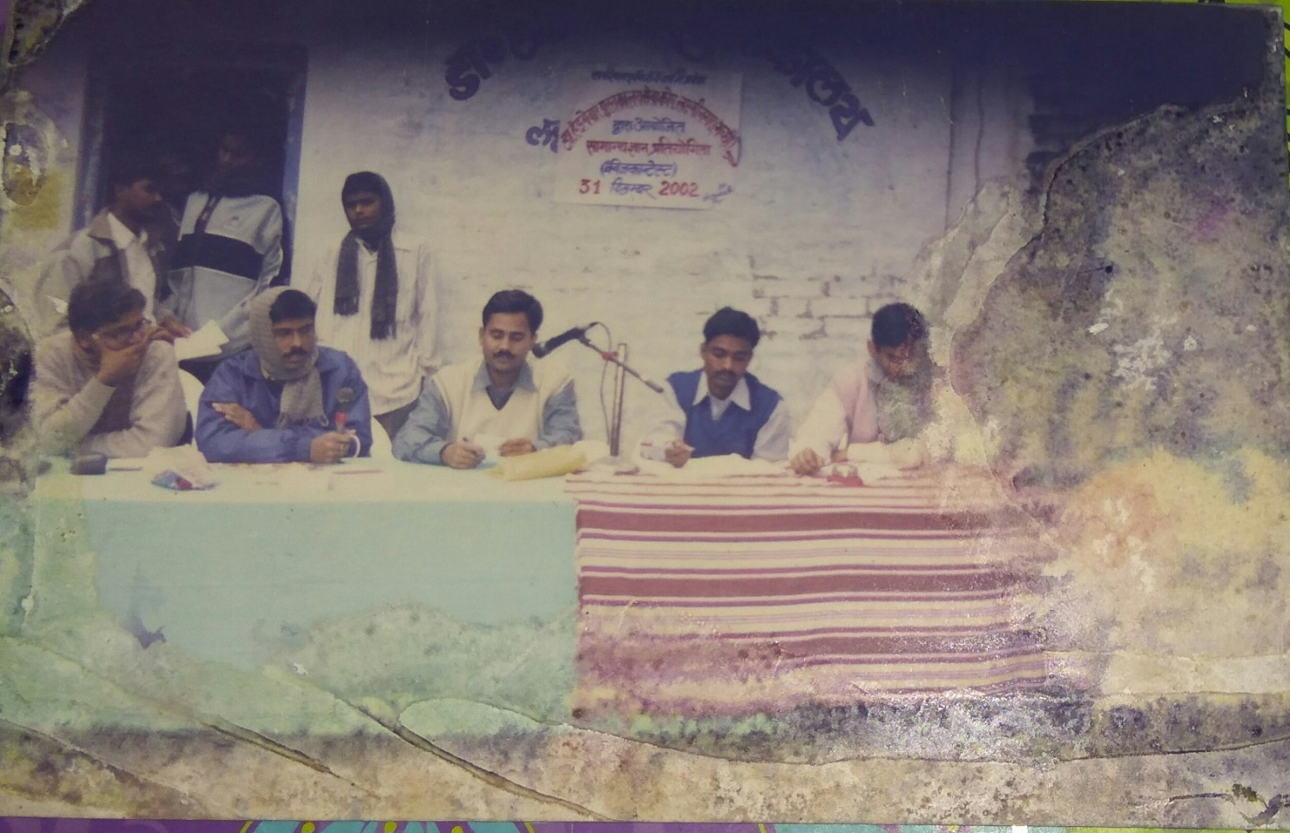
All Organizing committee members are in govt. job Now

Slide 33
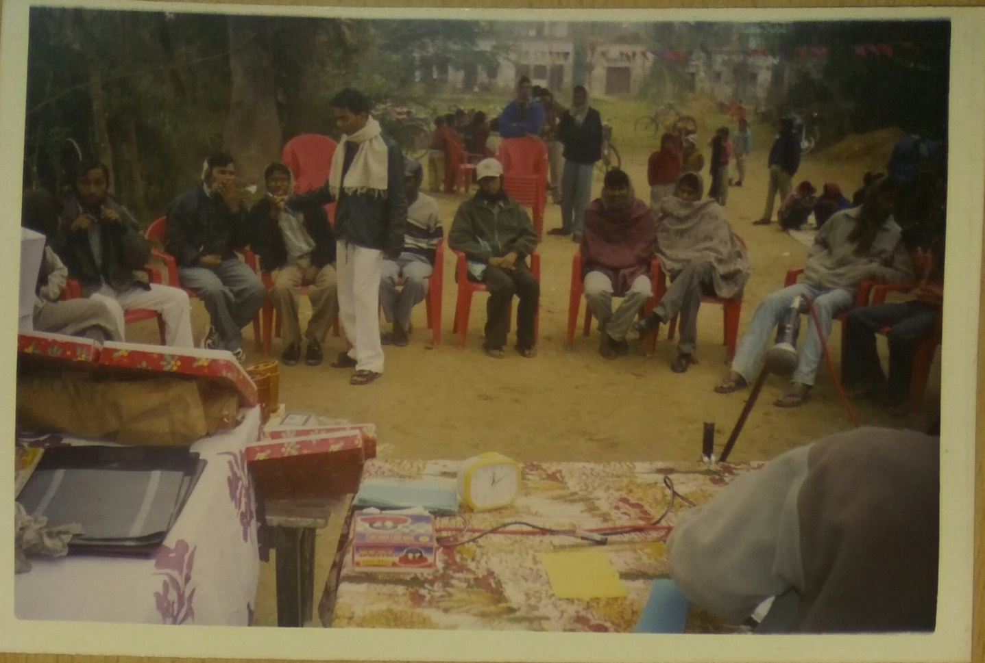
Quiz contest 2003

Slide 34
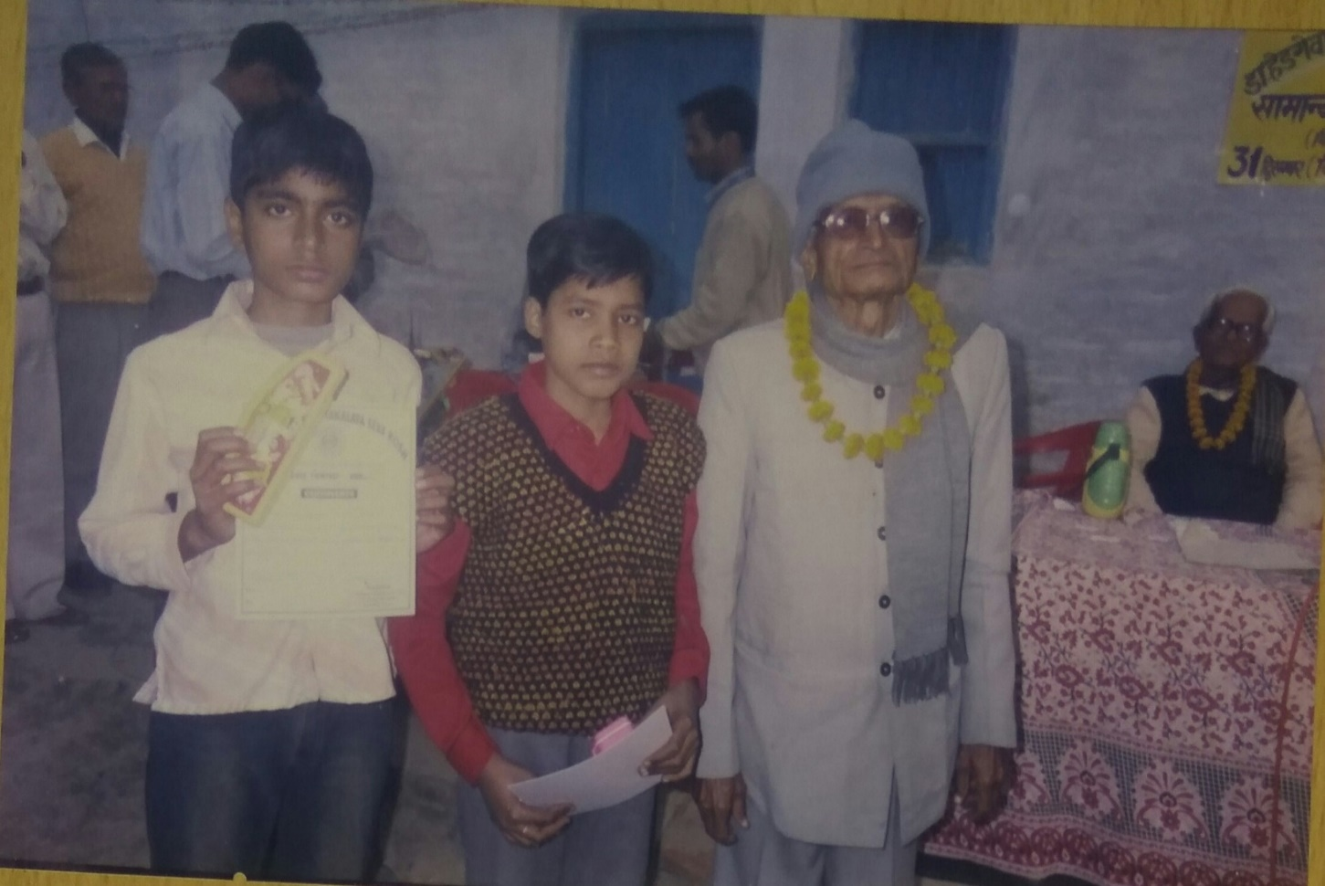
Winners with the MentorS

Slide 35
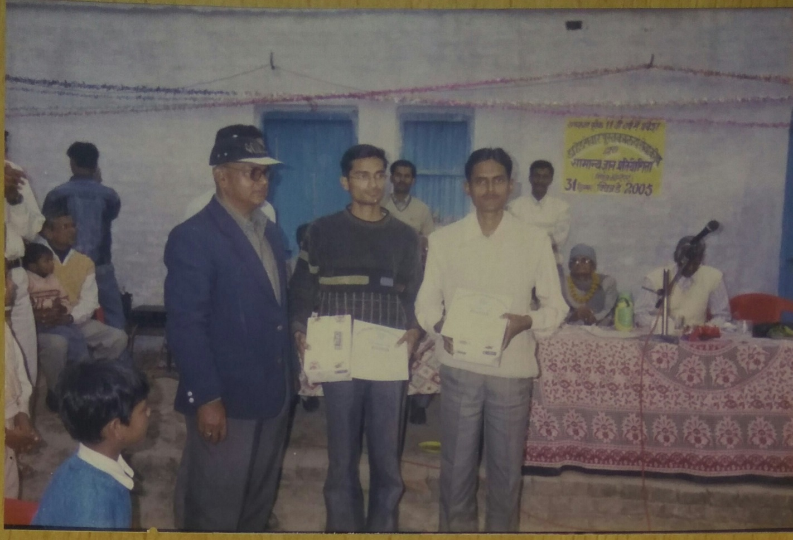
College level winner with guest IN 2005

Slide 36
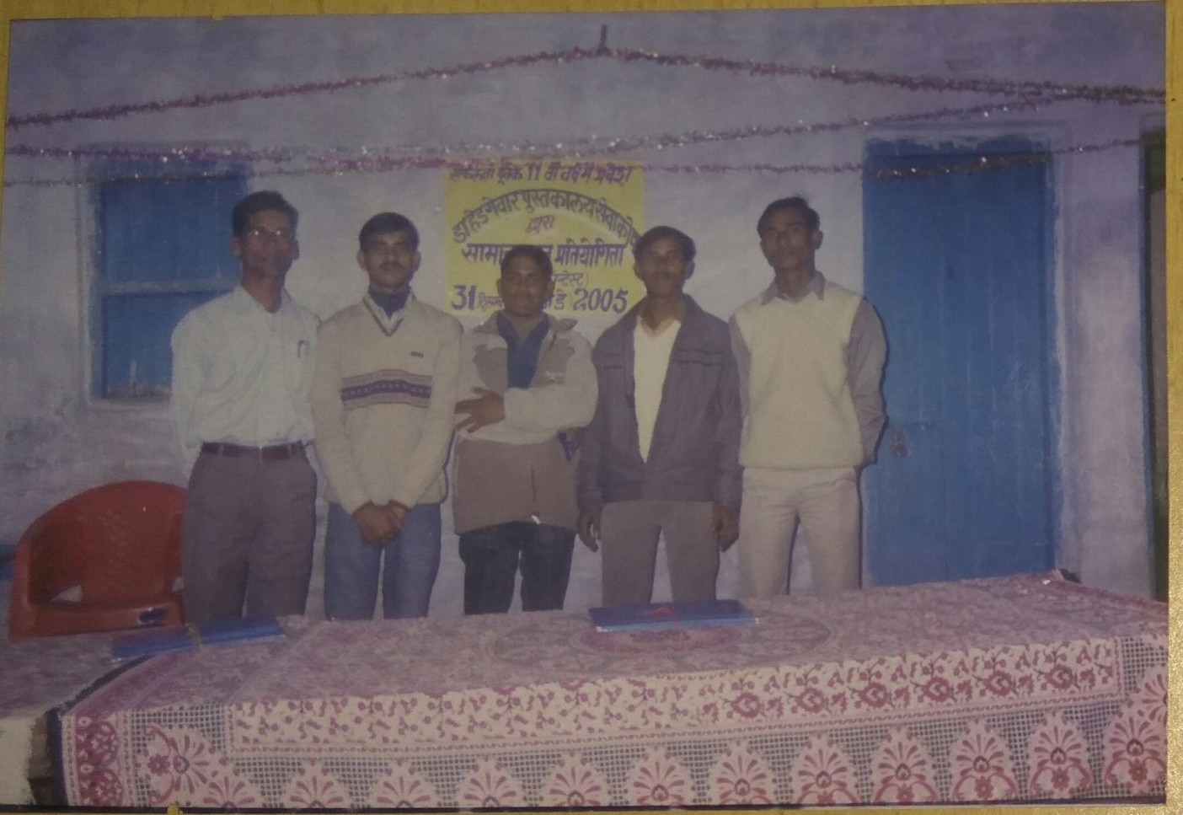
All our members are working in various organizations

Slide 37
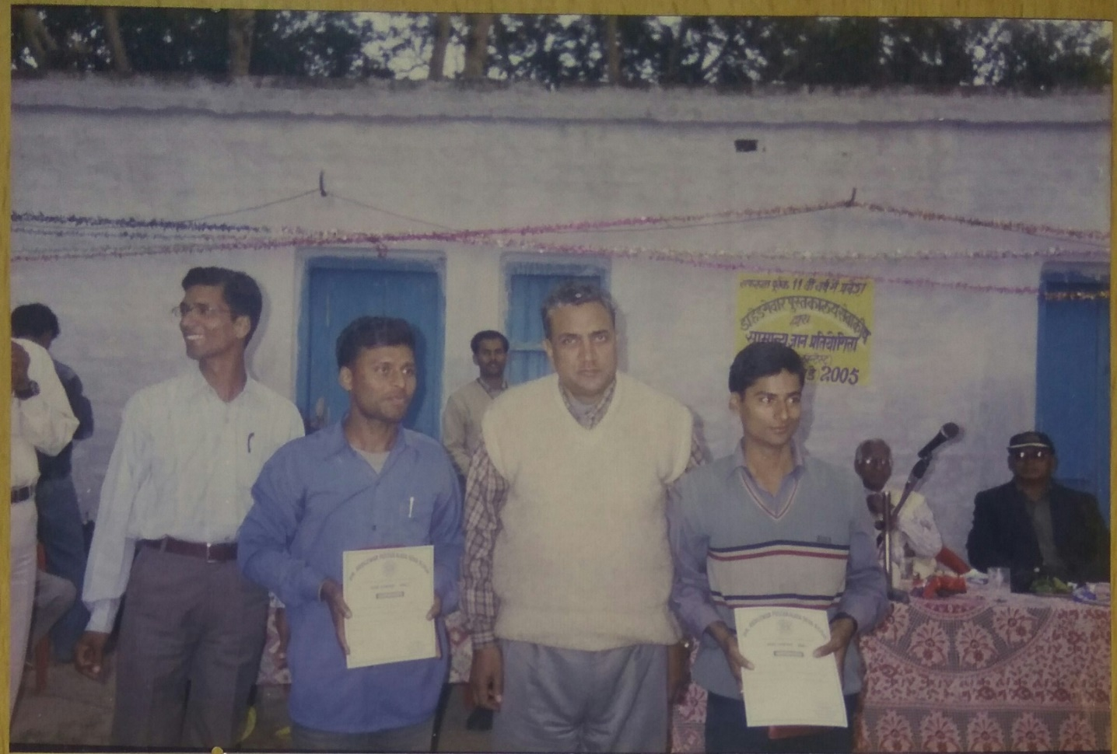
Winners with our Mentor
Late Arun kr. Mishra Sir

Slide 38
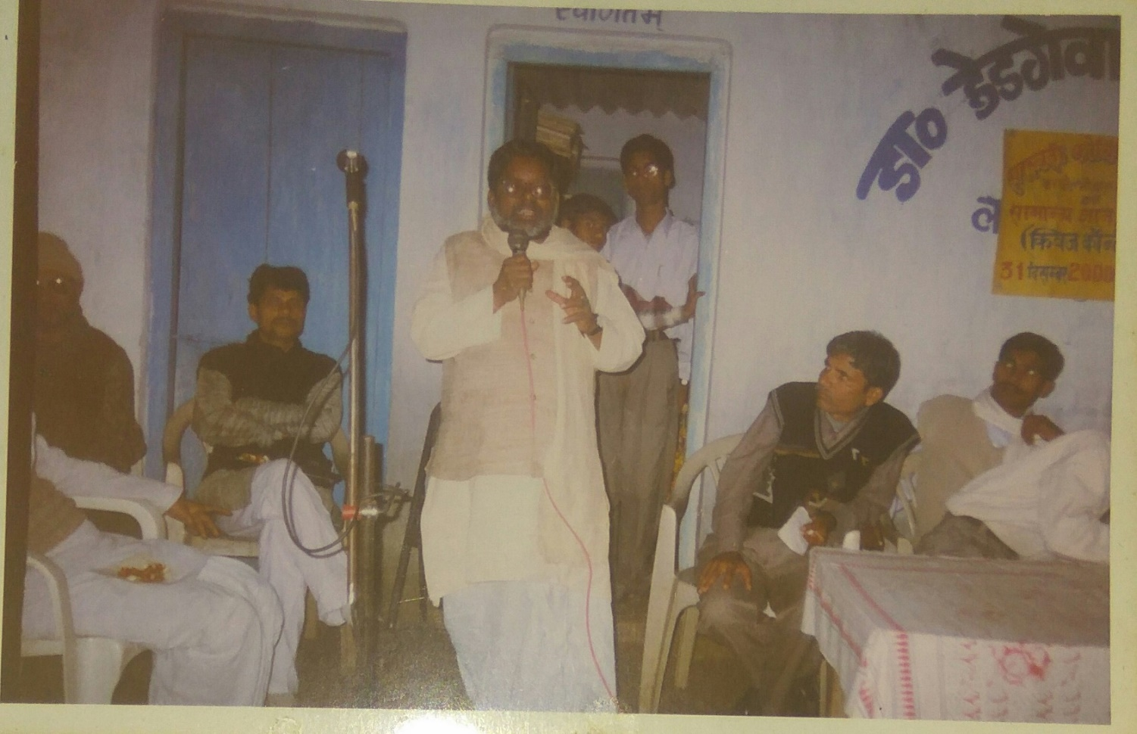
speech by former M.L.A
Shri Ramdev Mahto

Slide 39
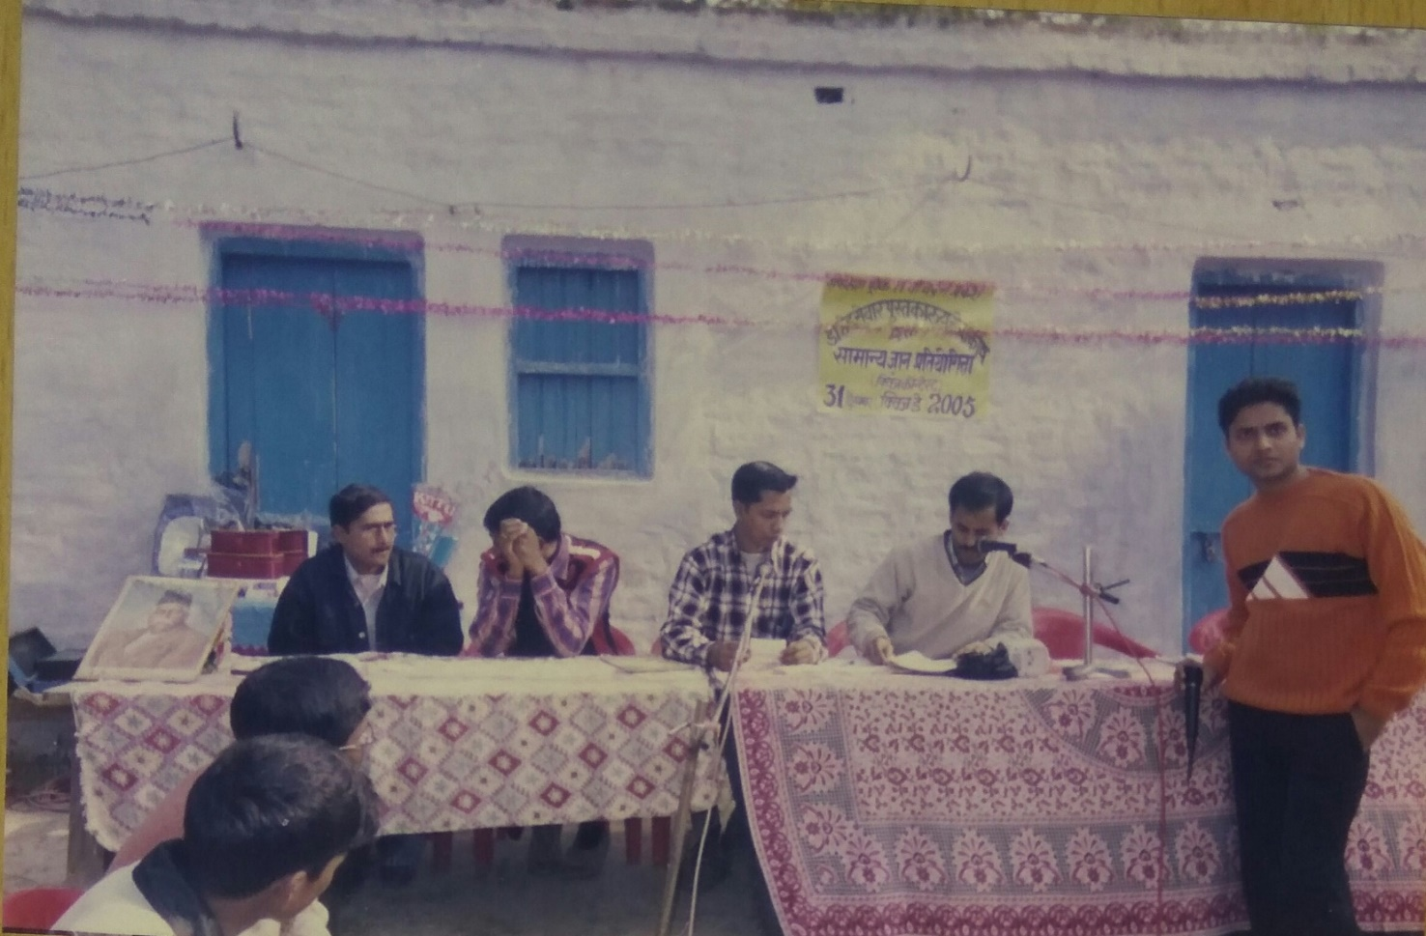
College level round

Slide 40
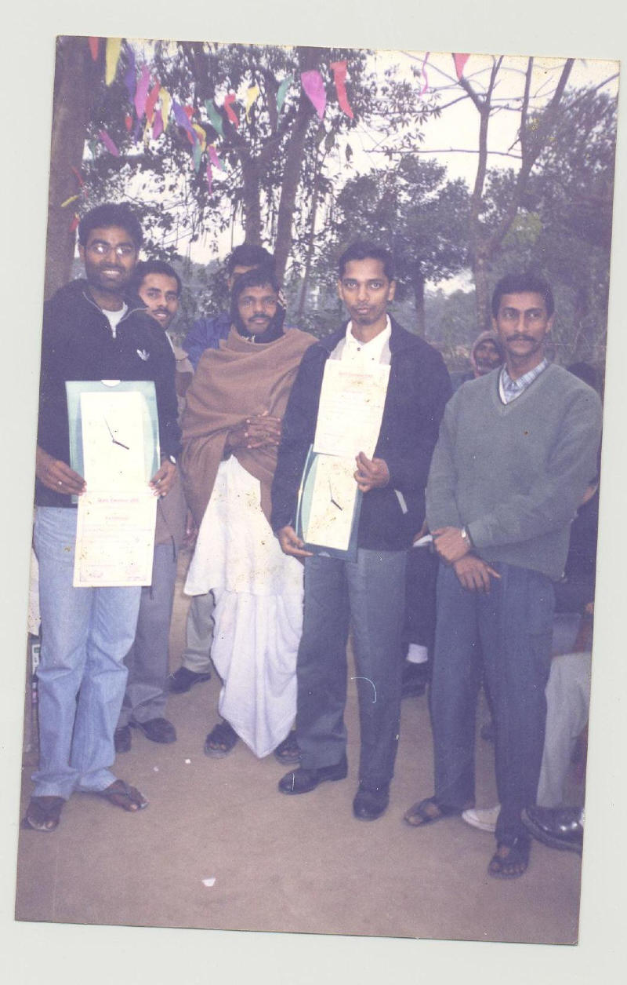
WINNERS OF the QUIZ CONTEST

Slide 41
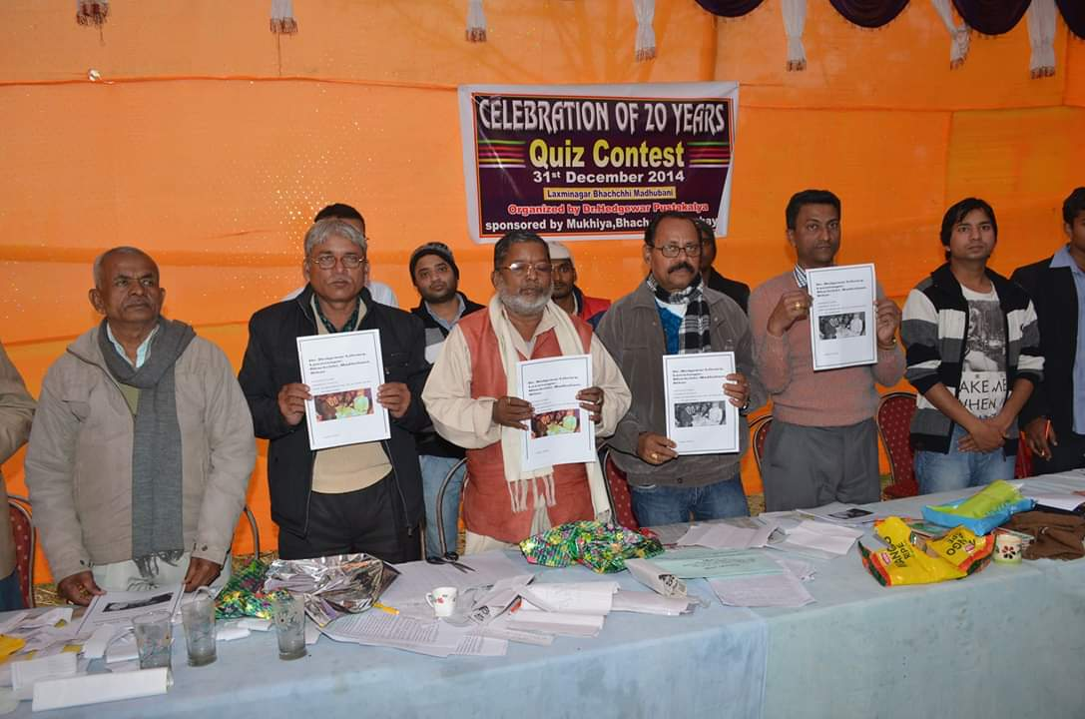
Guest & Members with Booklet 2014

Slide 42
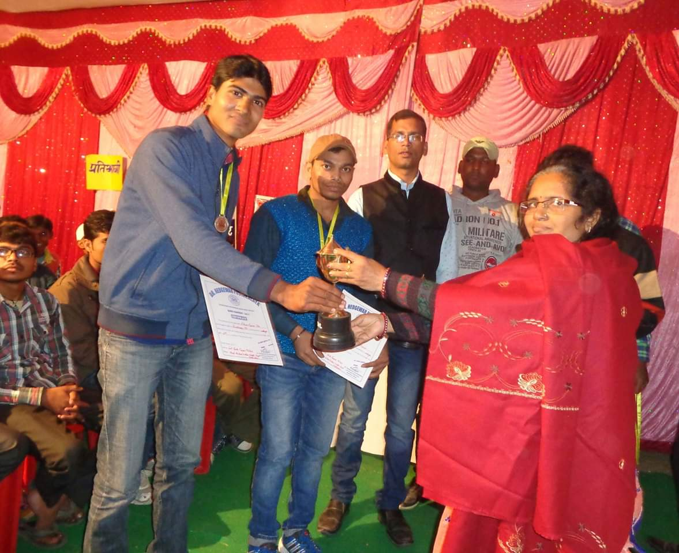
Winners with Smt. Gita Mishra

Slide 43
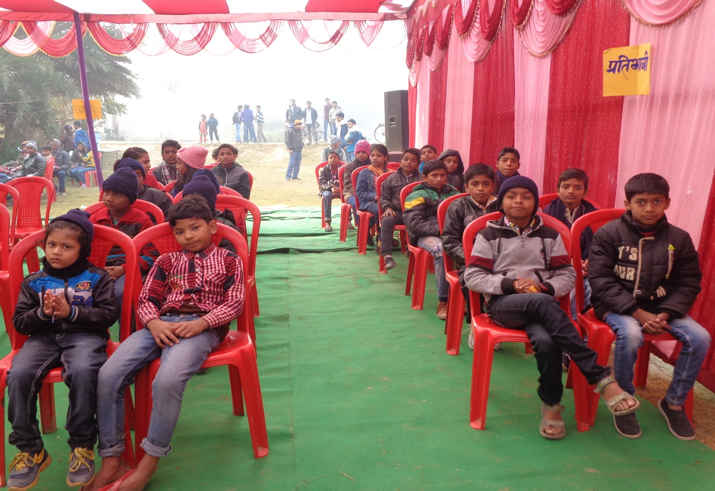
PARTICIPANTS OF QUIZ CONTEST

Slide 44
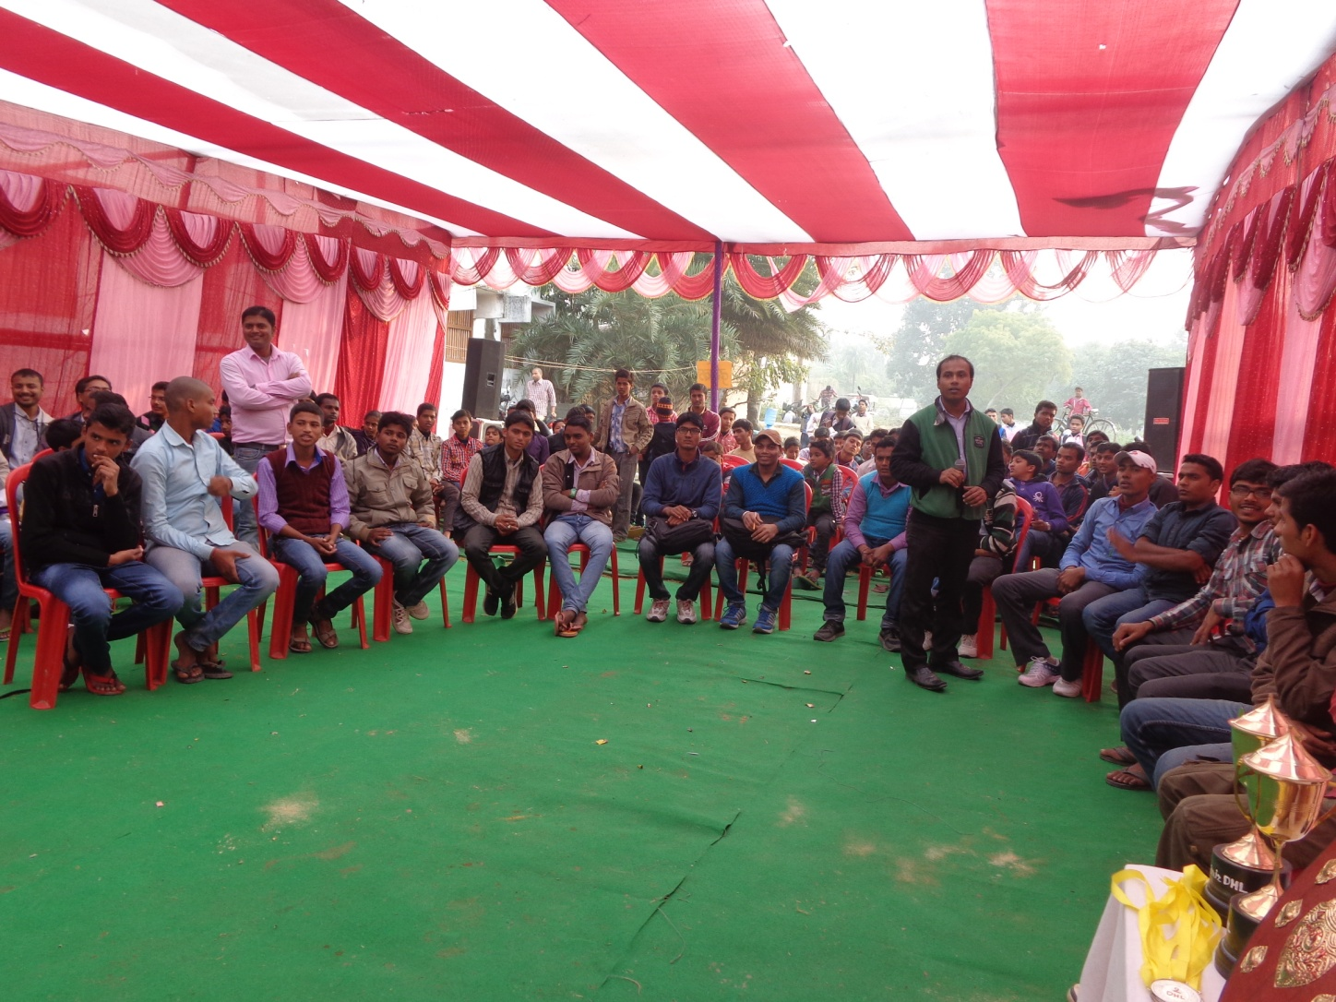
FINAL ROUND OF one of our QUIZ CONTESTs

Slide 45
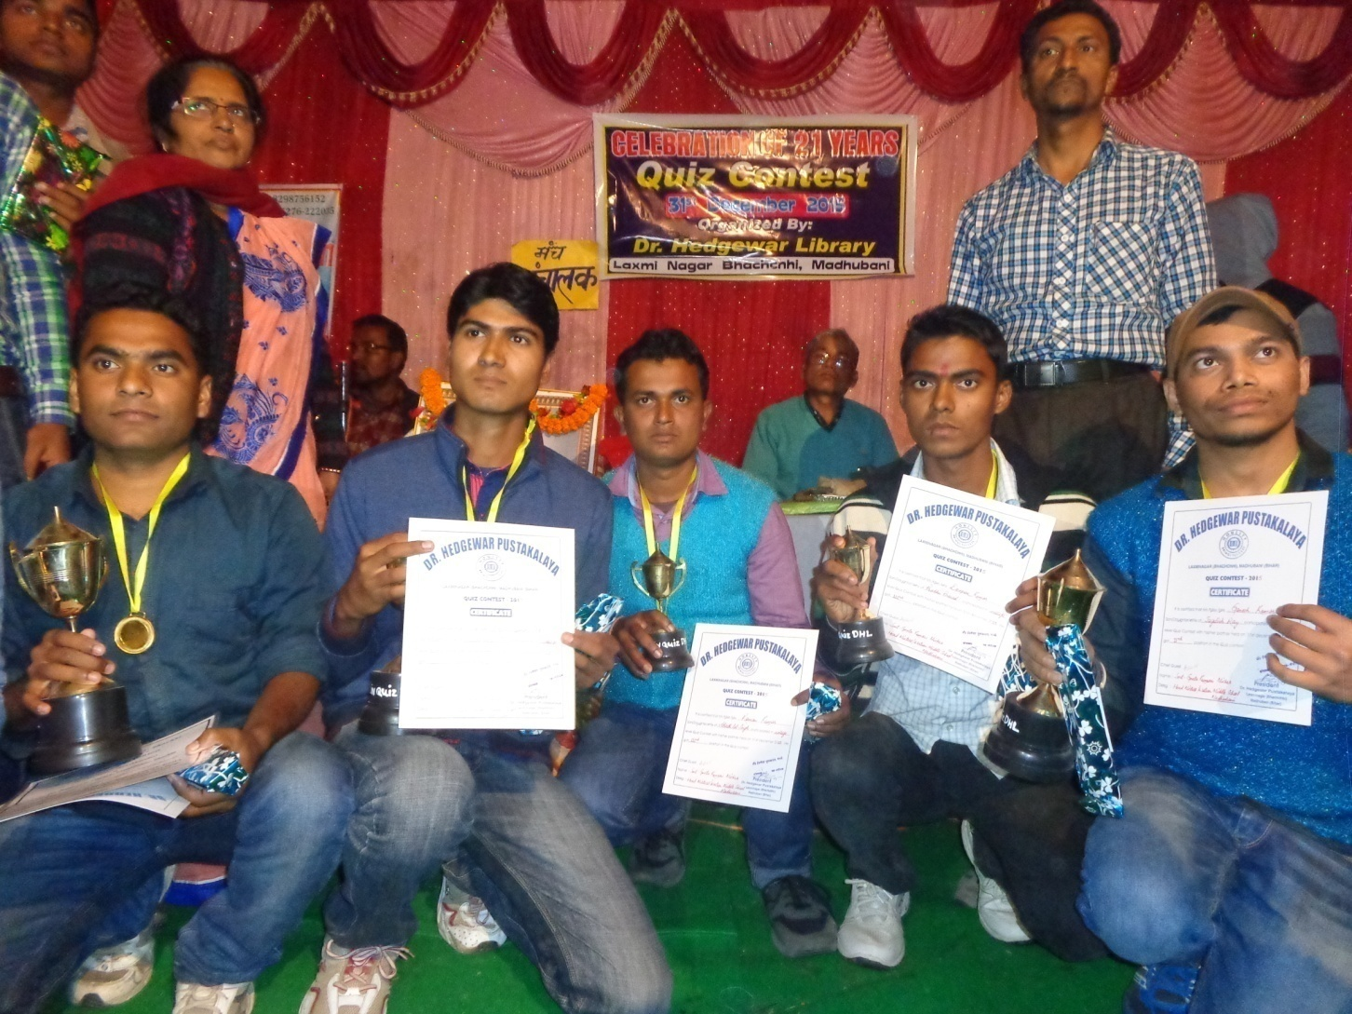
WINNERS of QUIZ CONTEST 2015

Slide 46
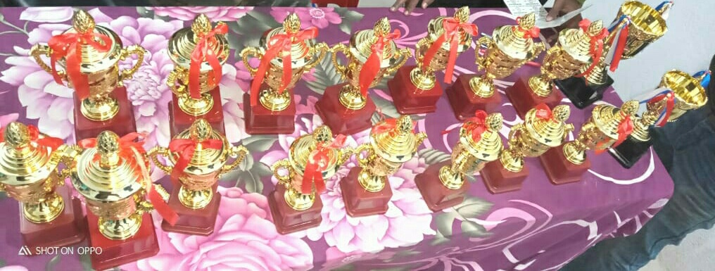
PRIZES IN QUIZ CONTEST

Slide 47
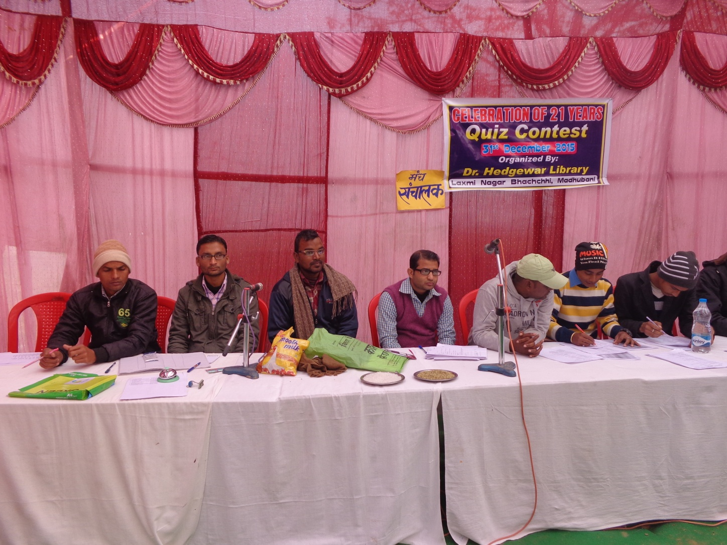
Quiz Contest - 2015

Slide 48
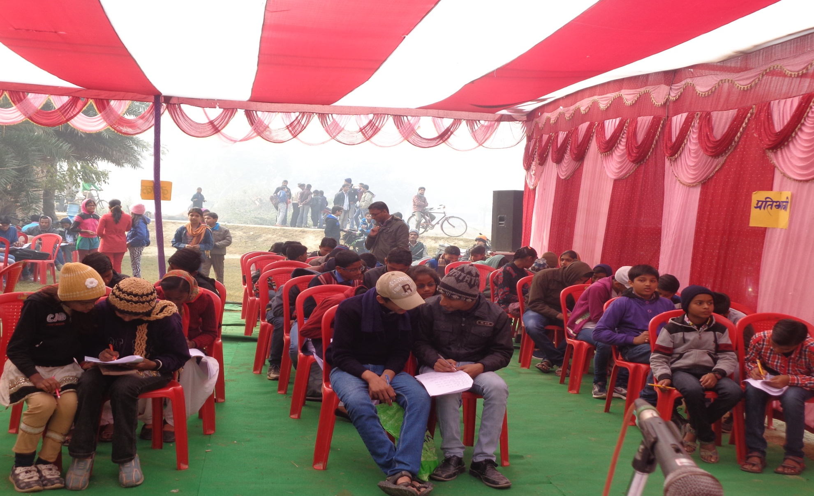
Quiz Contest 2015 (Engaging the audience & contestants alike)

Slide 49
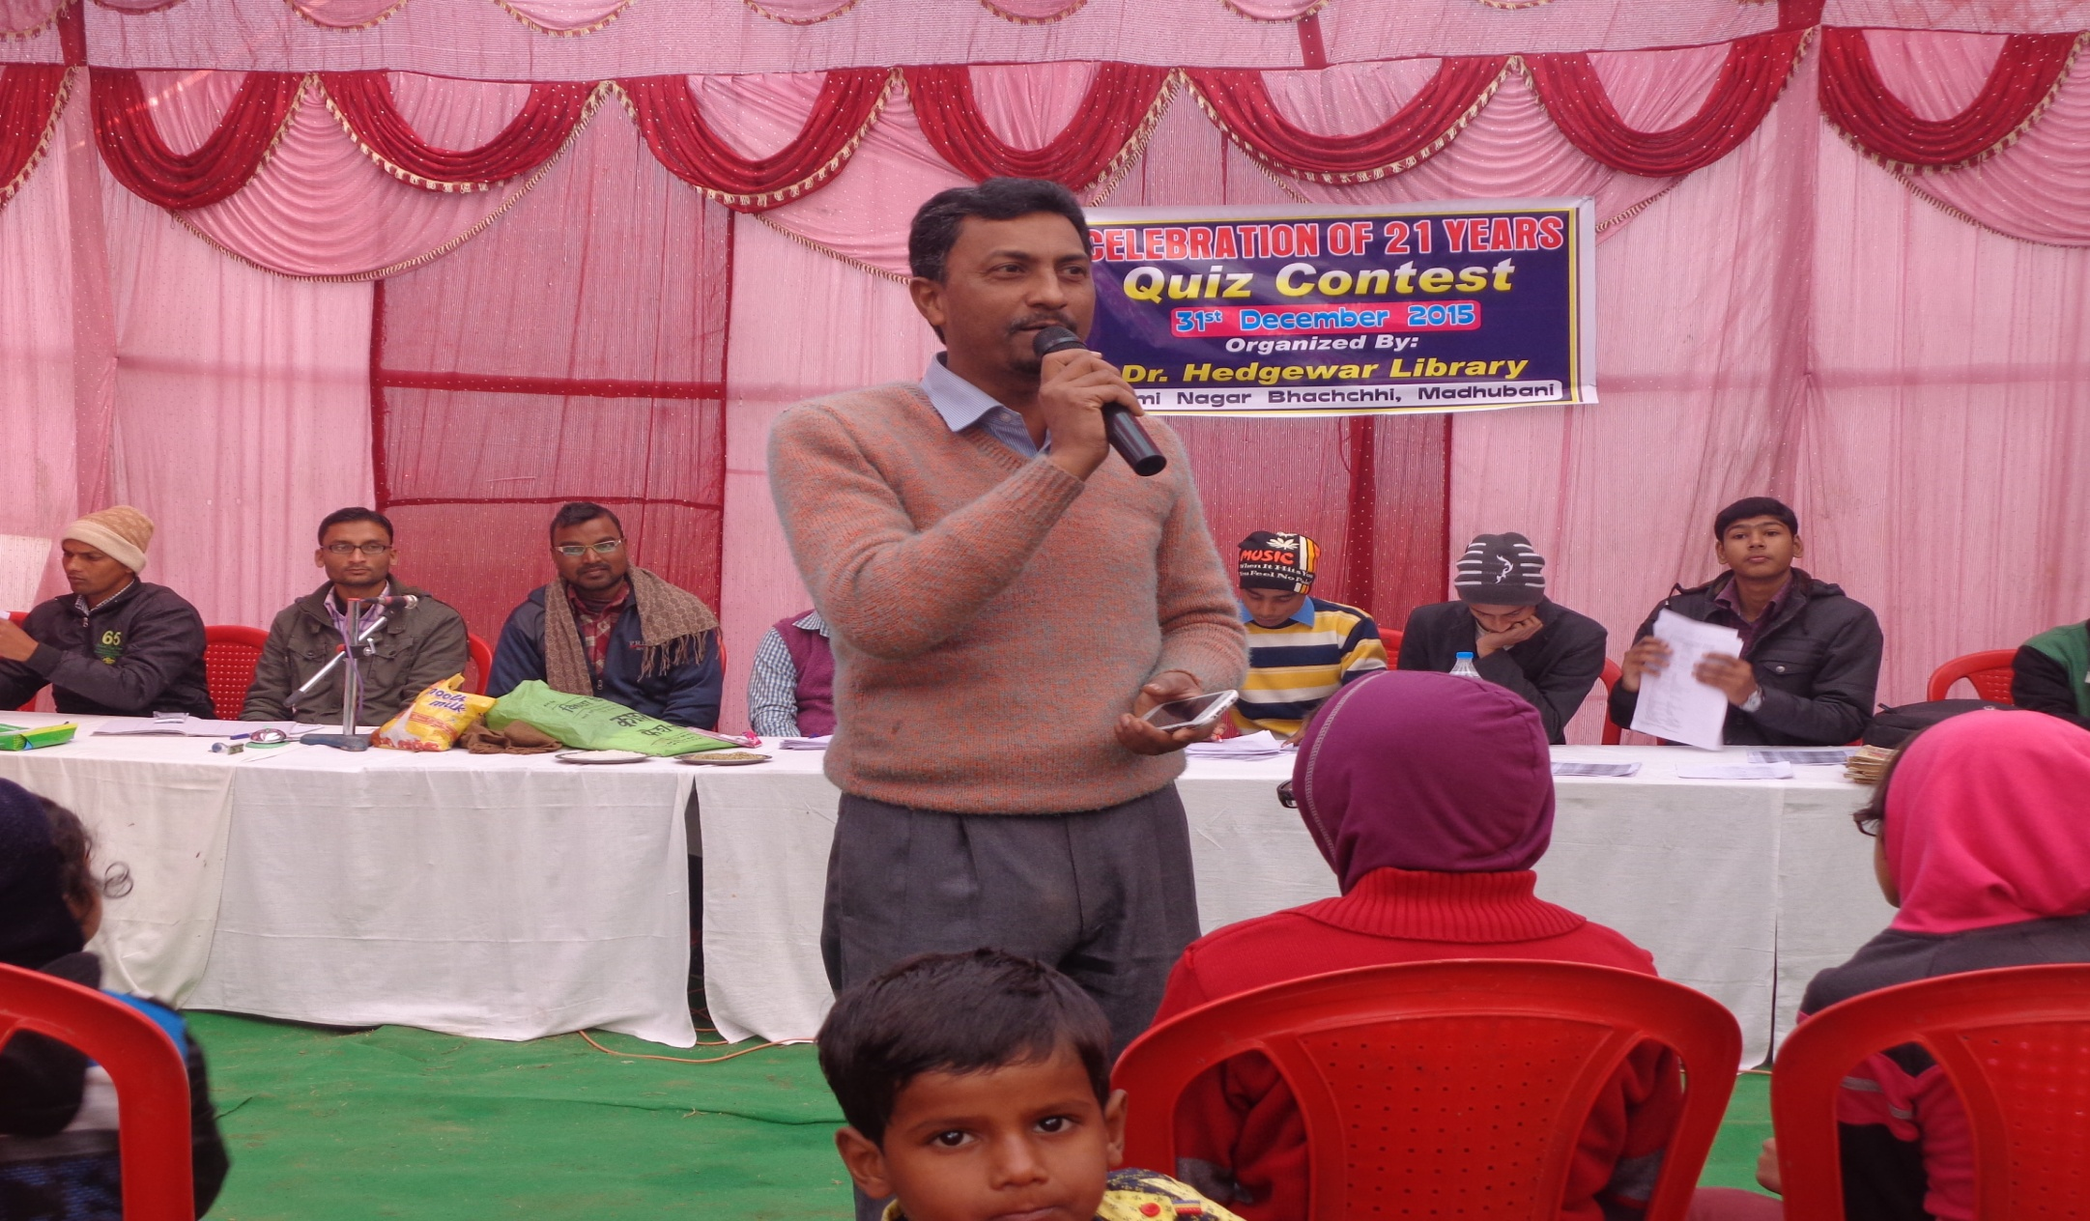
Quiz contest 2015 (Our very own Pawan Sir)

Slide 50
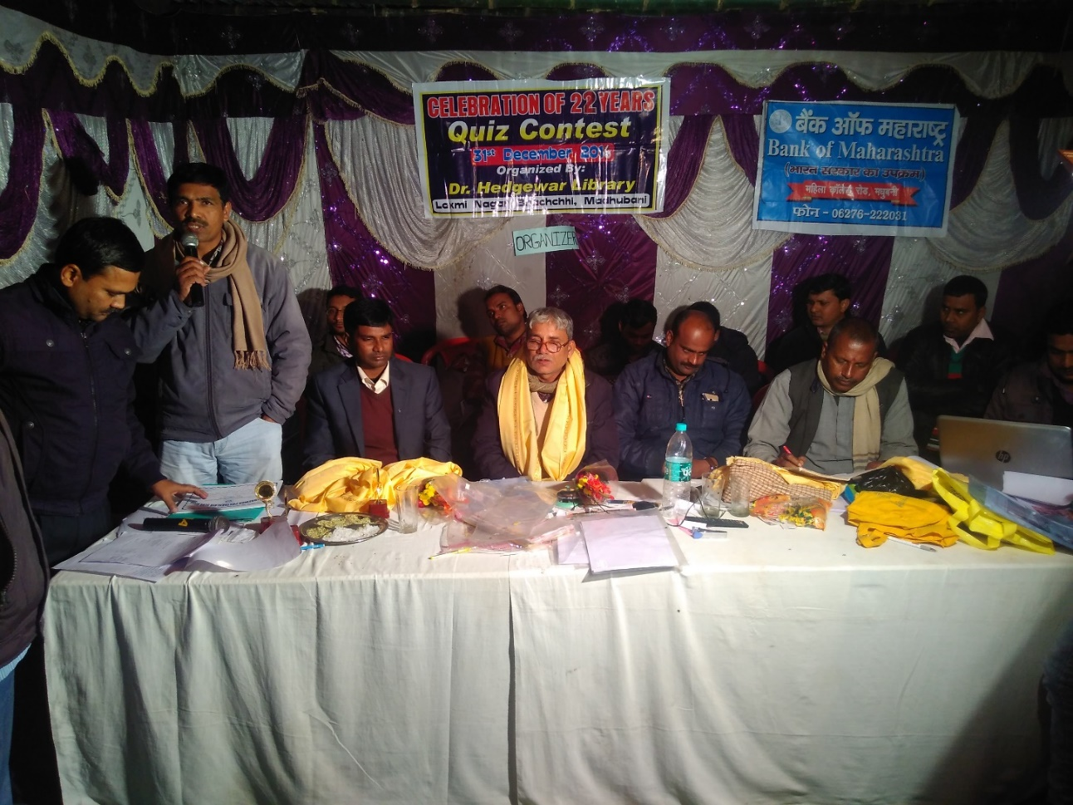
Quiz CONTEST 2016

Slide 51
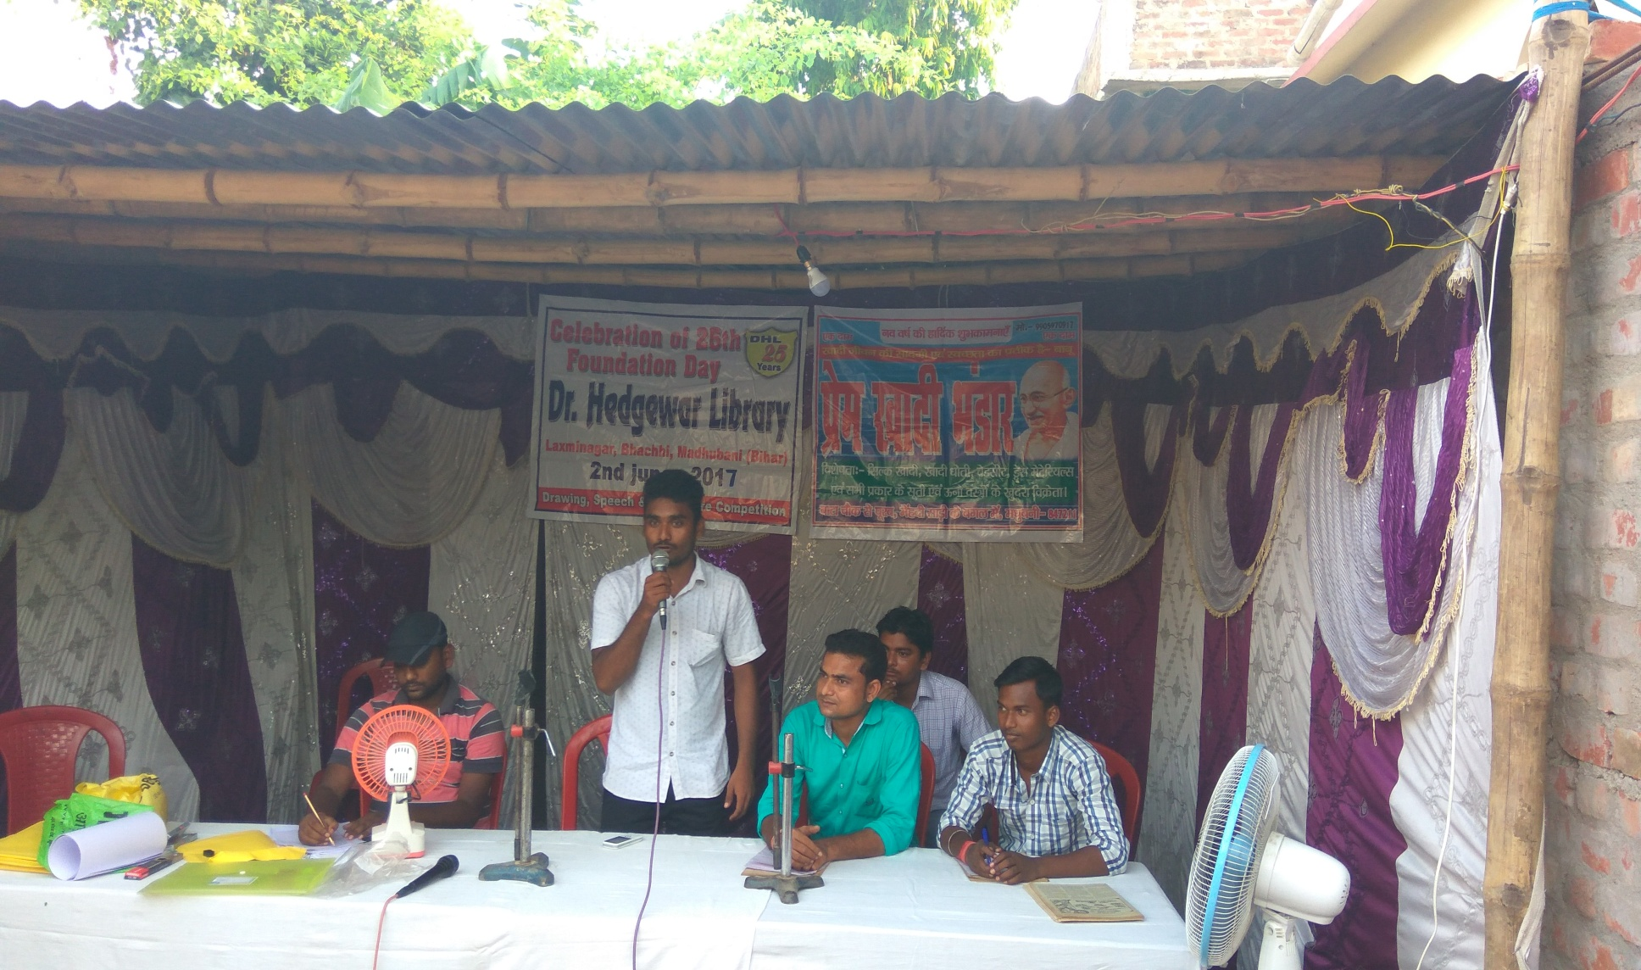
Foundation day, 2nd June 2017

Slide 52
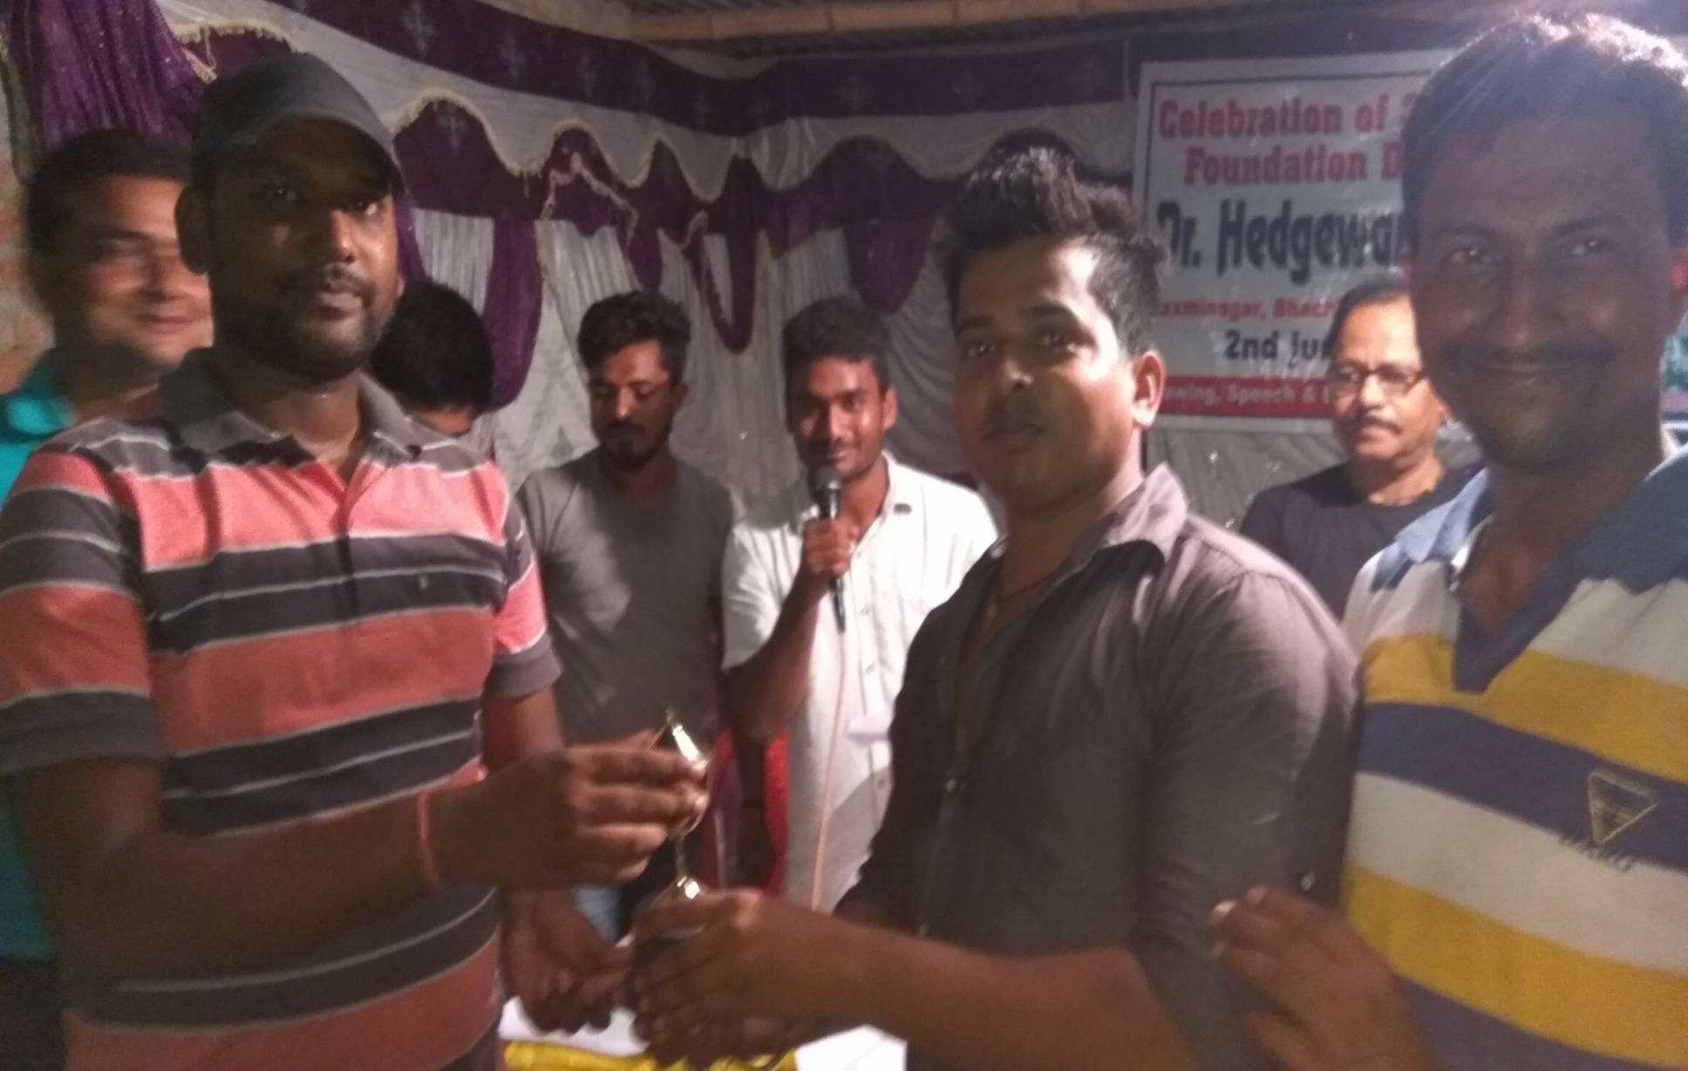
WINNERS Foundation day,2nd June 2017

Slide 53
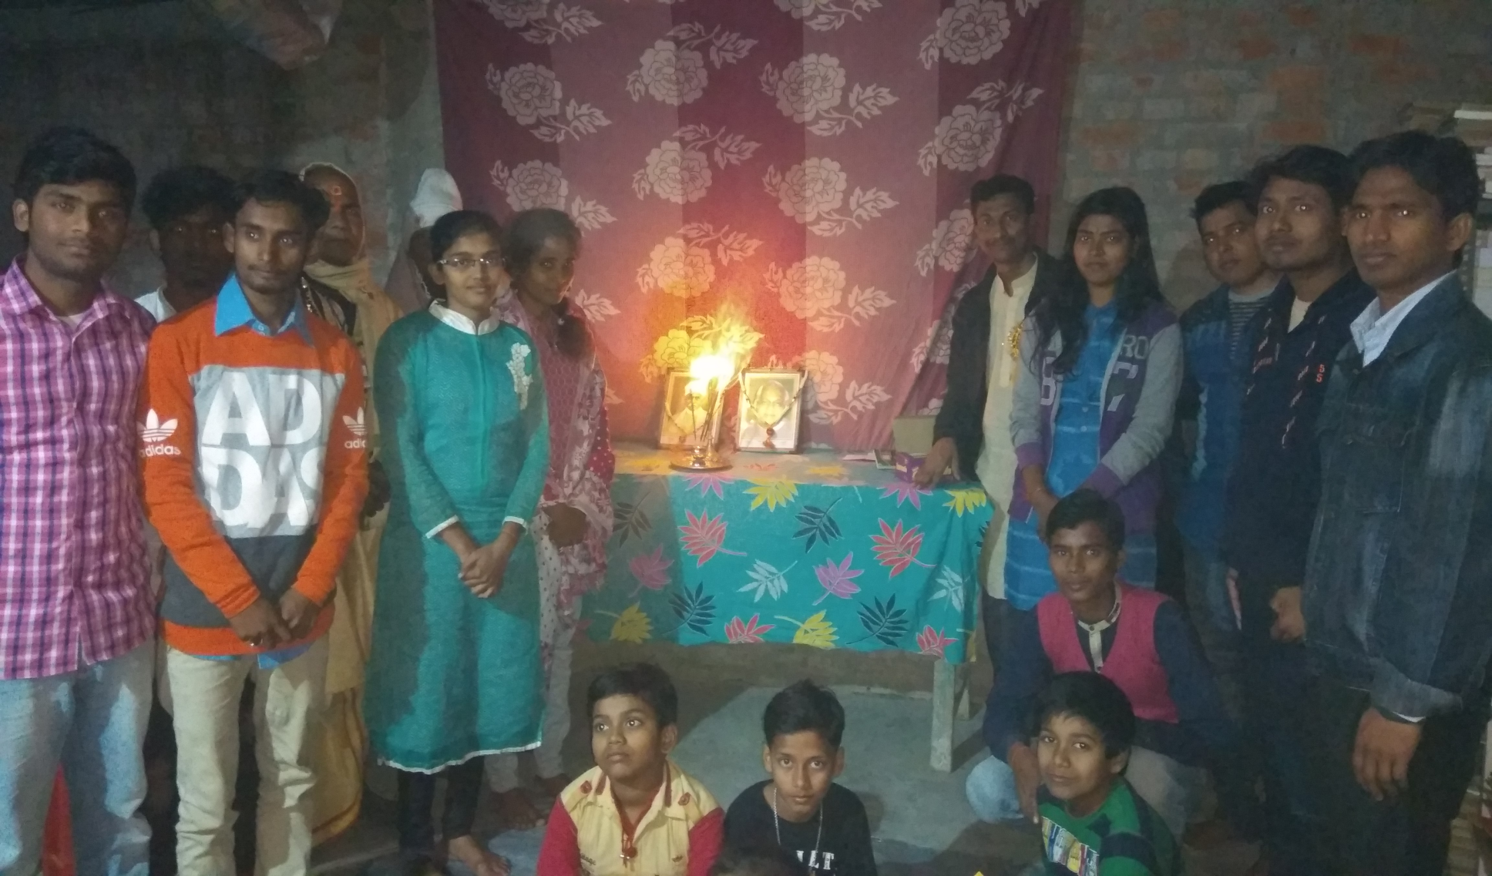
Birthday Celebration of Vajpayee and Malviya ji
25-12-17

Slide 54
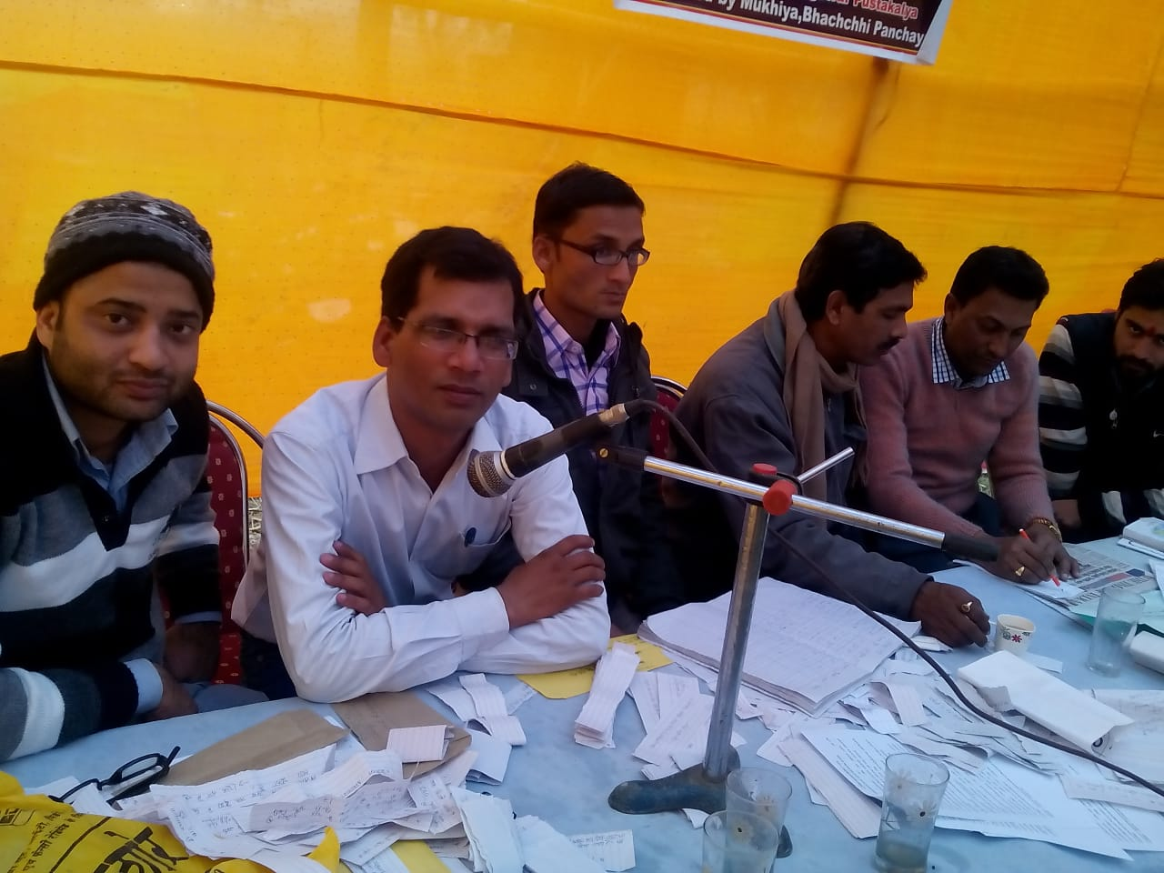
Our busybees

Slide 55

WINNERS OF Quiz Contest 2017

Slide 56

Prize received by Preeti on behalf of her Grand Mother

Slide 57

Quiz Contest-2017

Slide 58

zara Hat kay

Slide 59

Prize Received by ishwar

Slide 60

Prize as Quiz Master Prem

Slide 61

Quiz Contest-2018 SPEECH BY MENTOR ABHAY SIR

Slide 62

A career Counseling session by MENTOR Amitabh ji

Slide 63

Members of the Library IN FREE MOOD MEETING IN 2019

Slide 64

Learners in our Library

Slide 65

Quiz Awareness campaign by members of Library in 2019

Slide 66

SILVER JUBILEE CELEBRATION QUIZ CONTEST IN 2019

Slide 67

FOUNDER SPEECH
SILVER JUBILEE CELEBRATION

Slide 68

PRIZE DISTRIBUTION BY MLC MADHUBANI WITH SANJIV JI
SILVER JUBILEE CELEBRATION

Slide 69

PRIZE DISTRIBUTION BY PRINCIPAL REGIONAL SCHOOL
SILVER JUBILEE CELEBRATION

Slide 70

GUEST AND AUDIENCE
SILVER JUBILEE CELEBRATION

Slide 71

SPEECH BY MENTOR MD. KAMRAN SIR
SILVER JUBILEE CELEBRATION

Slide 72

HONOUR TO MLC BY FOUNDER
SILVER JUBILEE CELEBRATION

Slide 73

PUBLISHed IN NEWS PAPER
SILVER JUBILEE CELEBRATION

Slide 74

ONLINE COMPETITION 2020

Slide 75


ONLINE COMPETITION 2020

Slide 76
ACHIEVERS
of
DHL

Slide 77

Md. MAHTAB ANSARI
BDO KEOTI ,DARBHANGA

Slide 78

MR. Ashutosh Jha
AGM, SBI, MAHARASHTRA

Slide 79

MR. KUNDAN KUMAR
Senior Manager
Punjab and Sind Bank Zonal office Model Town Jalandhar Punjab

Slide 80

MR. PRAKASH KUMAR
SENIOR ACCOUNTANT
BANK OF MAHARASHTRA MADHUBANI

Slide 81

Md. Shamshir
PGT( GEOGRAPHY)
G.M.S.S. HiGHER SECONDARY SCHOOL MADHUBANI

Slide 82

MR. BHARAT BHUSHAN
OFFICER BANK OF MAHARASTRA

Slide 83
AND
MANY
MORE

