Slide 1

Dr. Hedgewar pustakalay sah sewa samitee Laxminagar,
Bhachhi
PRESENTS

Slide 2
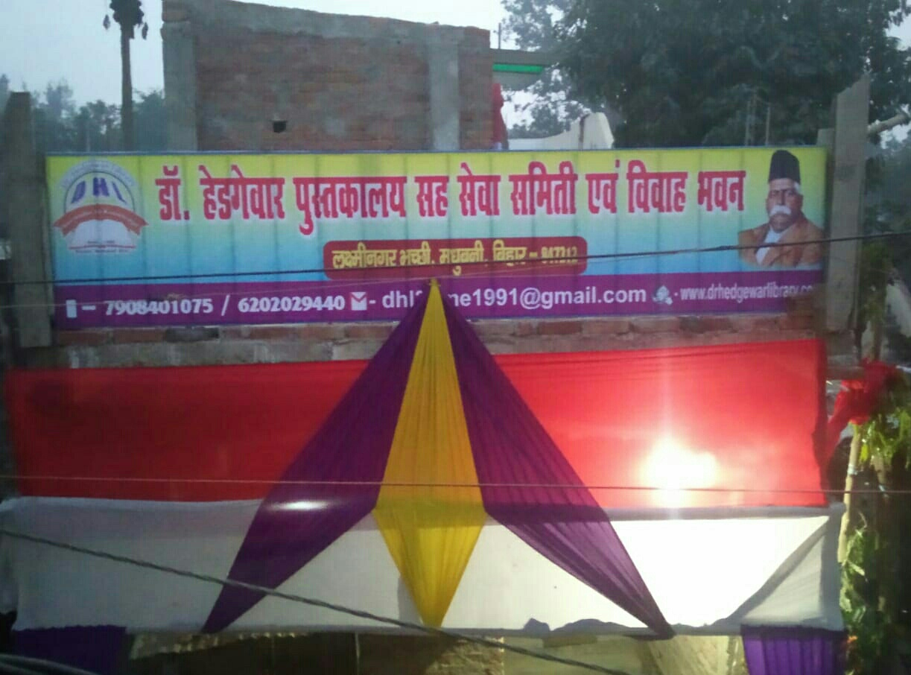
A brief look INTO
Activities from 1991 to 2023

Slide 3
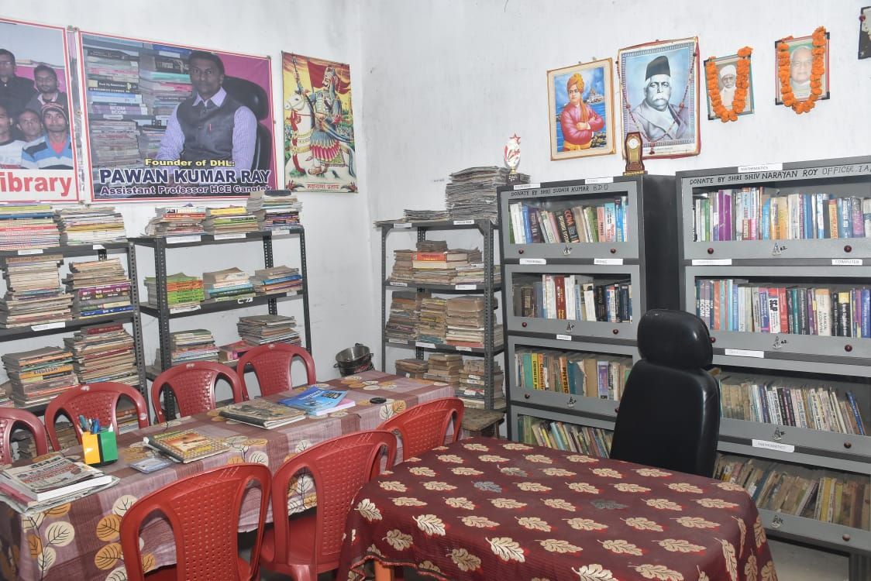
LIBRARY

Slide 4
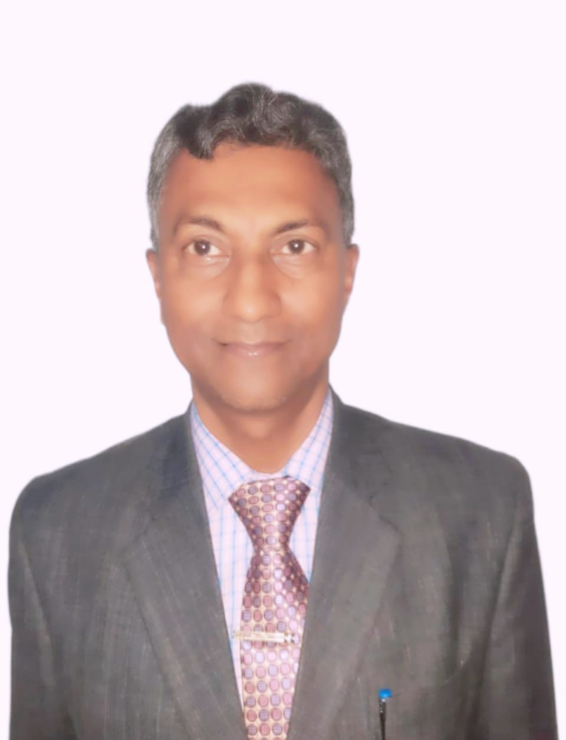
Founder:
Pawan Kumar Ray
ASSISTANT PROFESSOR

Slide 5
Founder members:
1.Lalit Kumar (Business Man)
2.Pradeep Ray (Hardware Engineer)
3.Mahesh Kumar (Business Man)
4.Hiralal Ray (Business Man)

Slide 6
NEW
COMMITTEE MEMBERS

Slide 7
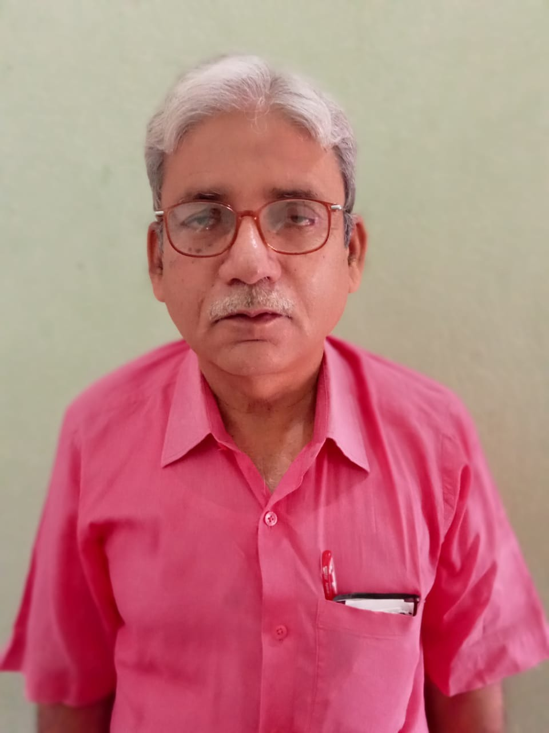
MD. KAMRAN
(PRESIDENT )

Slide 8
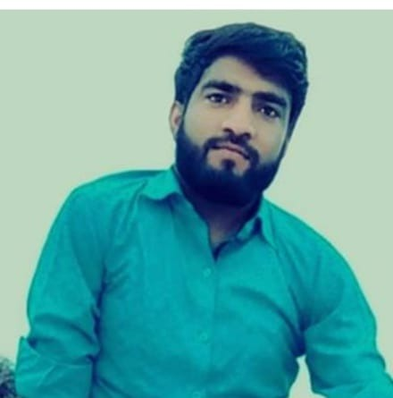
MR. Mahavir kumar
(Secretary)

Slide 9
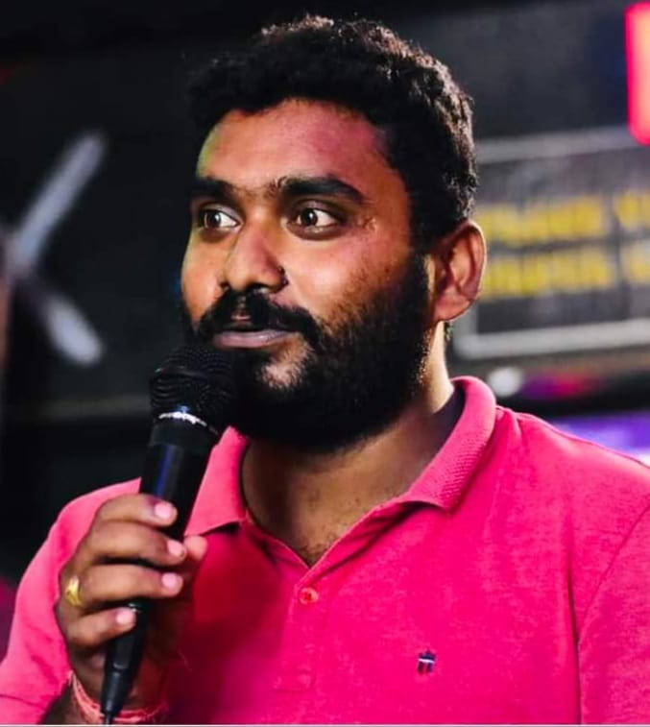
MR. ABHIJIT SINGH
(program & media coordinator)

Slide 10
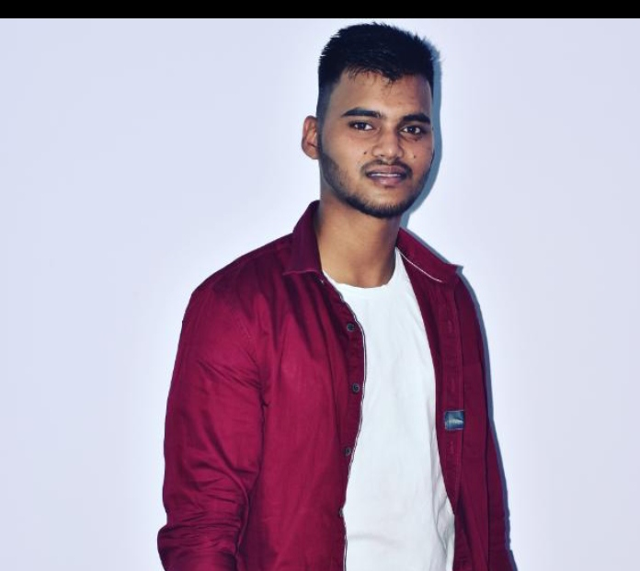
MR. ISHWAR KUMAR
(Treasurer)

Slide 11
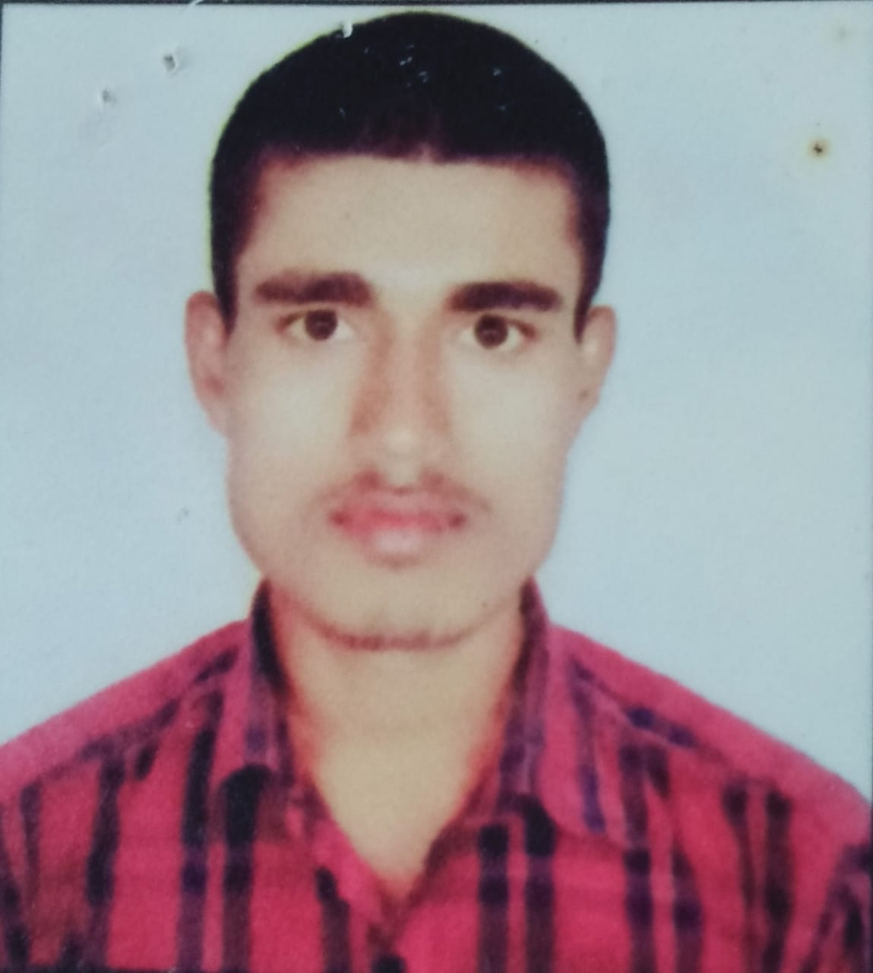
MR. Pappu Kumar kusiyait
(coordinator)

Slide 12
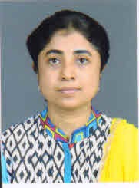
Ms.Pallavi Bhowmik
Co-ordinator of e-MAGAZINE

Slide 13
Mentors
Dr. Hedgewar Library

Slide 14
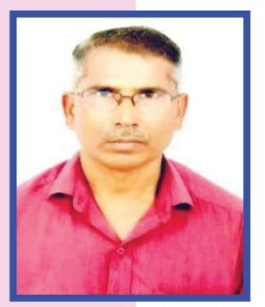
Shri. Shiv Narayan Ray
Warrant Officer, Indian Air force

Slide 15
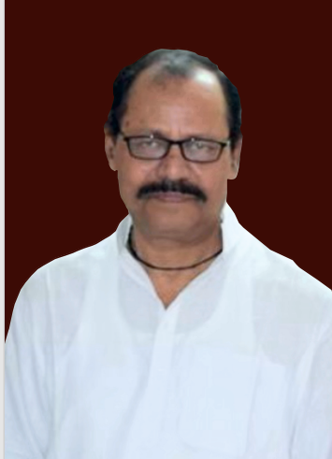
late Arun kumar SINHA
RETD. BANK OFFICER SBI

Slide 16
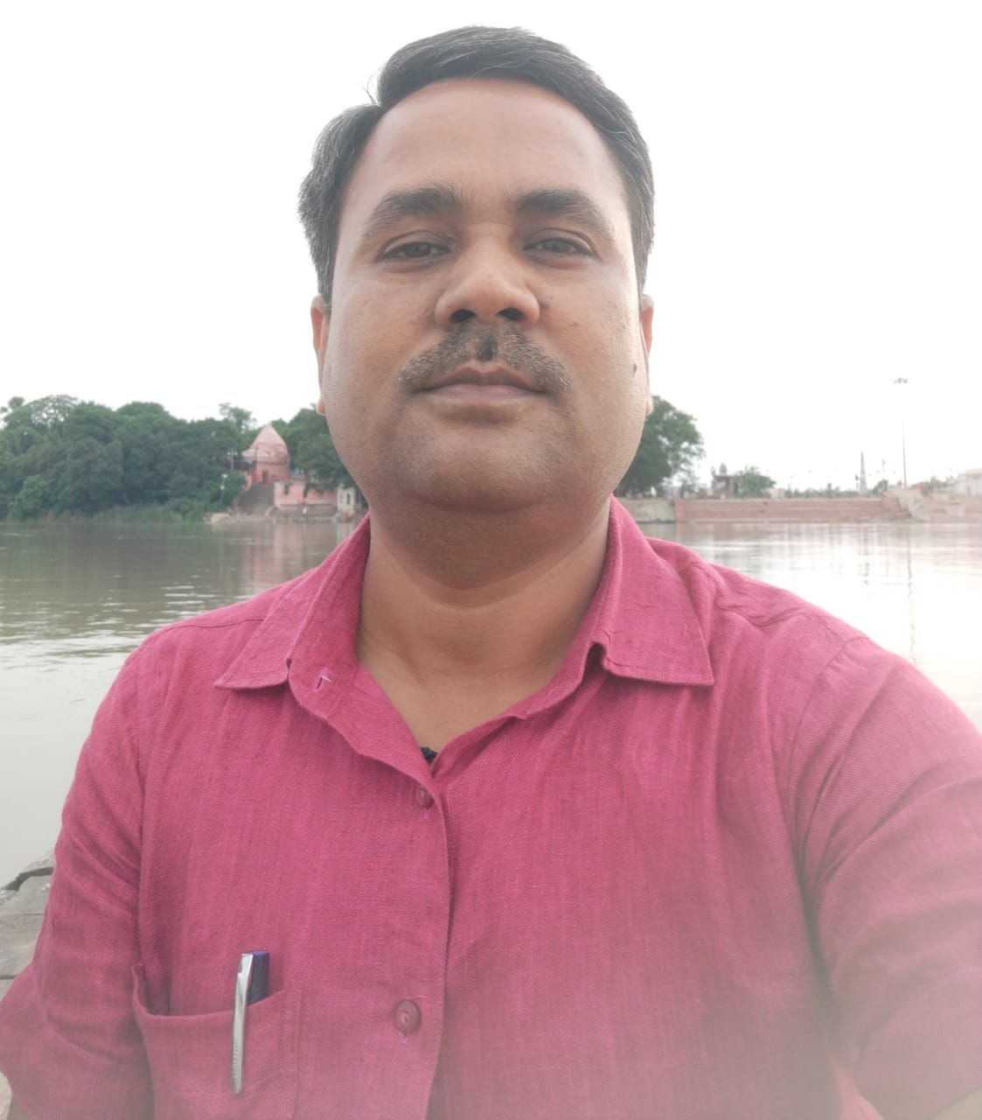
MR. Abhay kumar jha
Reservation Supervisor (HQ), DRM Office, Danapur, Patna, Bihar.

Slide 17
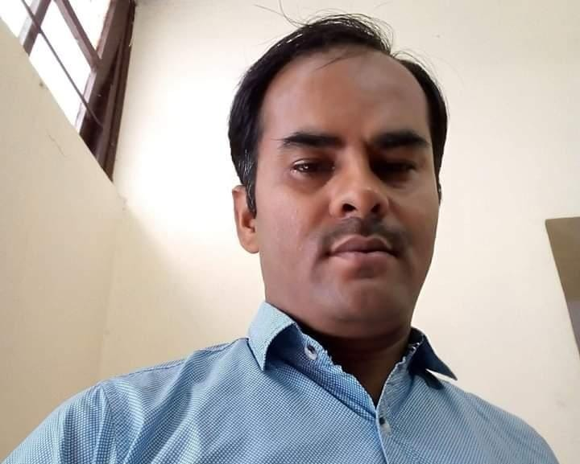
MR. Sanjeev Kumar
Assistant Section Officer Jharkhand Secretariat, Ranchi

Slide 18
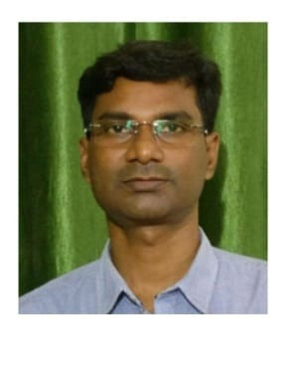
MR. Sudhir Kumar
B.D.O. MARHAURA, SARAN, BIHAR

Slide 19
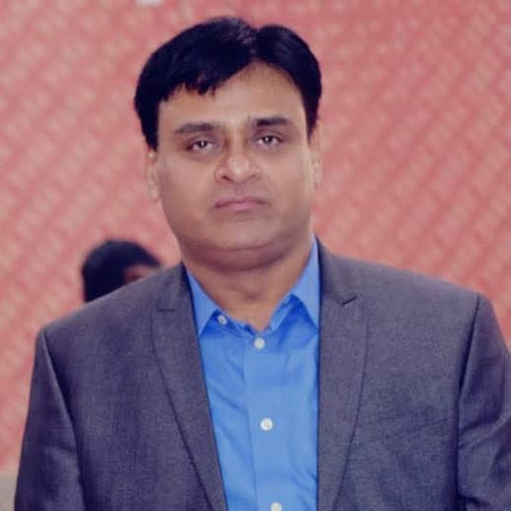
MR. Kishore Kumar
Zonal Head – North- AIB DCB Bank

Slide 20
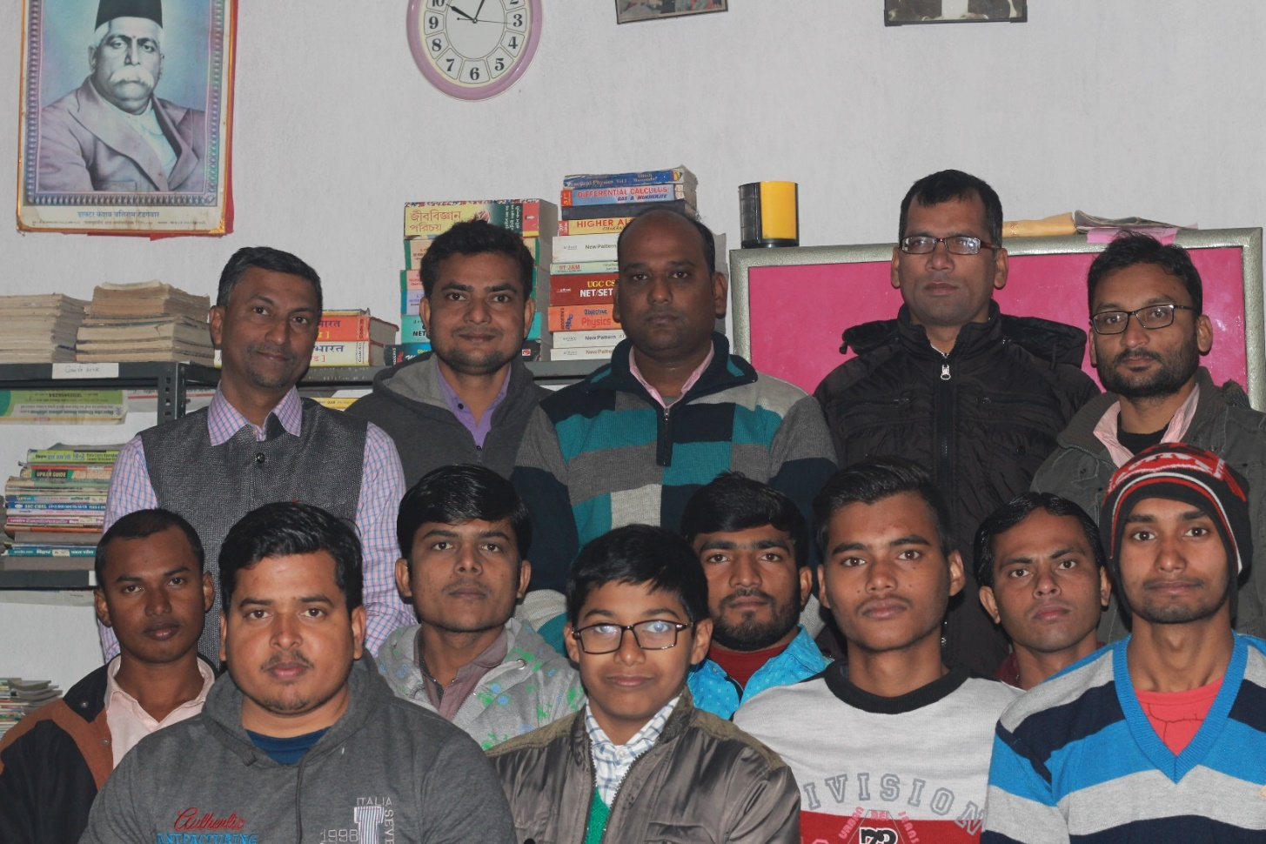
Members of THE Library

Slide 21
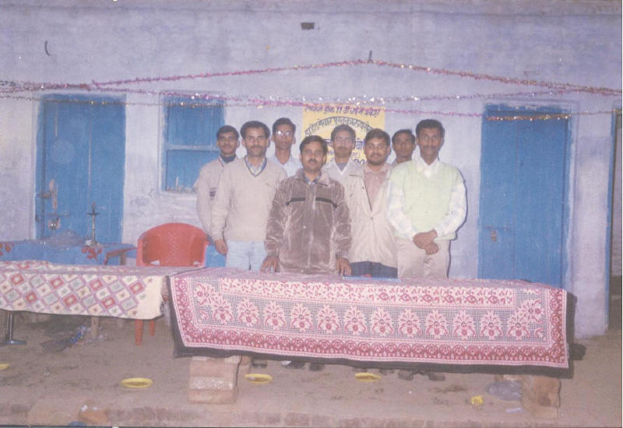
Our Earliest members

Slide 22
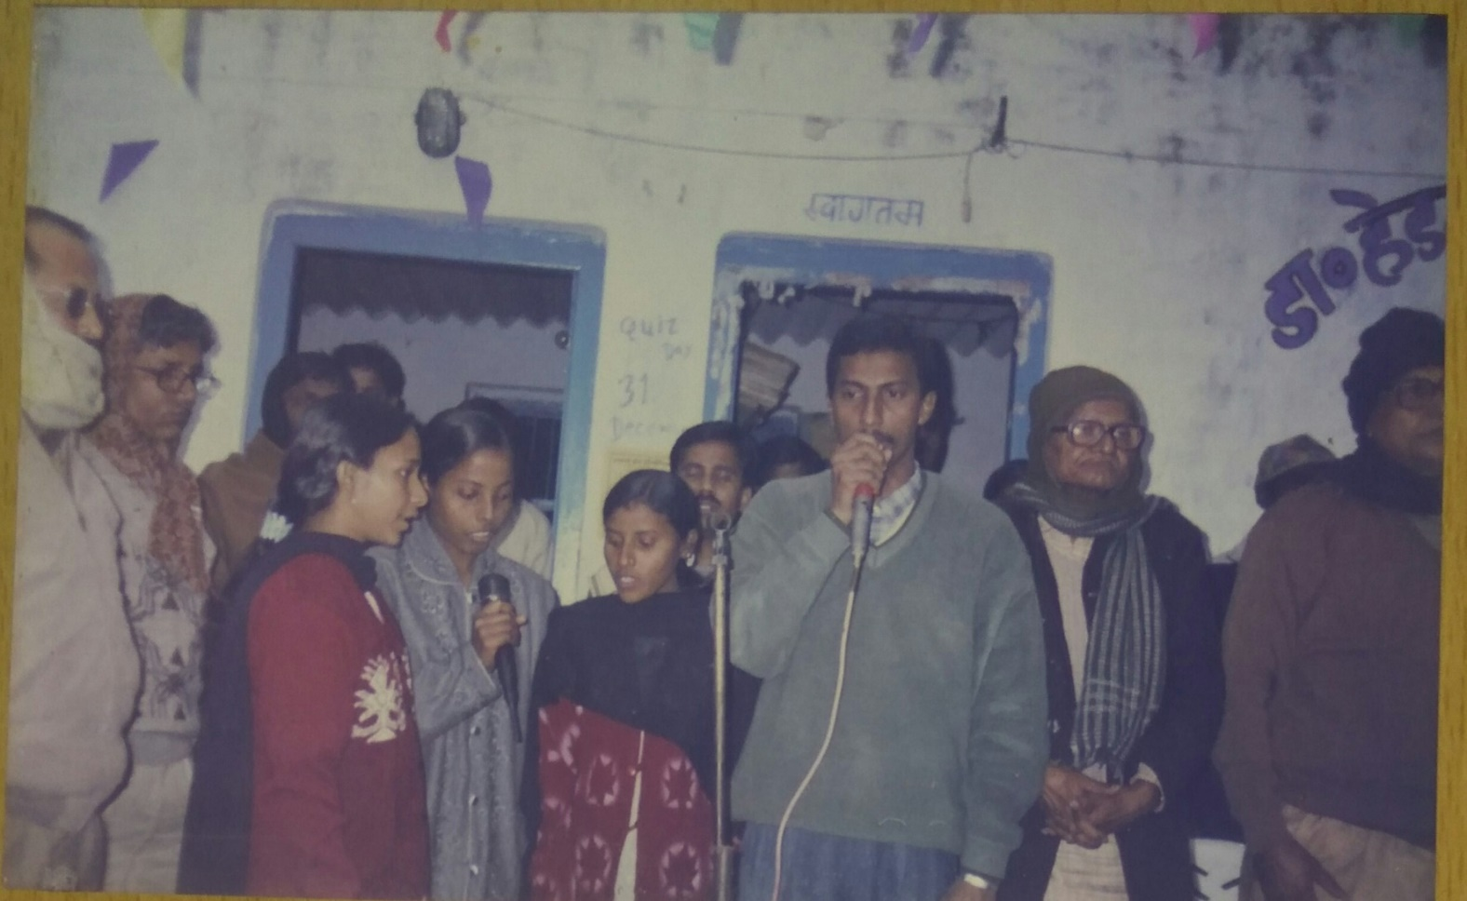
INAUGURAL Quiz contest in 1995

Slide 23
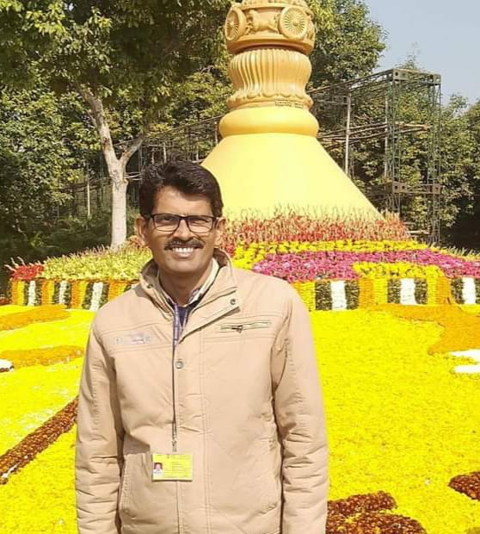
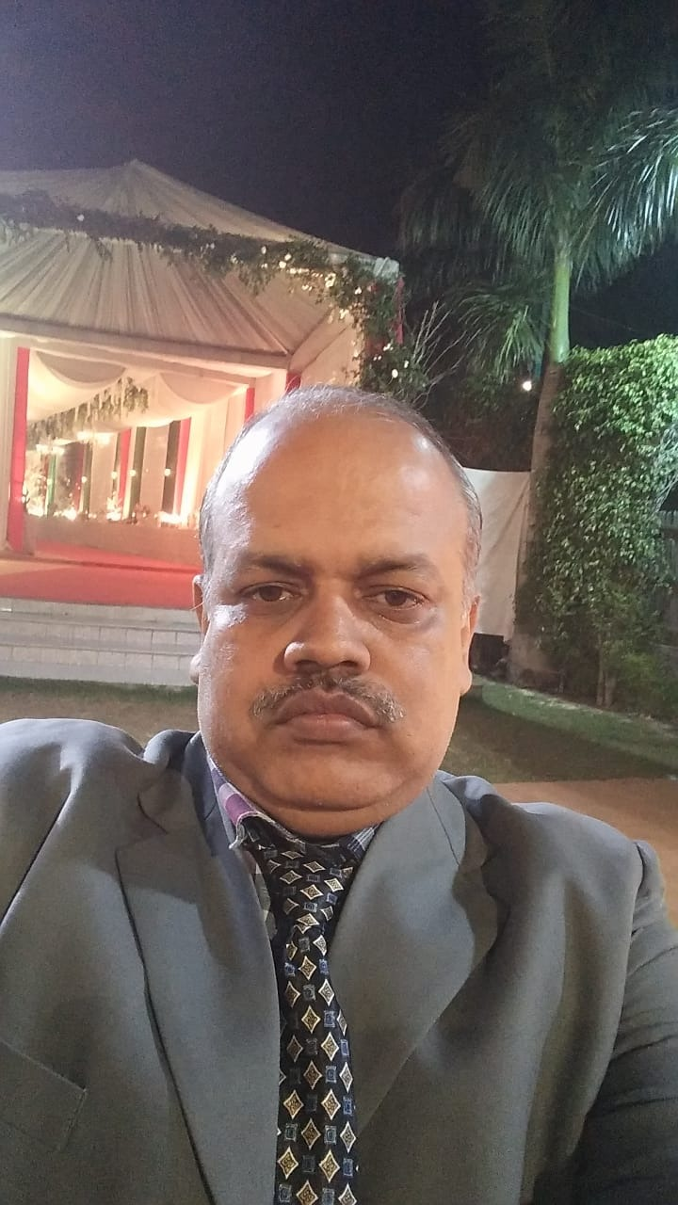
First winner of QUIZ CONTEST
MR. AMITABH PRASAD & LATE Shambhu nath Singh

Slide 24
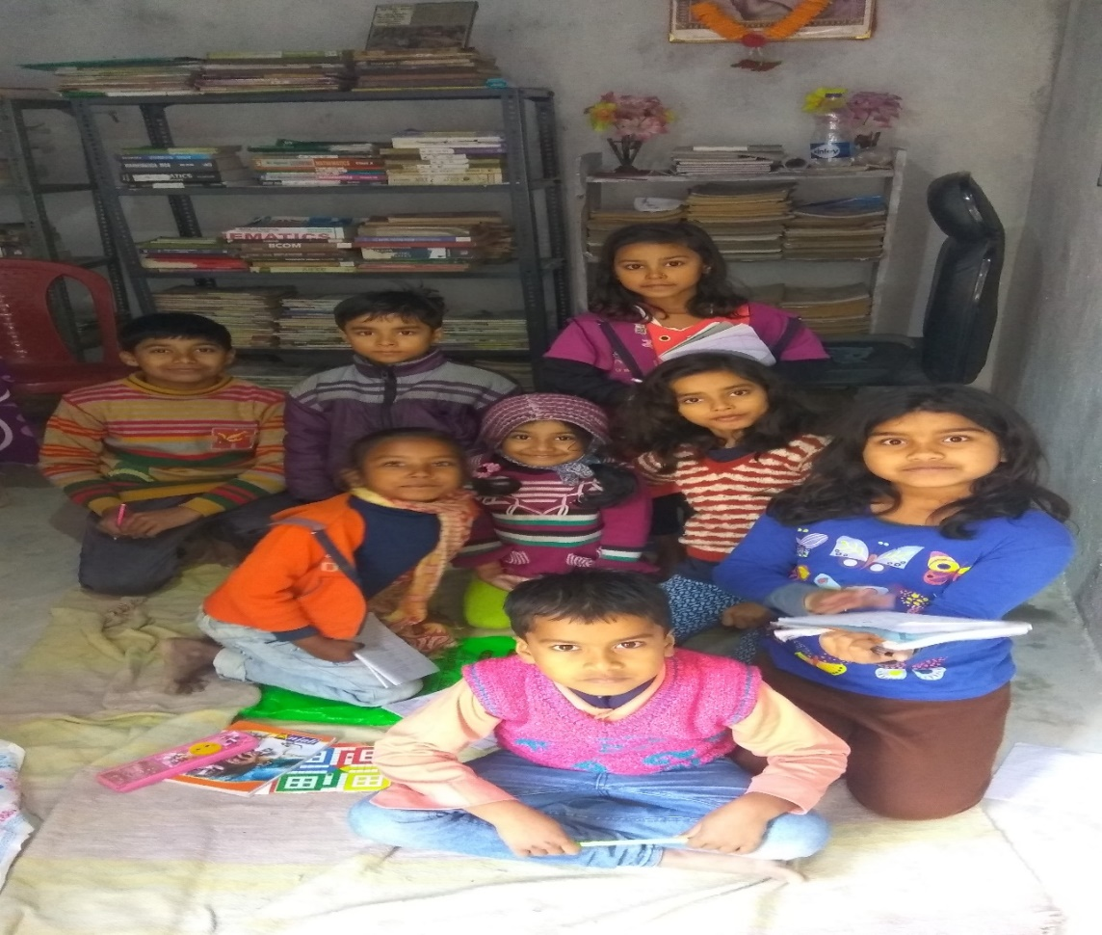
Little Children in our library

Slide 25
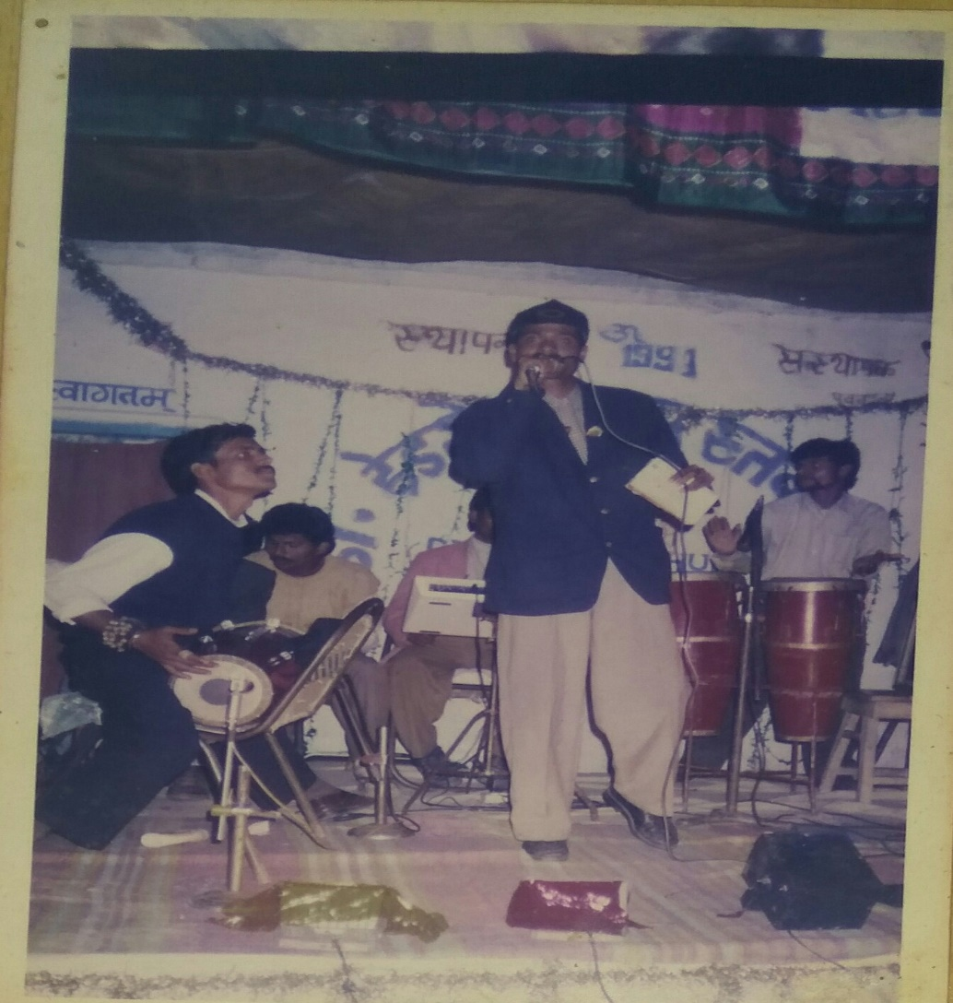
A Cultural program in our library in 1995

Slide 26
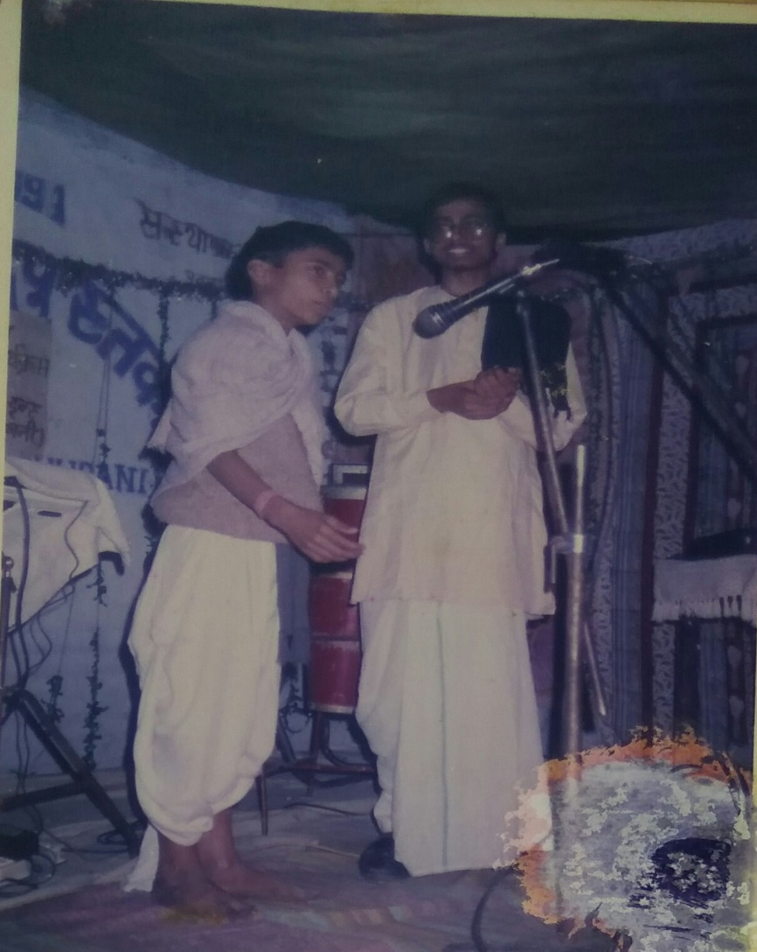
Skit by members

Slide 27
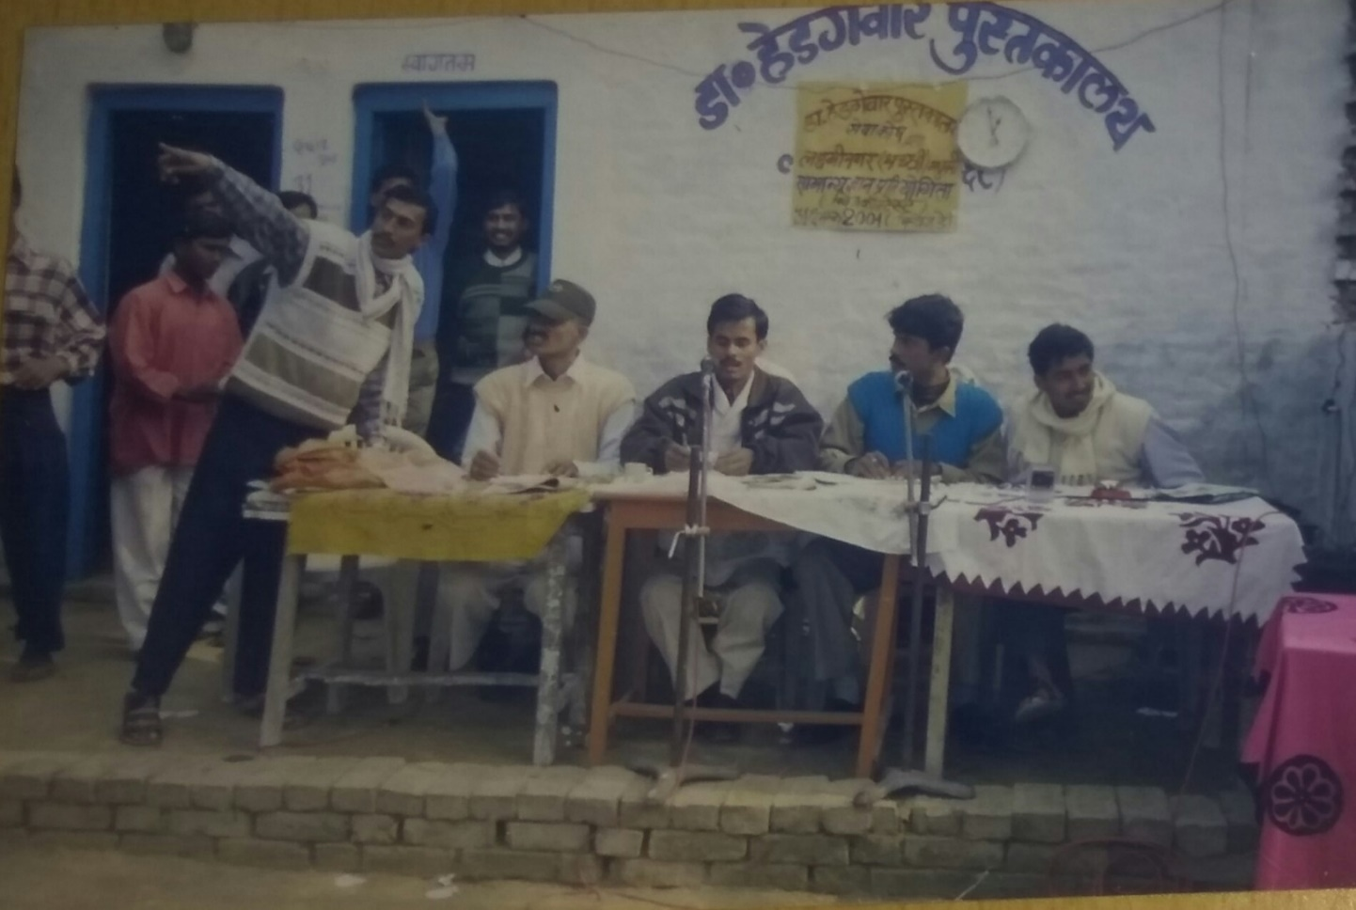
Old is Gold

Slide 28
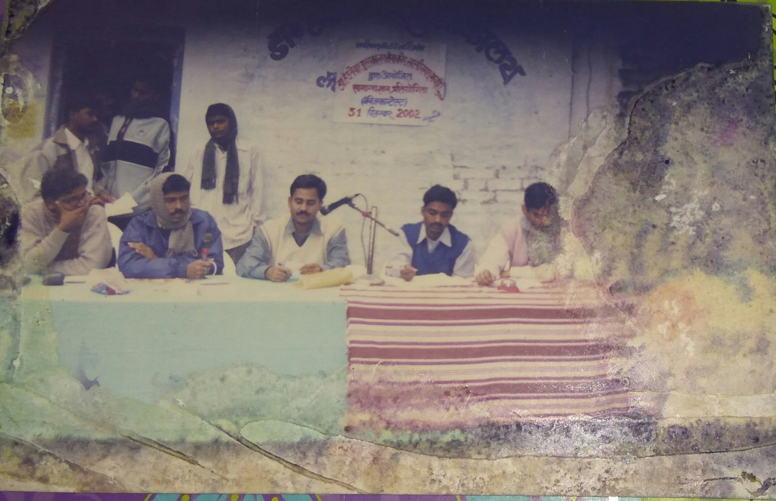
All Organizing committee members are in govt. job Now

Slide 29
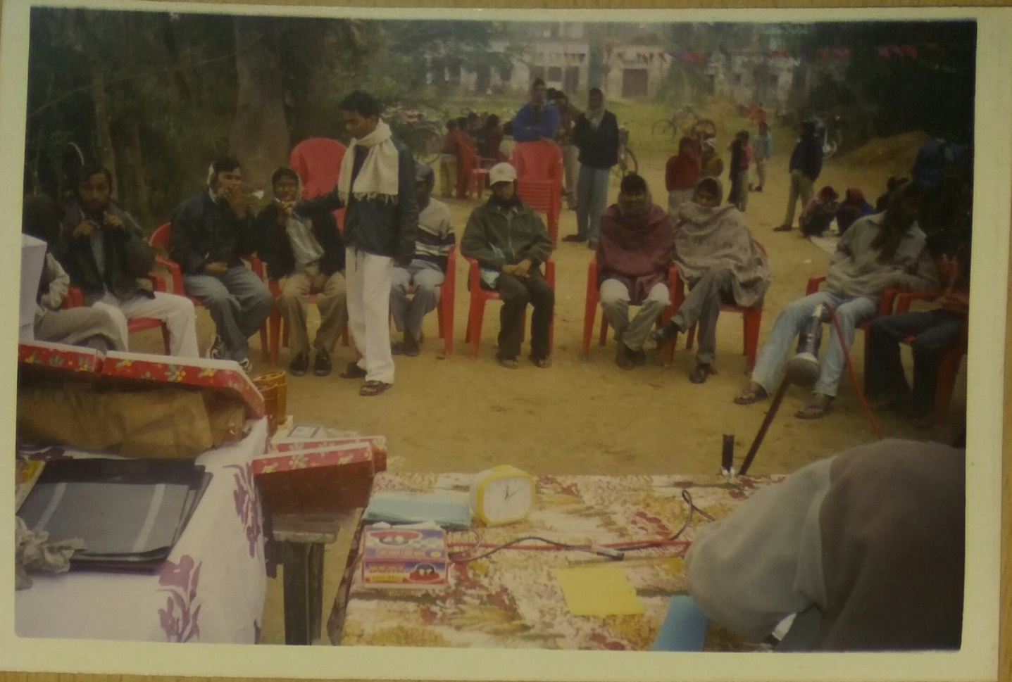
Quiz contest 2003

Slide 30
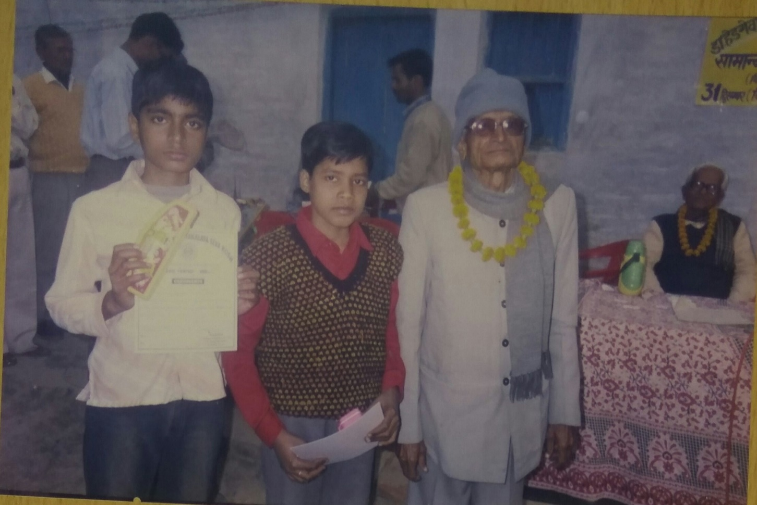
Winners with the MentorS

Slide 31
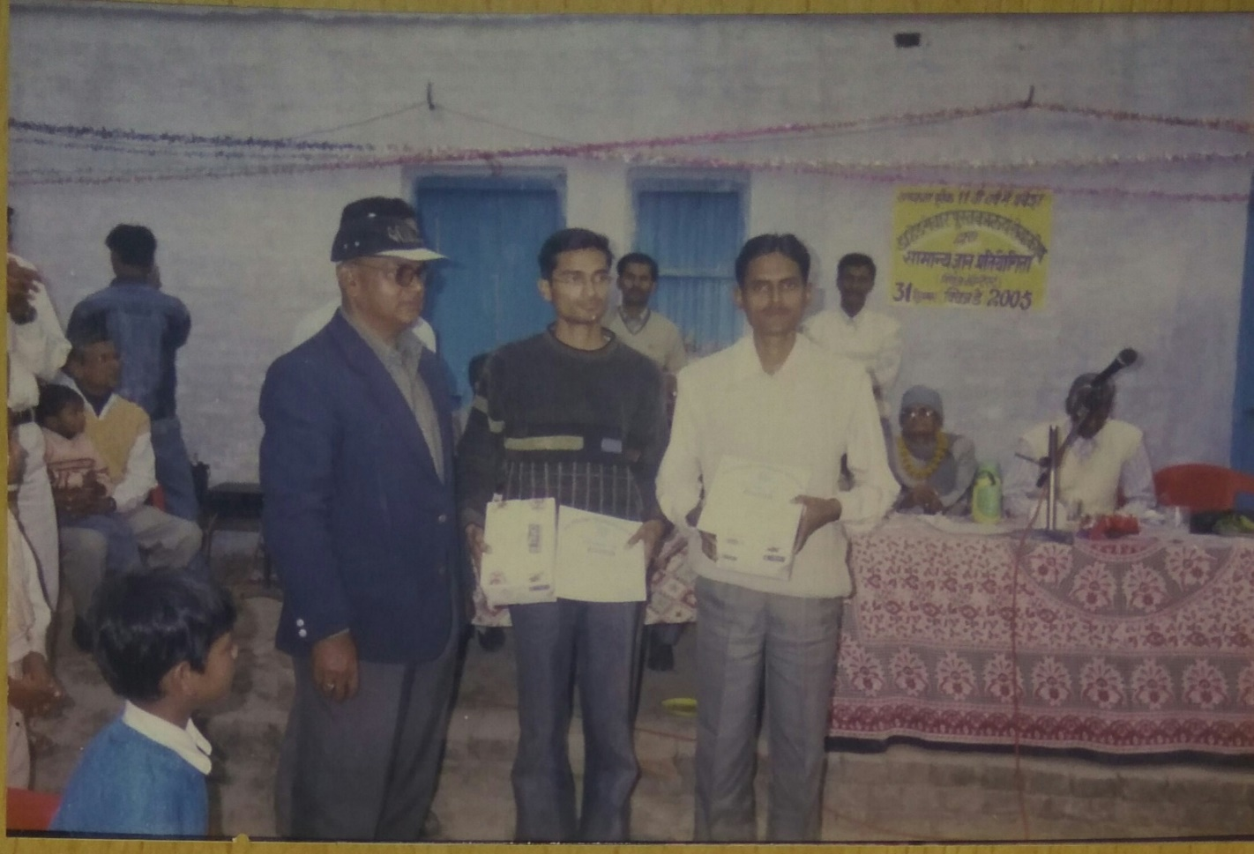
College level winner with guest IN 2005

Slide 32
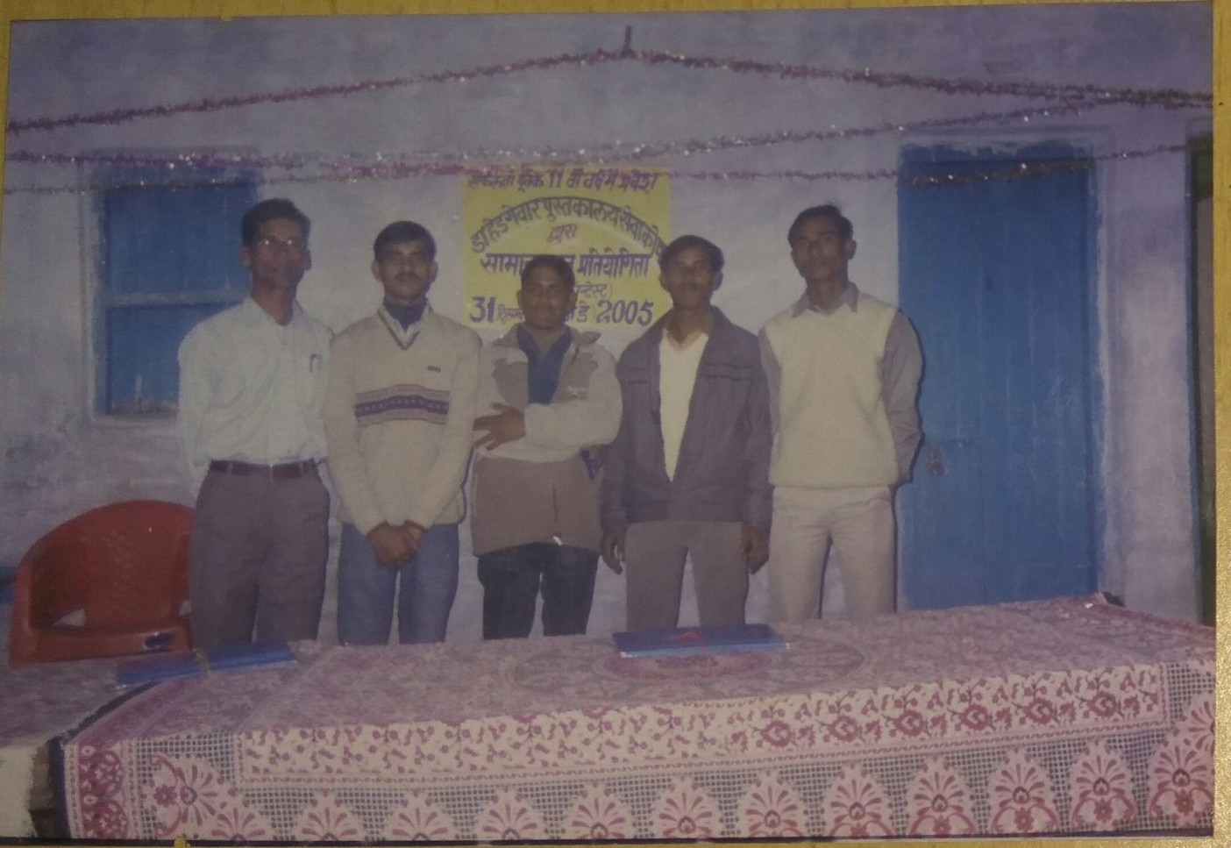
All our members are working in various organizations

Slide 33
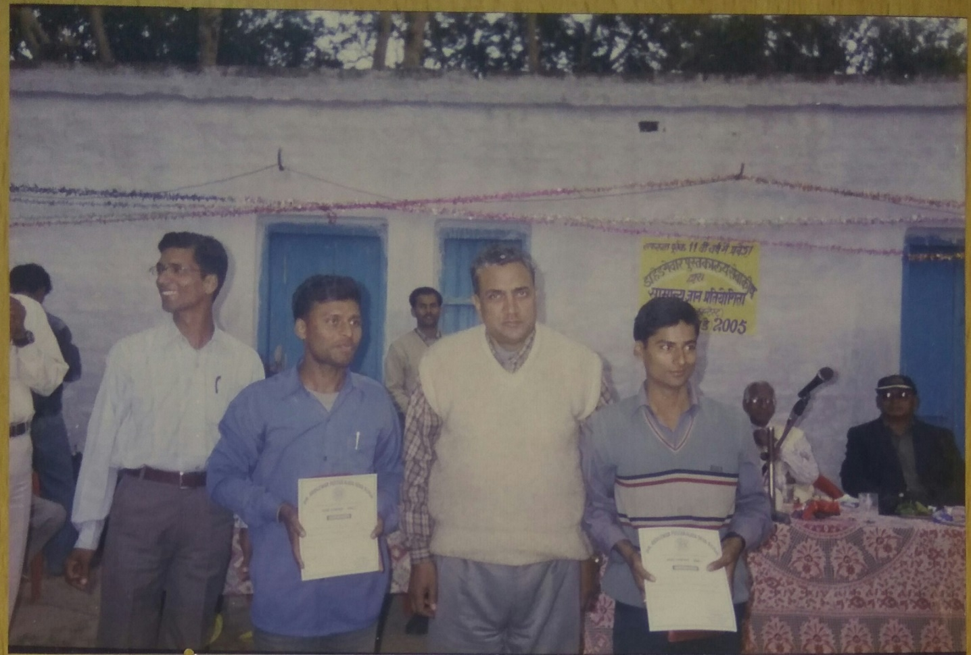
Winners with our Mentor
Late Arun kr. Mishra Sir

Slide 34
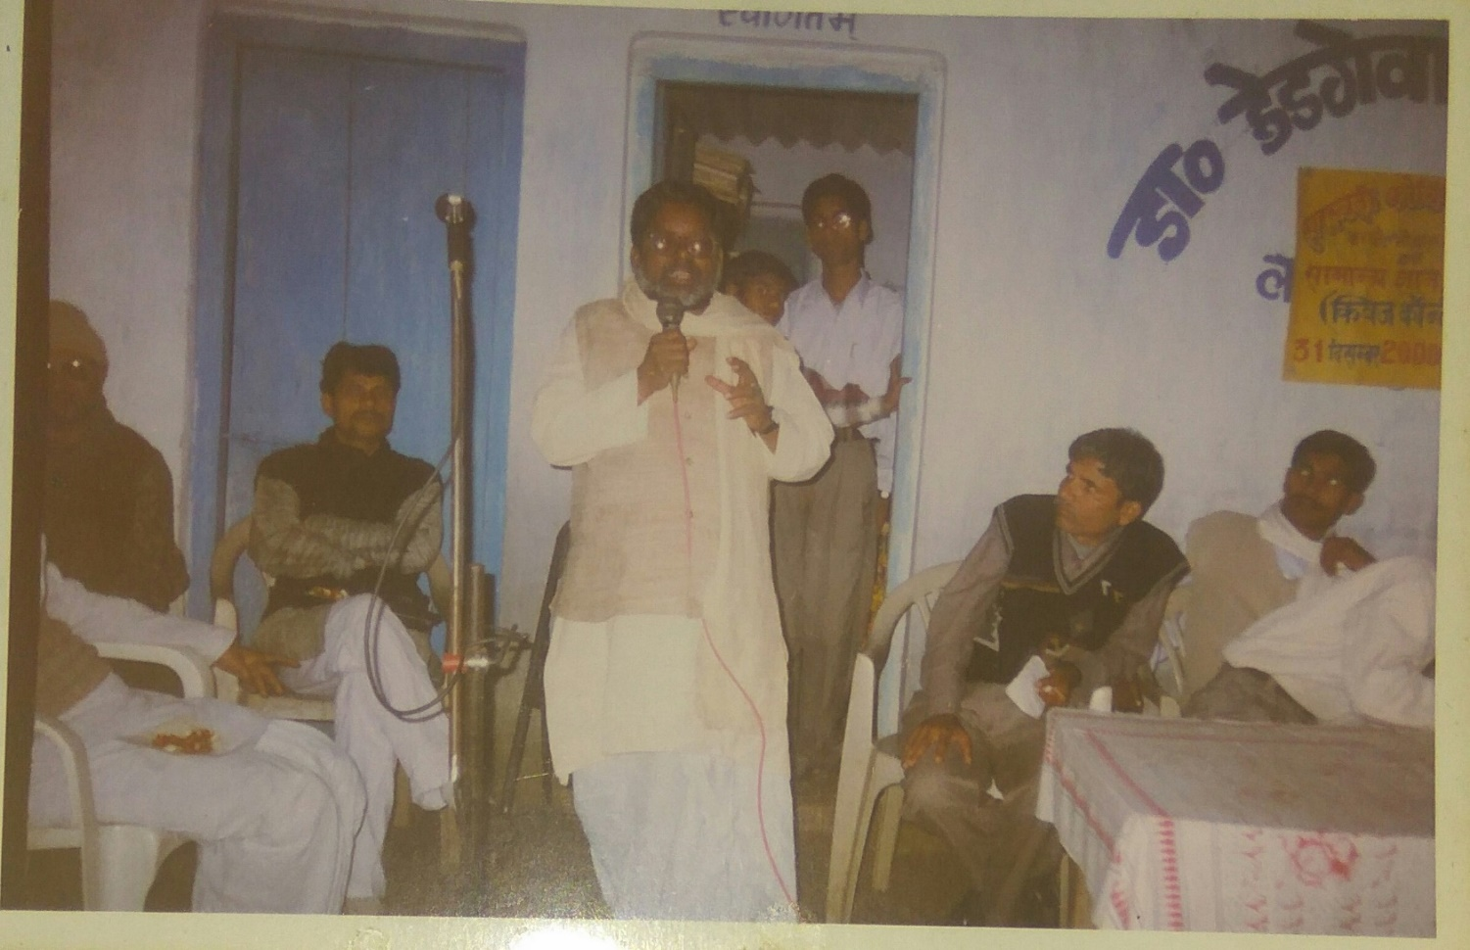
speech by former M.L.A
Shri Ramdev Mahto

Slide 35
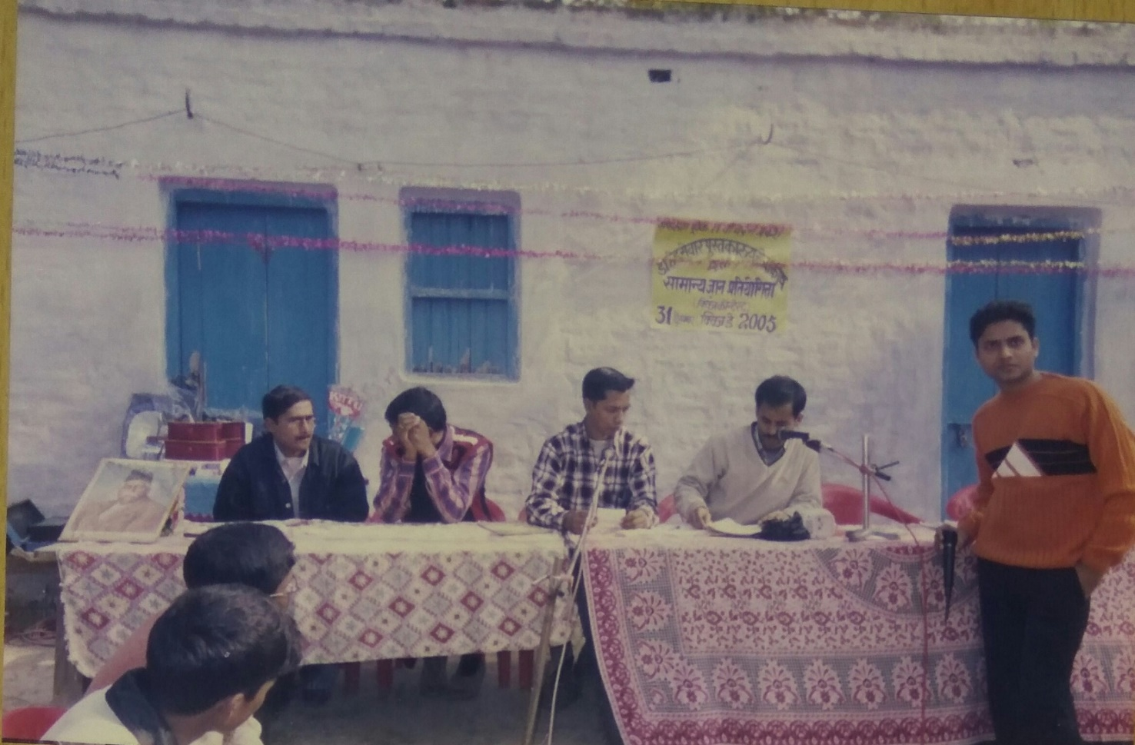
College level round

Slide 36
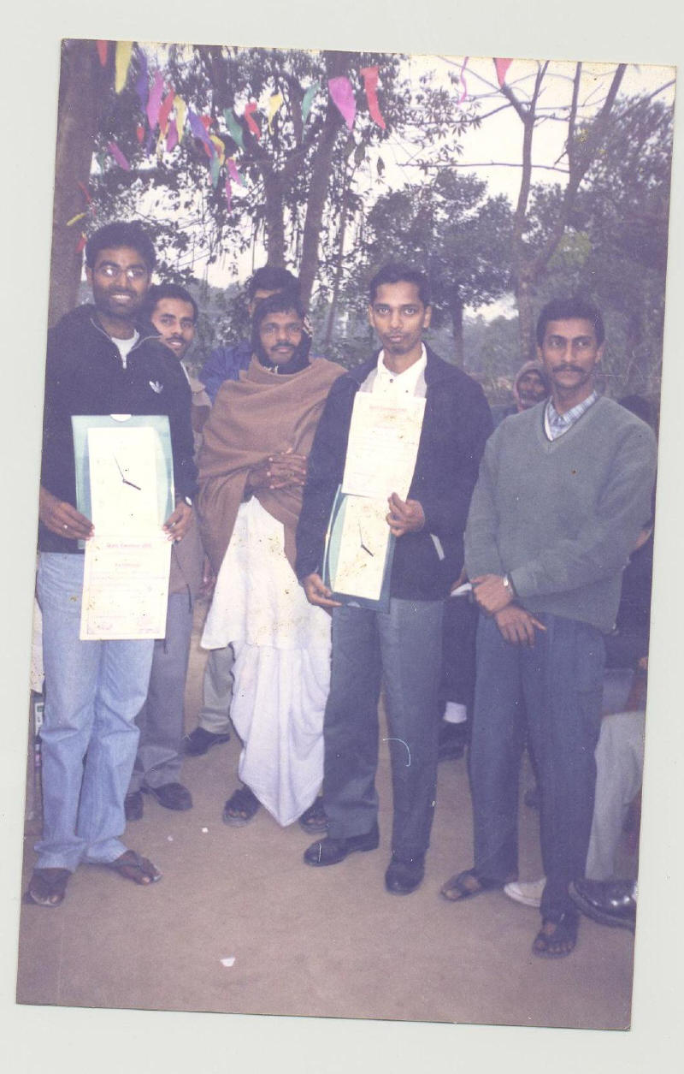
WINNERS OF the QUIZ CONTEST

Slide 37
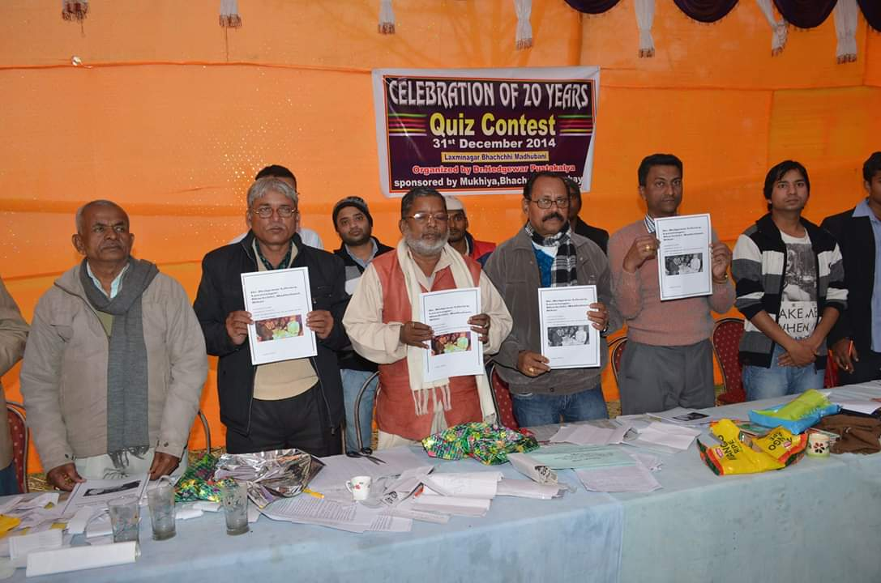
Guest & Members with Booklet 2014

Slide 38
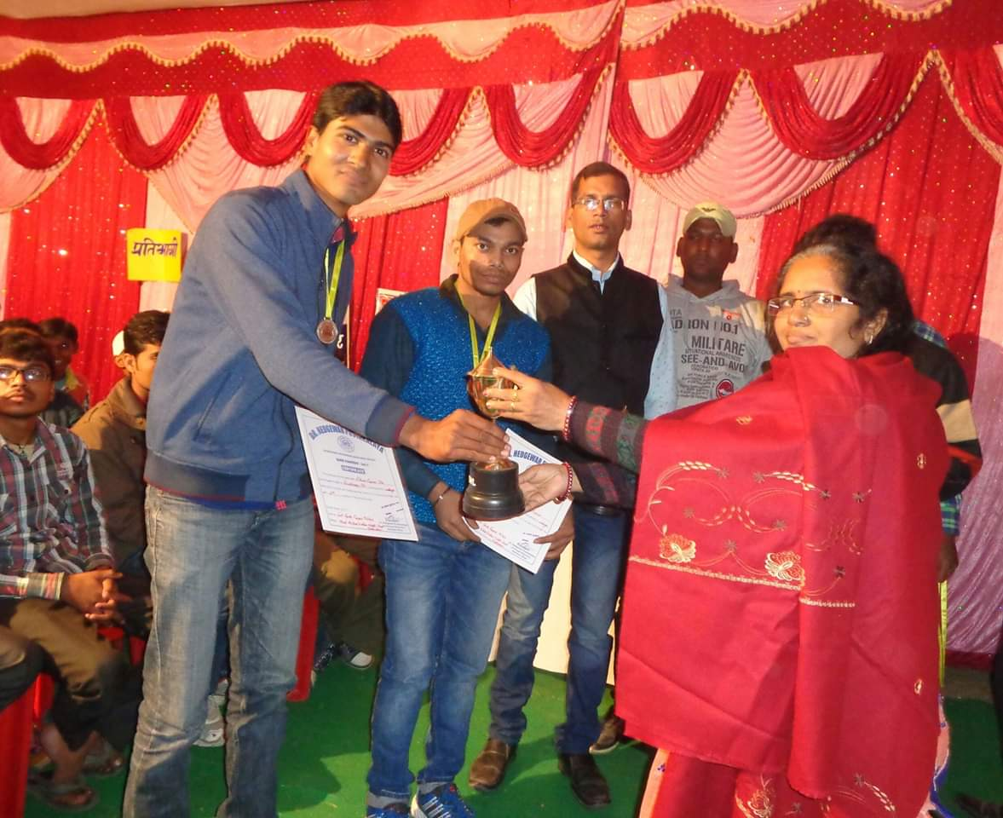
Winners with Smt. Gita Mishra

Slide 39
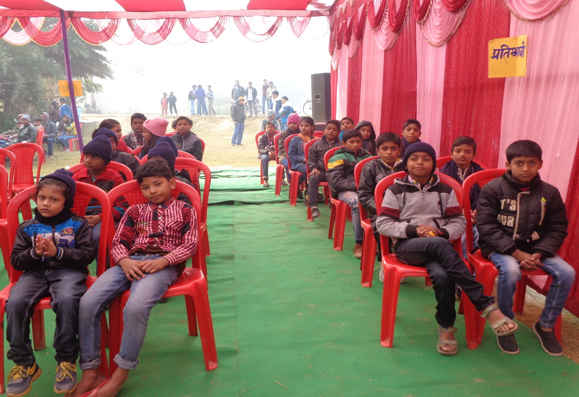
PARTICIPANTS OF QUIZ CONTEST

Slide 40
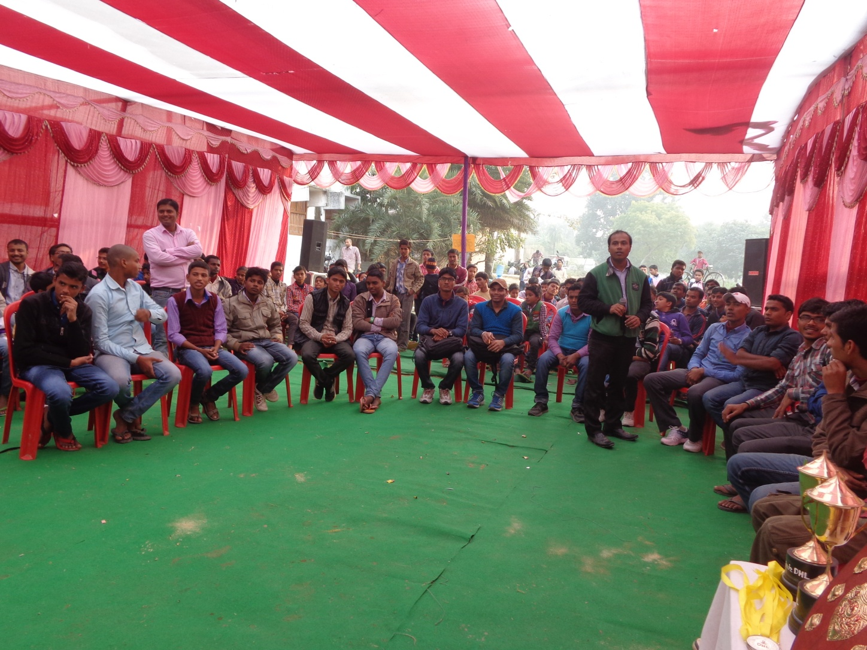
FINAL ROUND OF one of our QUIZ CONTESTs

Slide 41
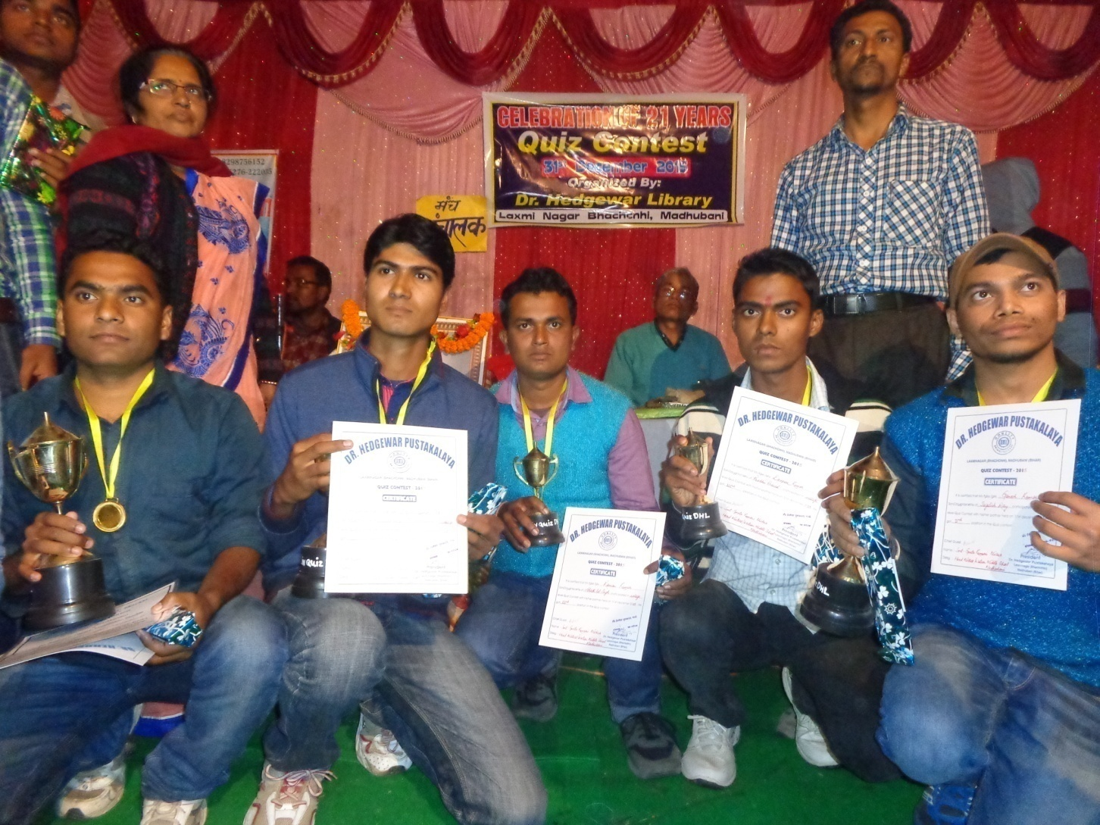
WINNERS of QUIZ CONTEST 2015

Slide 42
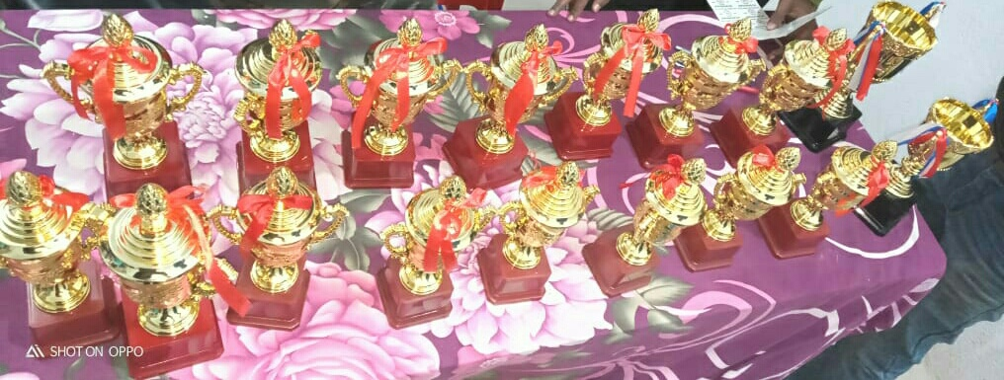
PRIZES IN QUIZ CONTEST

Slide 43
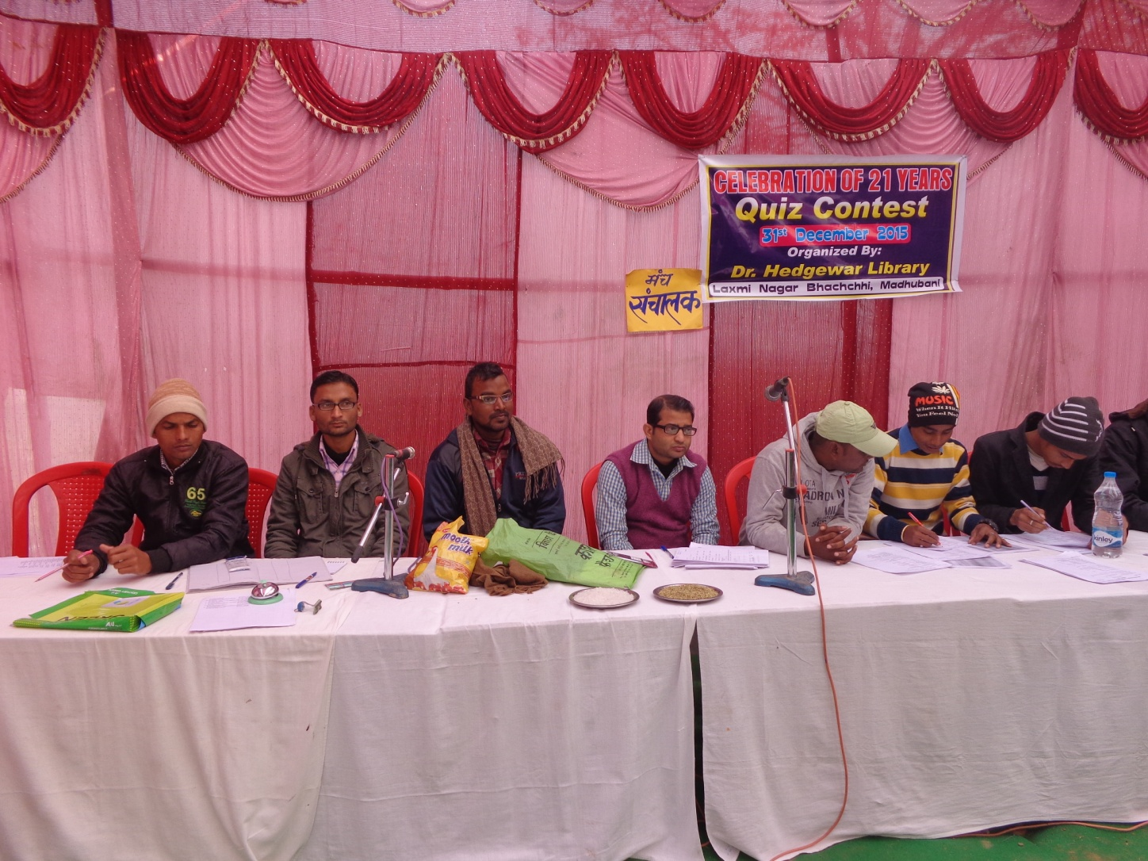
Quiz Contest - 2015

Slide 44
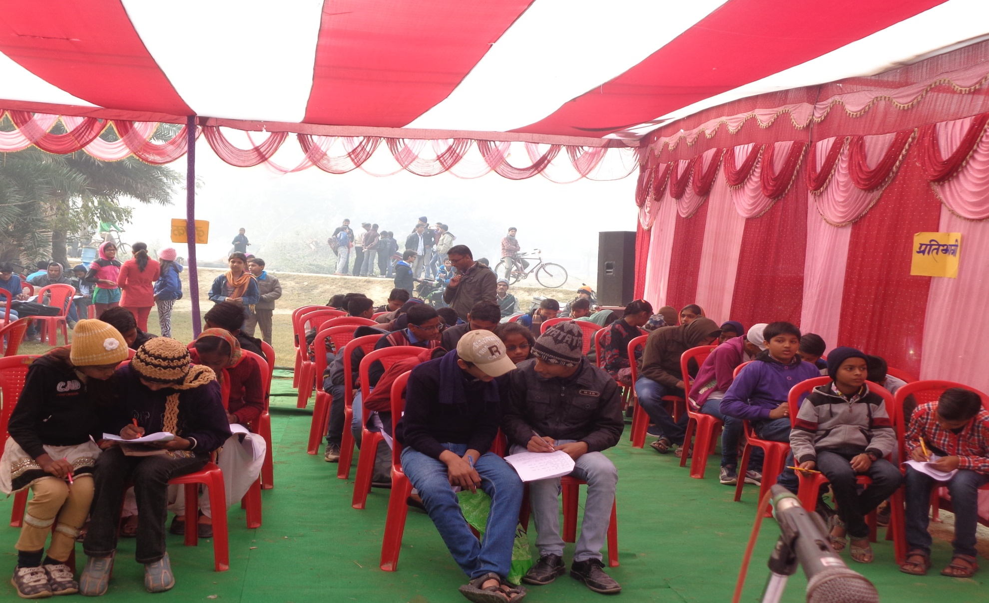
Quiz Contest 2015 (Engaging the audience & contestants alike)

Slide 45
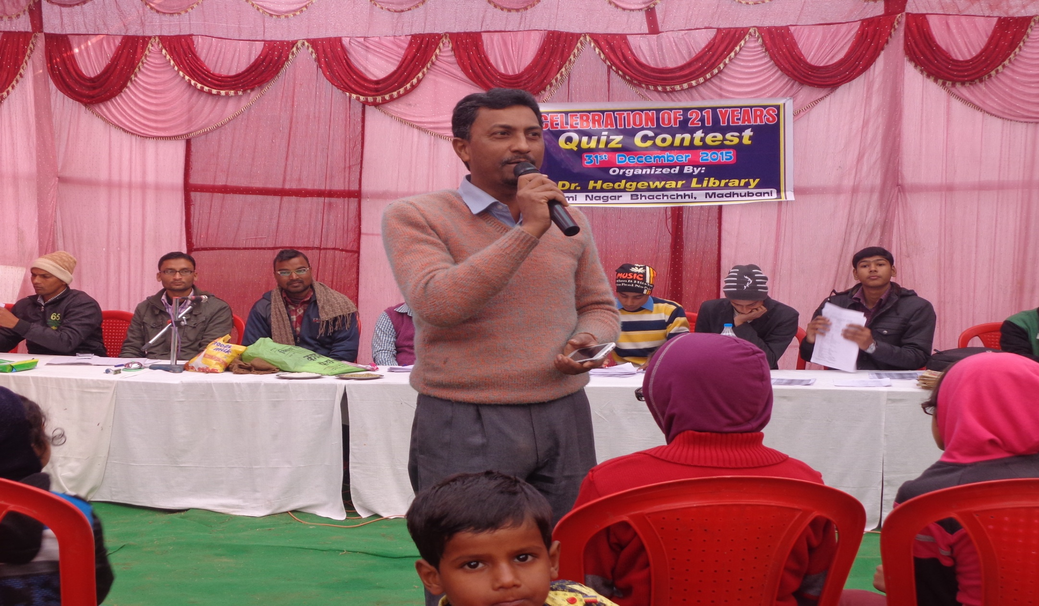
Quiz contest 2015 (Our very own Pawan Sir)

Slide 46
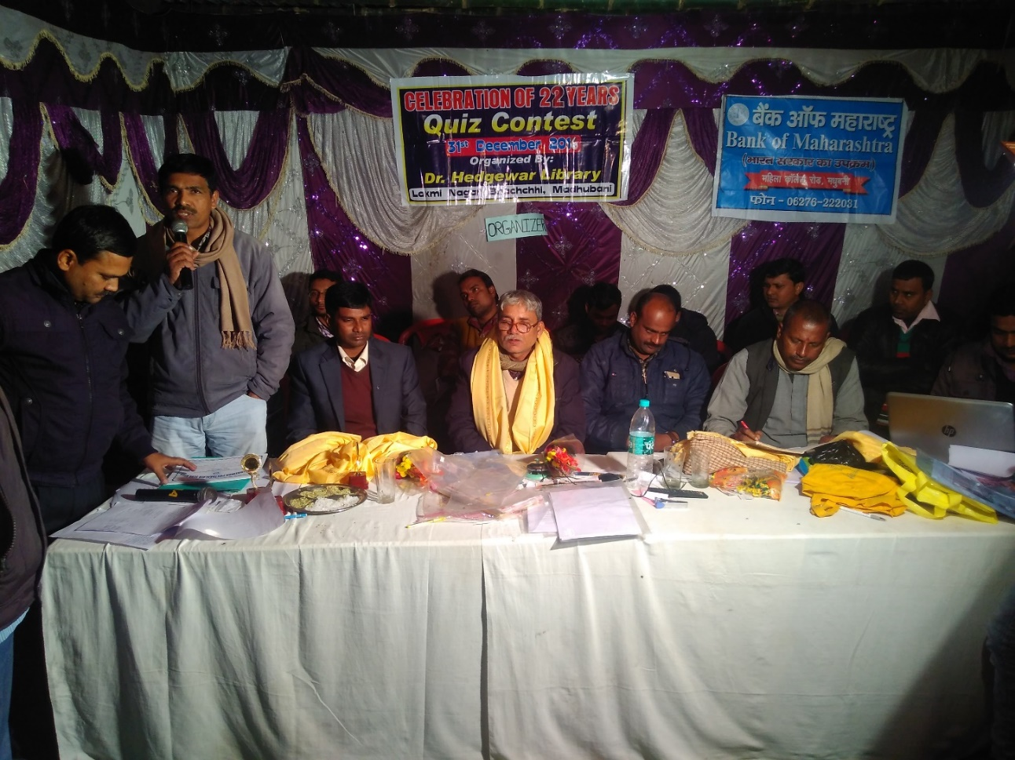
Quiz CONTEST 2016

Slide 47
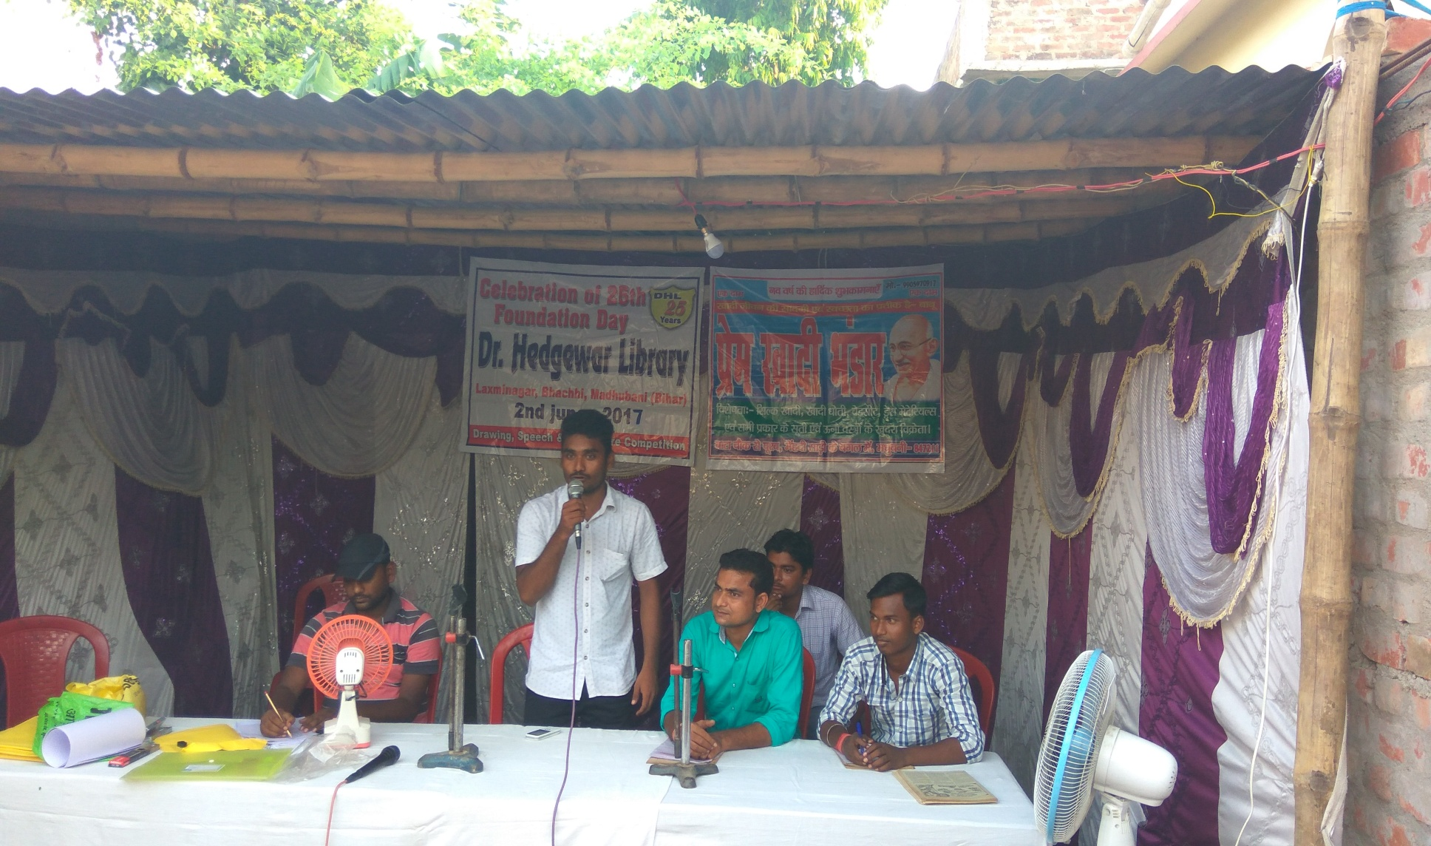
Foundation day, 2nd June 2017

Slide 48
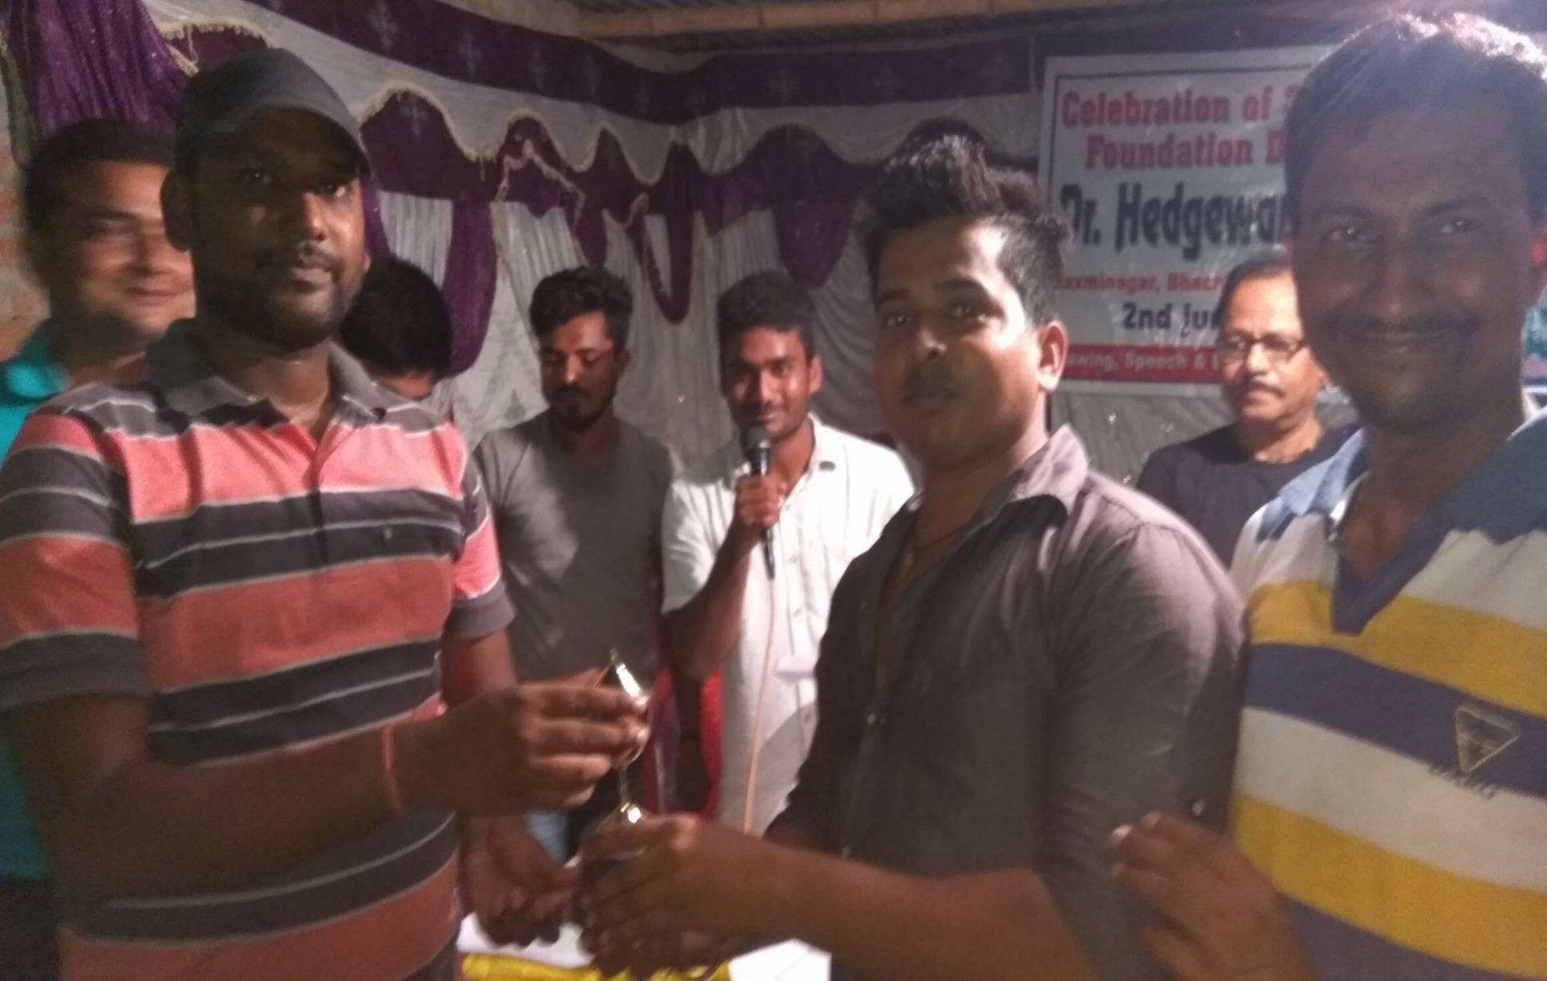
WINNERS Foundation day,2nd June 2017

Slide 49
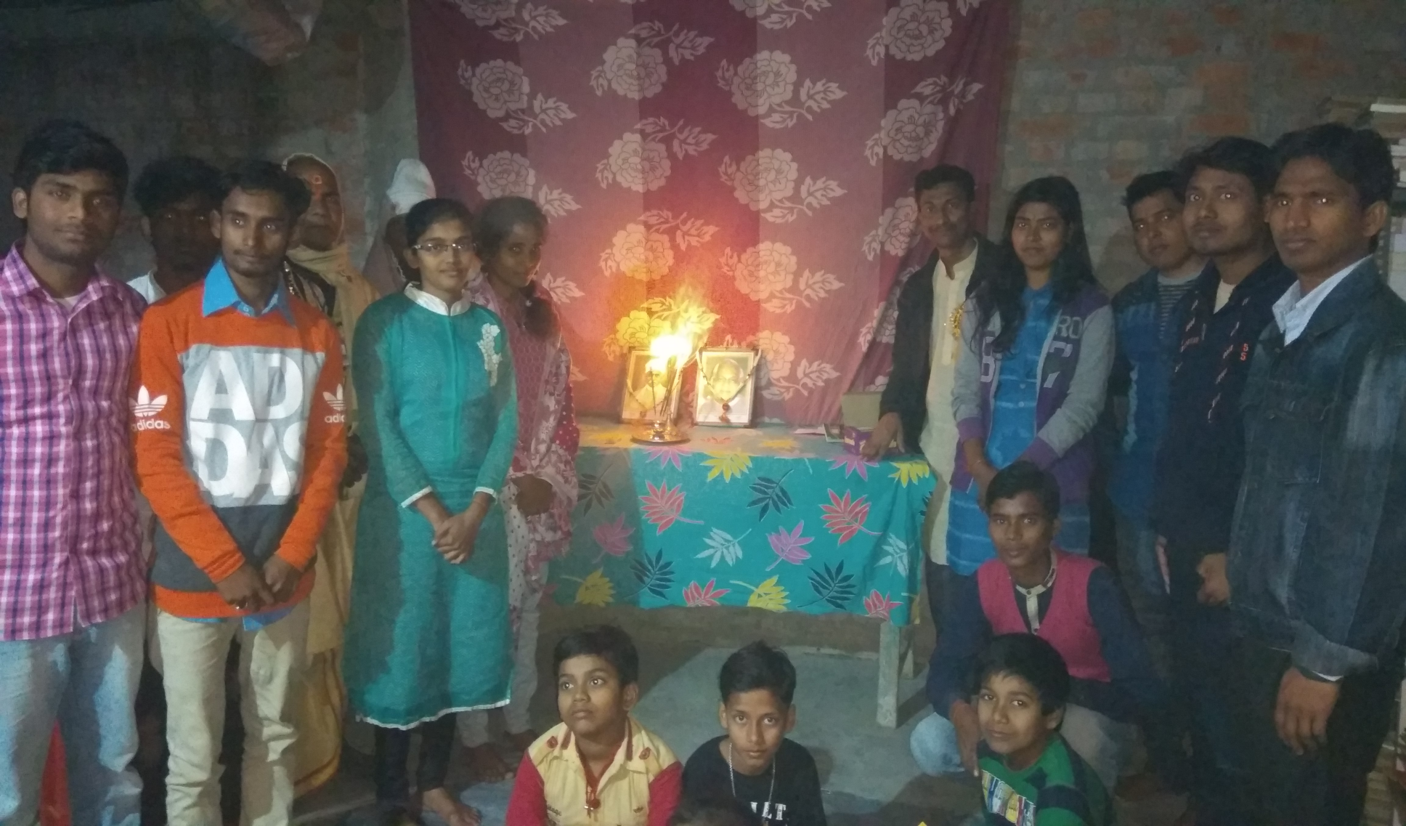
Birthday Celebration of Vajpayee and Malviya ji
25-12-17

Slide 50
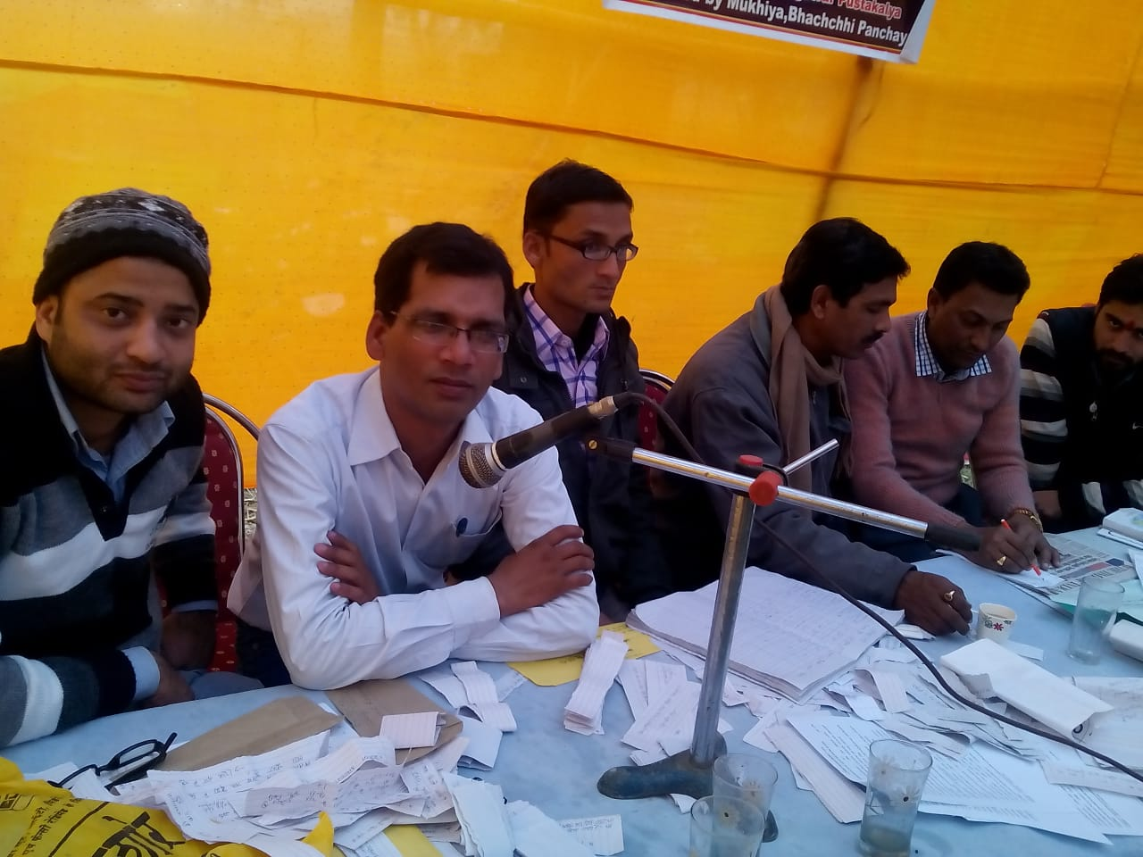
Our busybees

Slide 51
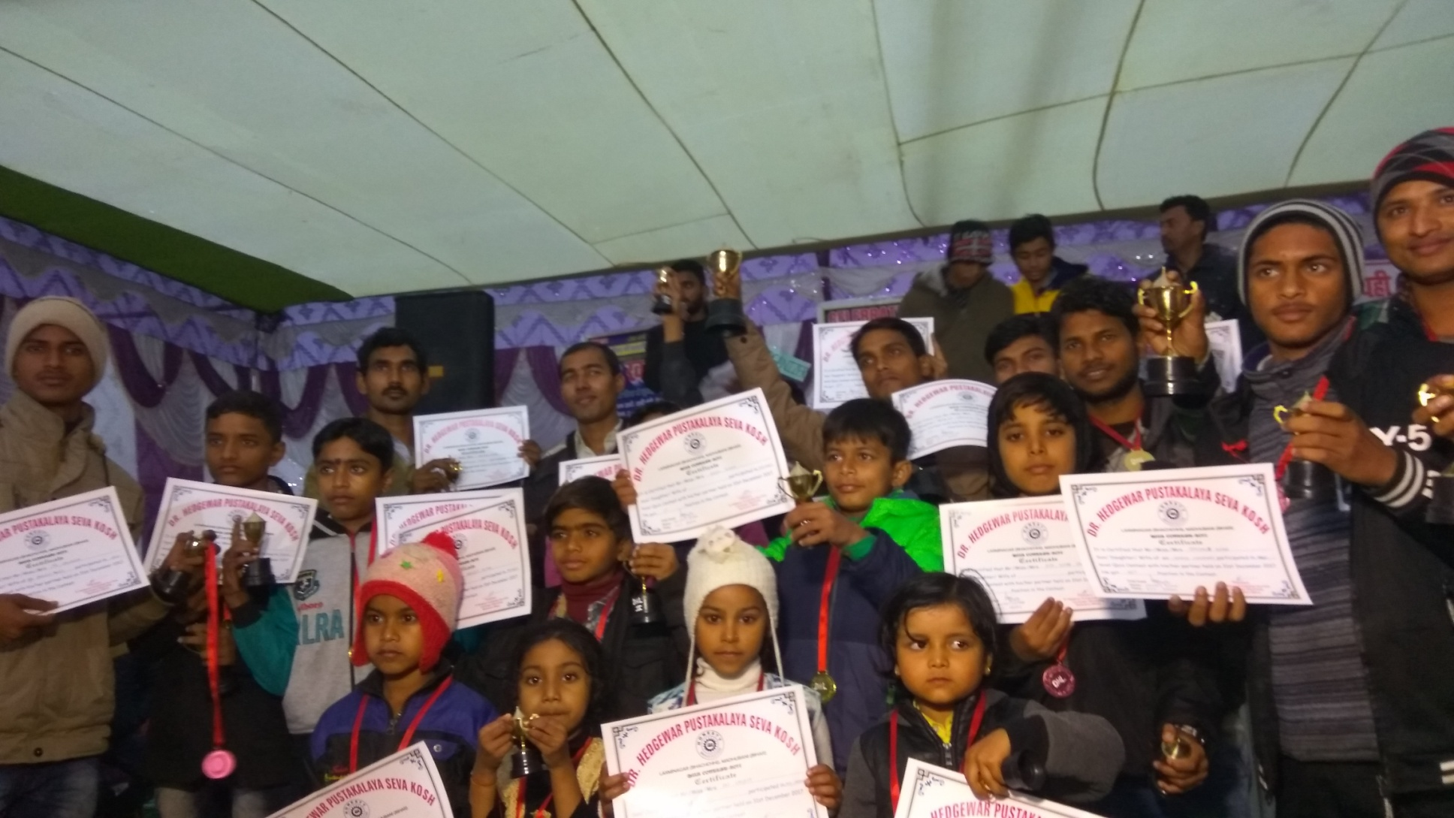
WINNERS OF Quiz Contest 2017

Slide 52
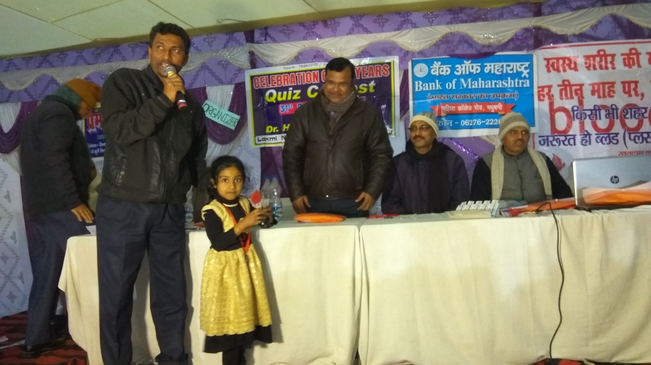
Prize received by Preeti on behalf of her Grand Mother

Slide 53
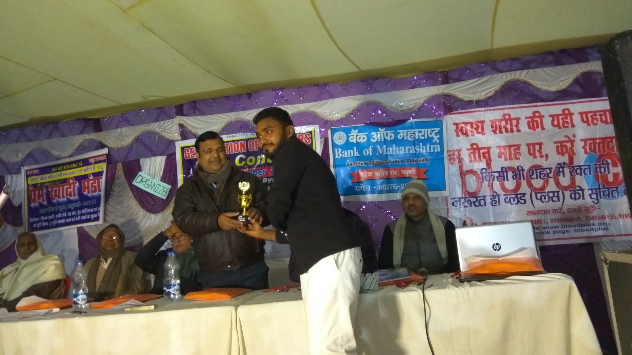
MR. ABHIJIT SINGH RECEIVED PRIZE by B.D.O RAHIKA

Slide 54

MR. PRAKASH KUMAR RECEIVED PRIZE by B.D.O RAHIKA

Slide 55

MR. ISHWAR KUMAR Received PRIZE by B.D.O RAHIKA

Slide 56

PREM RECEIVED Prize as Quiz Master by B.D.O RAHIKA

Slide 57

Quiz Contest-2018 SPEECH BY MENTOR MR.ABHAY KUMAR JHA

Slide 58

A career Counseling session by MENTOR MR. Amitabh PRASAD

Slide 59

Members of the Library IN FREE MOOD MEETING IN 2019

Slide 60

Learners in our Library

Slide 61

Quiz Awareness campaign by members of Library in 2019

Slide 62

SILVER JUBILEE CELEBRATION QUIZ CONTEST IN 2019

Slide 63

FOUNDER SPEECH
SILVER JUBILEE CELEBRATION

Slide 64

PRIZE DISTRIBUTION BY MLC MADHUBANI WITH SANJIV JI
SILVER JUBILEE CELEBRATION

Slide 65

PRIZE DISTRIBUTION BY PRINCIPAL REGIONAL SCHOOL
SILVER JUBILEE CELEBRATION

Slide 66

GUEST AND AUDIENCE
SILVER JUBILEE CELEBRATION

Slide 67

SPEECH BY MENTOR MD. KAMRAN SIR
SILVER JUBILEE CELEBRATION

Slide 68

HONOUR TO MLC BY FOUNDER
SILVER JUBILEE CELEBRATION

Slide 69

PUBLISHed IN NEWS PAPER
SILVER JUBILEE CELEBRATION

Slide 70

ONLINE COMPETITION 2020

Slide 71


ONLINE QUIZ CONTEST 2020

Slide 72

OFFLINE COMPETITION IN 2021

Slide 73

ONLINE FOUNDATION DAY 2021

Slide 74


QUIZ CONTEST
2021

Slide 75

WINNER QUIZ CONTEST 2021

Slide 76

Quiz contest news in Dainik bhaskar, janUARY 2022

Slide 77

ARTICLE BASED ON ACHIEVEMENT OF LIBRARY BY DAINIK JAGRAN ON 18- 02- 2022

Slide 78

quiz contest news in prabhat khabar,janUARY 2022

Slide 79


OFFLINE AND ONLINE FOUNDATION DAY 2022

Slide 80


QUIZ CONTEST
2022

Slide 81


QUIZ CONTEST
2022

Slide 82


WINNERS: QUIZ CONTEST 2022

Slide 83

OFFLINE AND ONLINE FOUNDATION DAY 2023

Slide 84

OFFLINE AND ONLINE TEACHER’S DAY 2023

Slide 85
ACHIEVERS
of
DHL

Slide 86

Md. MAHTAB ANSARI
BDO, KEOTI ,DARBHANGA

Slide 87

MR. Ashutosh Jha
Chief Dealer, SBI, NEW YORK USA

Slide 88

MR. KUNDAN KUMAR
Senior Manager
Punjab and Sind Bank Zonal office Model Town Jalandhar Punjab

Slide 89

MR. PRAKASH KUMAR
SENIOR ACCOUNTANT
BANK OF MAHARASHTRA DARBHANGA

Slide 90

Md. Shamshir
PGT( GEOGRAPHY)
G.M.S.S. HiGHER SECONDARY SCHOOL MADHUBANI

Slide 91

MR. BHARAT BHUSHAN
OFFICER BANK OF MAHARASTRA

Slide 92

PRAKASH NARAYAN JHA
Bank of America as a Lead Analyst (Enterprise Data Science & Platform Engineering)

Slide 93
AND
MANY
MORE

Slide 94

Thank you

